Slide 1



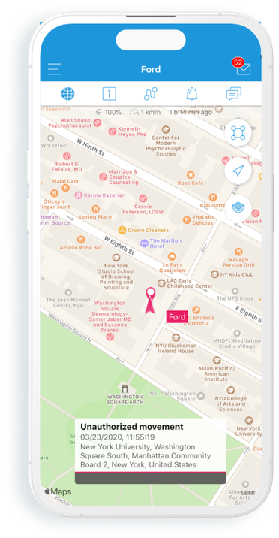
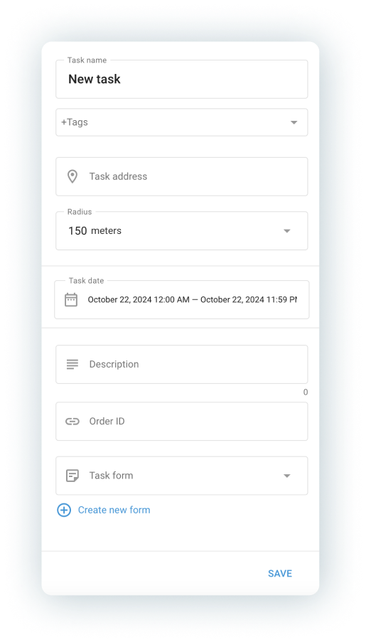
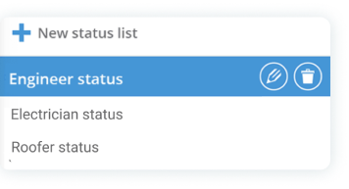
How to transform
field operations
in construction?

Slide 2
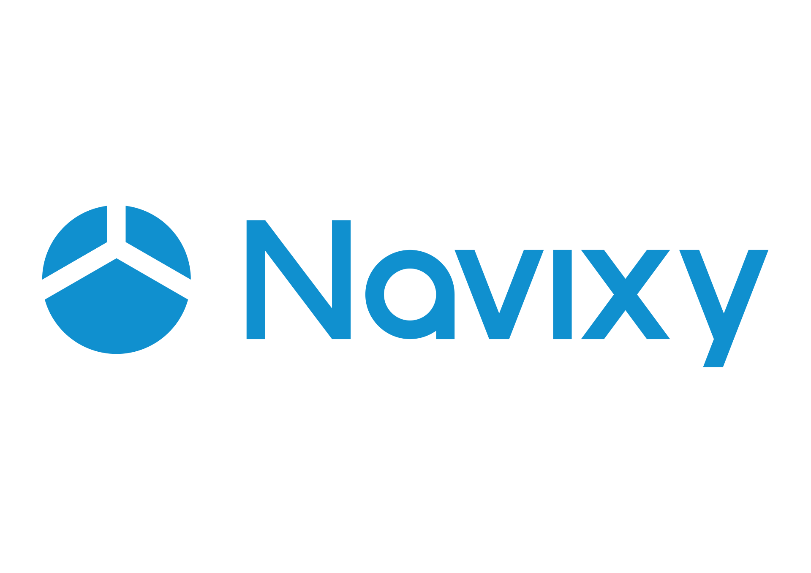

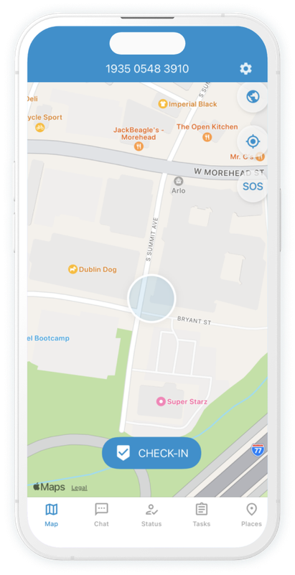

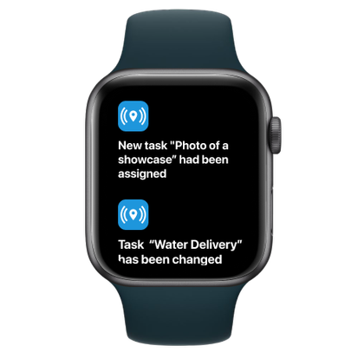
navixy.com
The challenges in the
construction industry:
Difficulty tracking field teams
and vehicles
Inefficiencies leading to project delays and lost productivity
Compliance issues with safety regulations

Slide 3


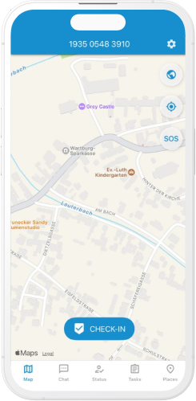
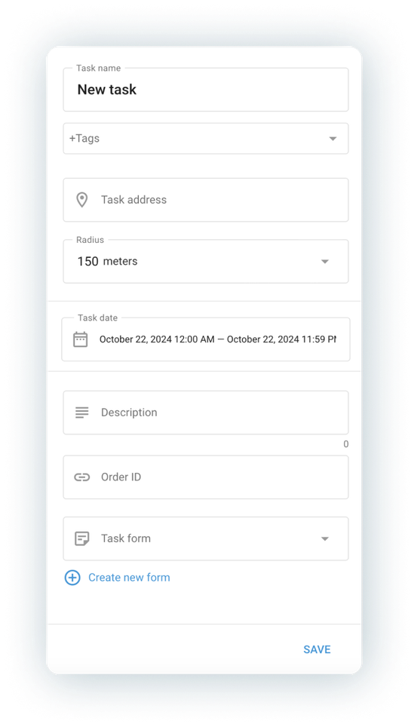
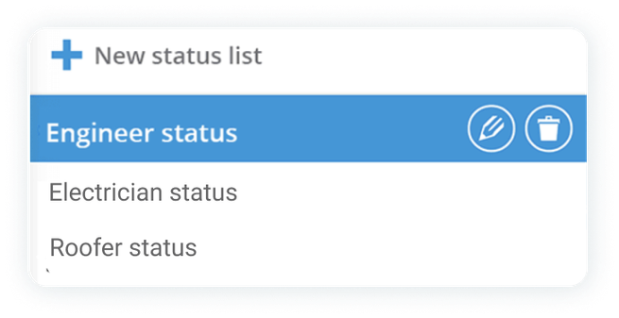
navixy.com
X-GPS Tracker app to address these challenges
Forms for compliance and productivity
Task assignment and monitoring
Real-time tracking

Slide 4
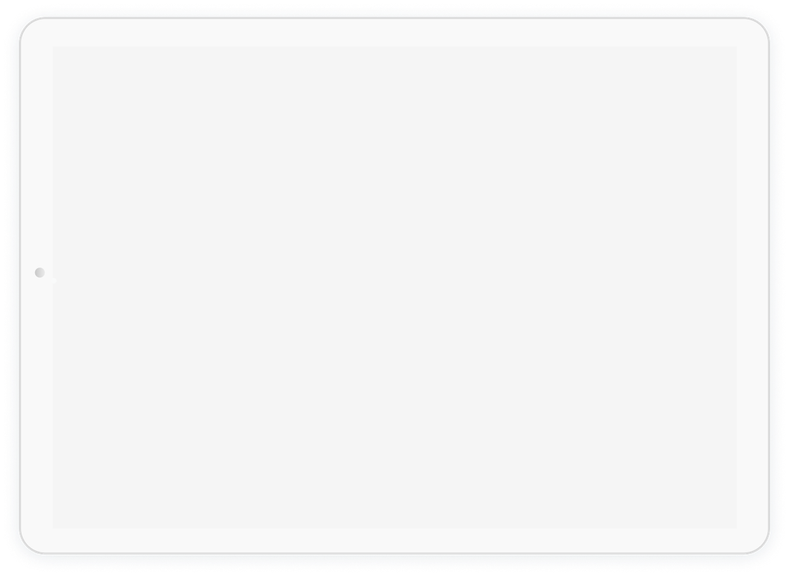
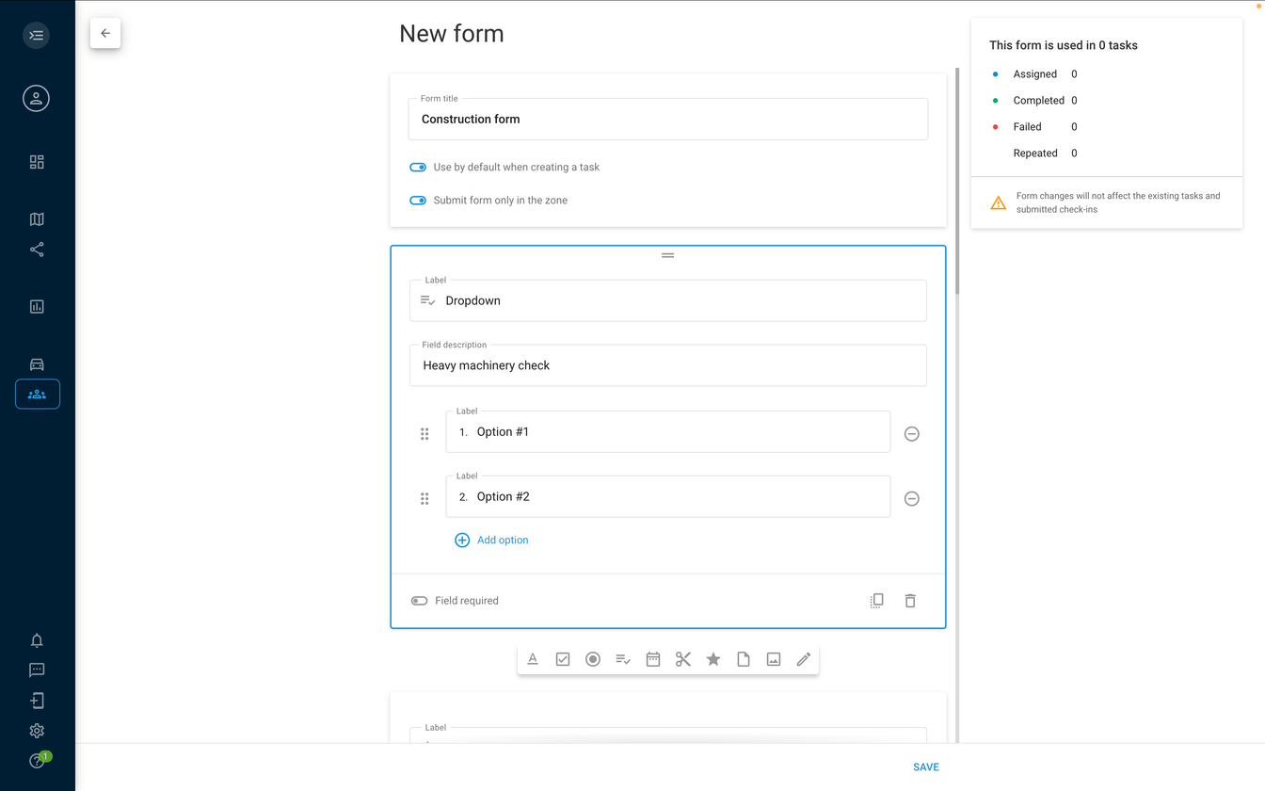
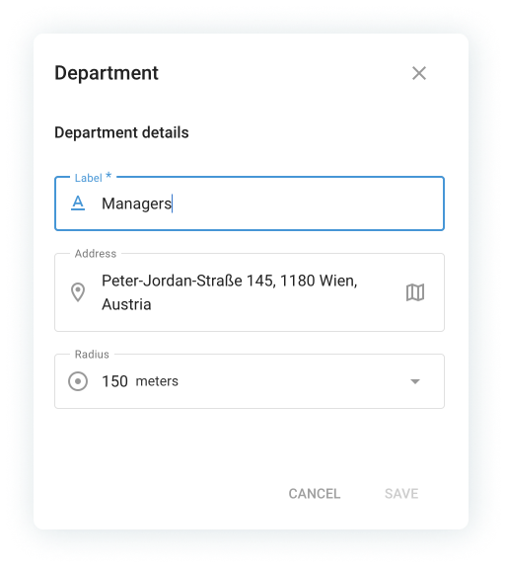
navixy.com
Forms for compliance
and productivity
Standardize workflows like truck inspections and clock-in/out reporting, reducing errors.

Slide 5
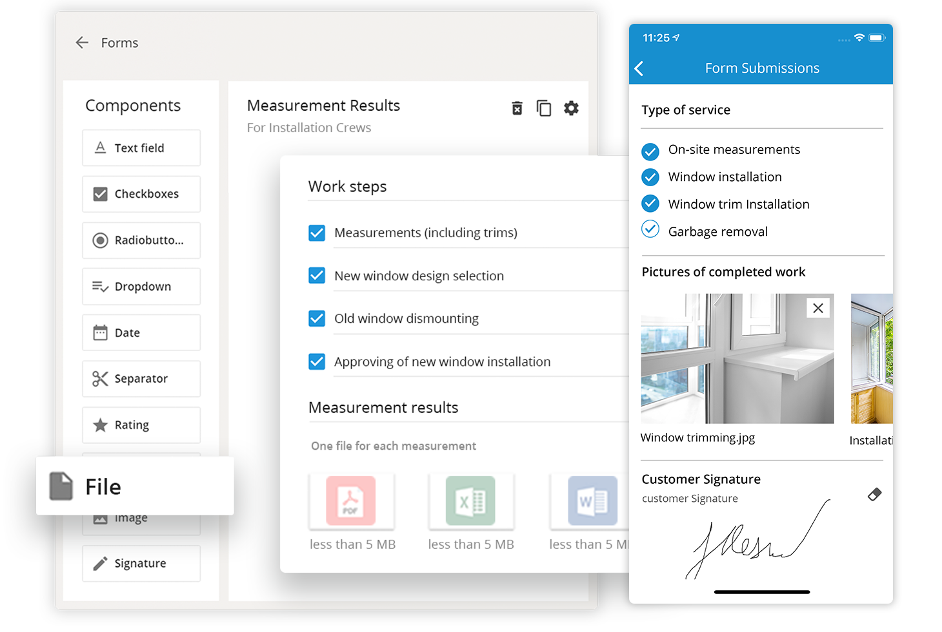
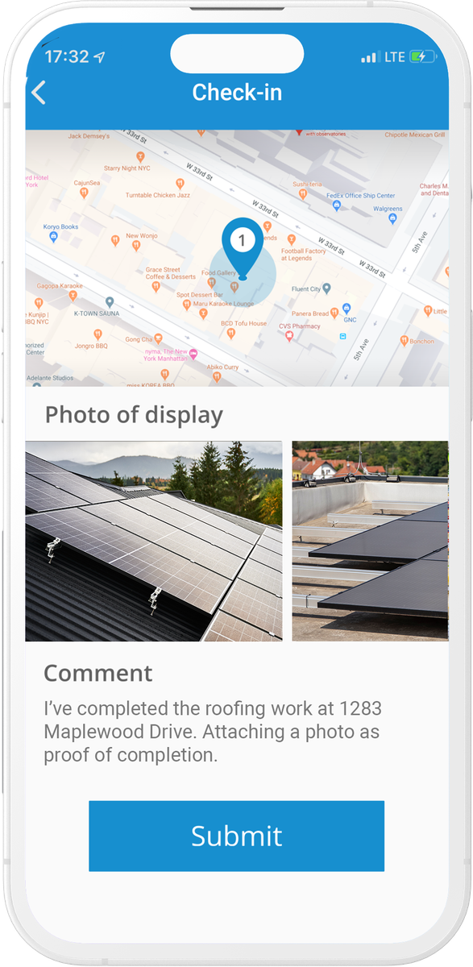
navixy.com
Task assignment and monitoring
Assign tasks and track them in real-time, complete with updates and photos

Slide 6

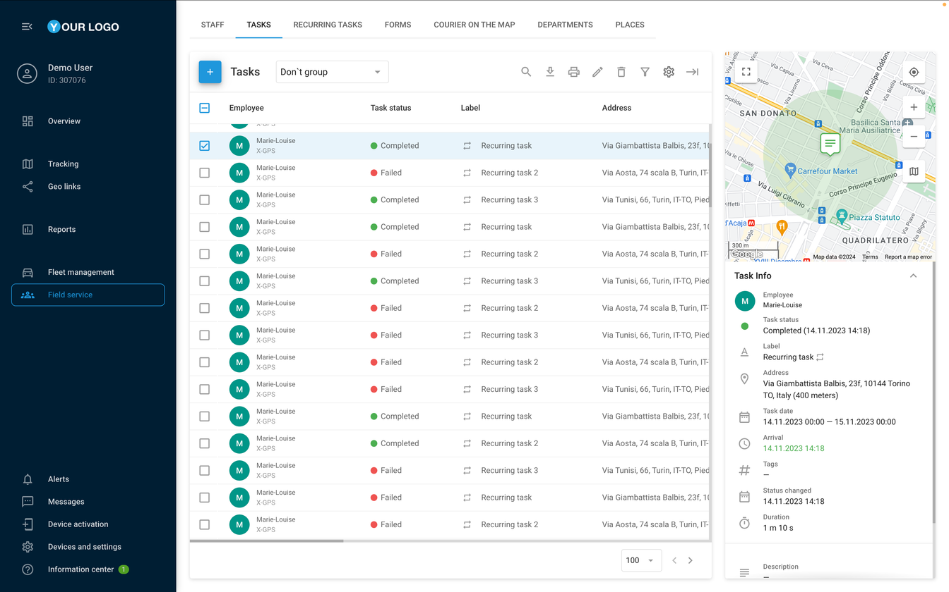

navixy.com
Real-time tracking
Monitor your teams and vehicles to ensure sites are attended and productivity is high.

Slide 7
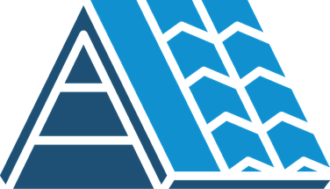


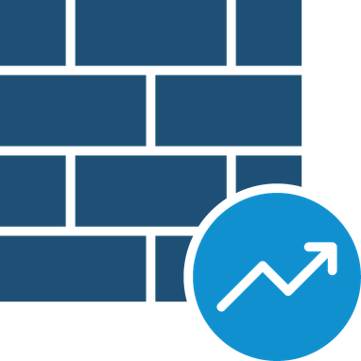
navixy.com
Real industry examples
Roofing companies:
scheduling tasks for their field workers and tracking progress in real-time.
Well drilling companies:
tracking vehicles arriving on-site and documenting completed work, helping avoid any discrepancies.
Restoration companies:
sharing before-and-after photos
of work, providing a clear and transparent process to stakeholders.
Remodeling firms:
daily progress updates through images, allowing task routing to contractors as projects advance.

Slide 8


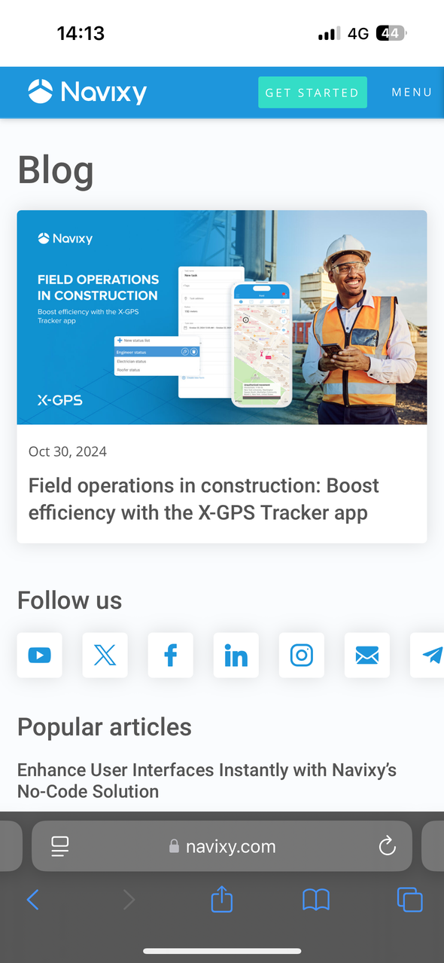
Read the full article
on our blog post

