Slide 1


Transforming field operations
in Construction
with X-GPS Tracker app
Notes:
Today, we'll be talking about how Navixy’s X-GPS Tracker app can help construction companies overcome their field operation challenges, improving efficiency, compliance, and productivity.
As the construction industry is undergoing significant transformation, digital tools like ours are key to staying competitive.

Slide 2


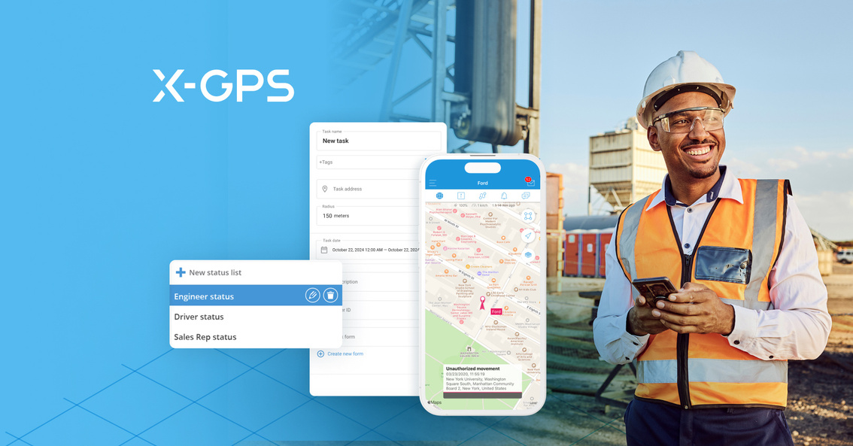

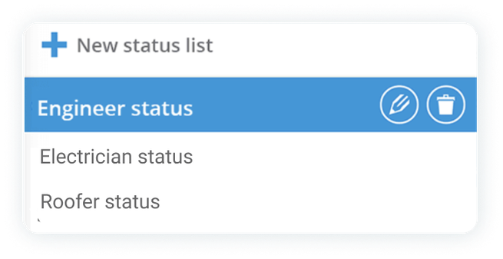

Construction industry
The challenges in the Construction industry
Difficulty tracking field teams and vehicles
Compliance issues with safety regulations
Inefficiencies leading to project delays and lost productivity
Navixy provides the digital tool, the X-GPS Tracker app, to address these challenges.
Notes:
From our participation at the Austin Build Expo, we identified recurring pain points in the construction industry.
Many companies struggle with tracking field teams, managing compliance, and preventing project delays caused by inefficiencies.
These are exactly the challenges our X-GPS Tracker app is designed to address.

Slide 3

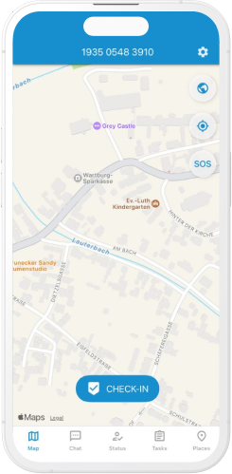
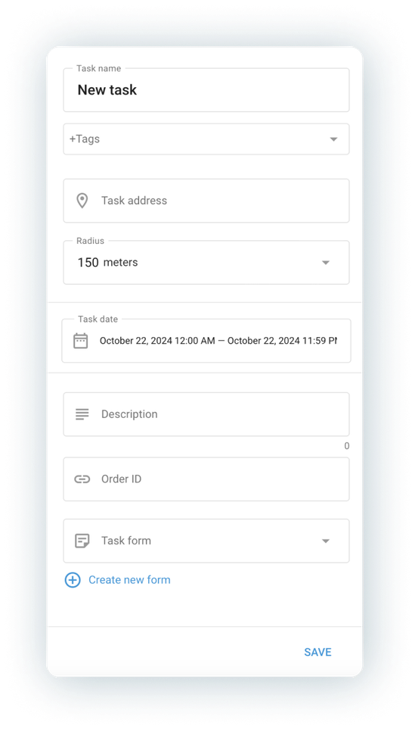

Construction industry
Key features that solve Construction industry pain points
Forms for compliance and productivity
Task assignment and monitoring
Real-time tracking
Notes:
The X-GPS Tracker app is the ideal solution for construction companies to manage their operations more effectively.
It offers real-time tracking for vehicles and workers, task assignment tools for easy monitoring, and digital forms to streamline compliance with safety regulations.

Slide 4
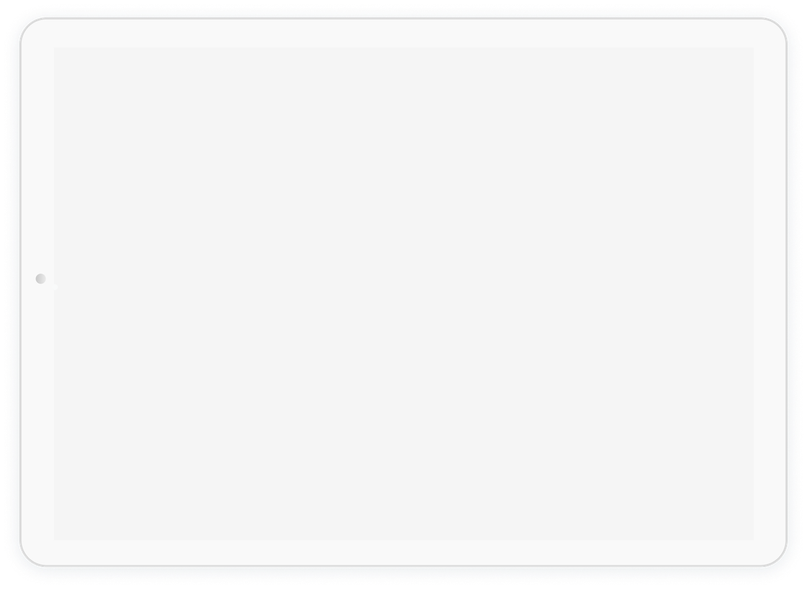
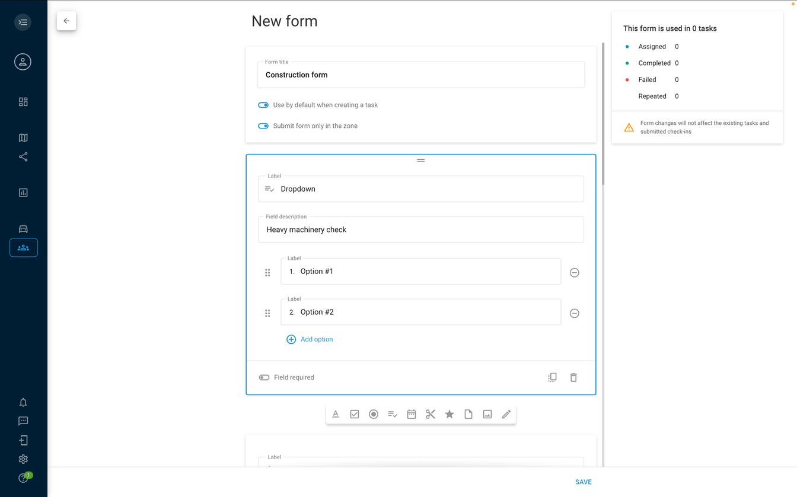
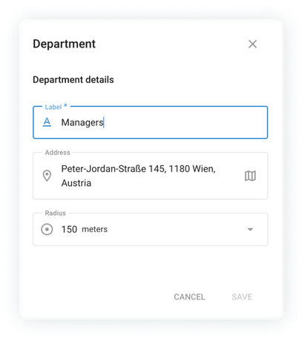
Construction industry
Forms for compliance
and productivity
The X-GPS Tracker app includes forms that make tasks like pre-trip truck inspections, safety checks, and clock-in/out reporting easy and accurate.
For construction companies, this means fewer errors and a more standardized workflow.
Notes:
Let’s look at the key features that directly address the industry's pain points:
Forms for Compliance:
The X-GPS Tracker app includes forms that make tasks like pre-trip truck inspections, safety checks, and clock-in/out reporting easy and accurate.
For construction companies, this means fewer errors and a more standardized workflow.

Slide 5
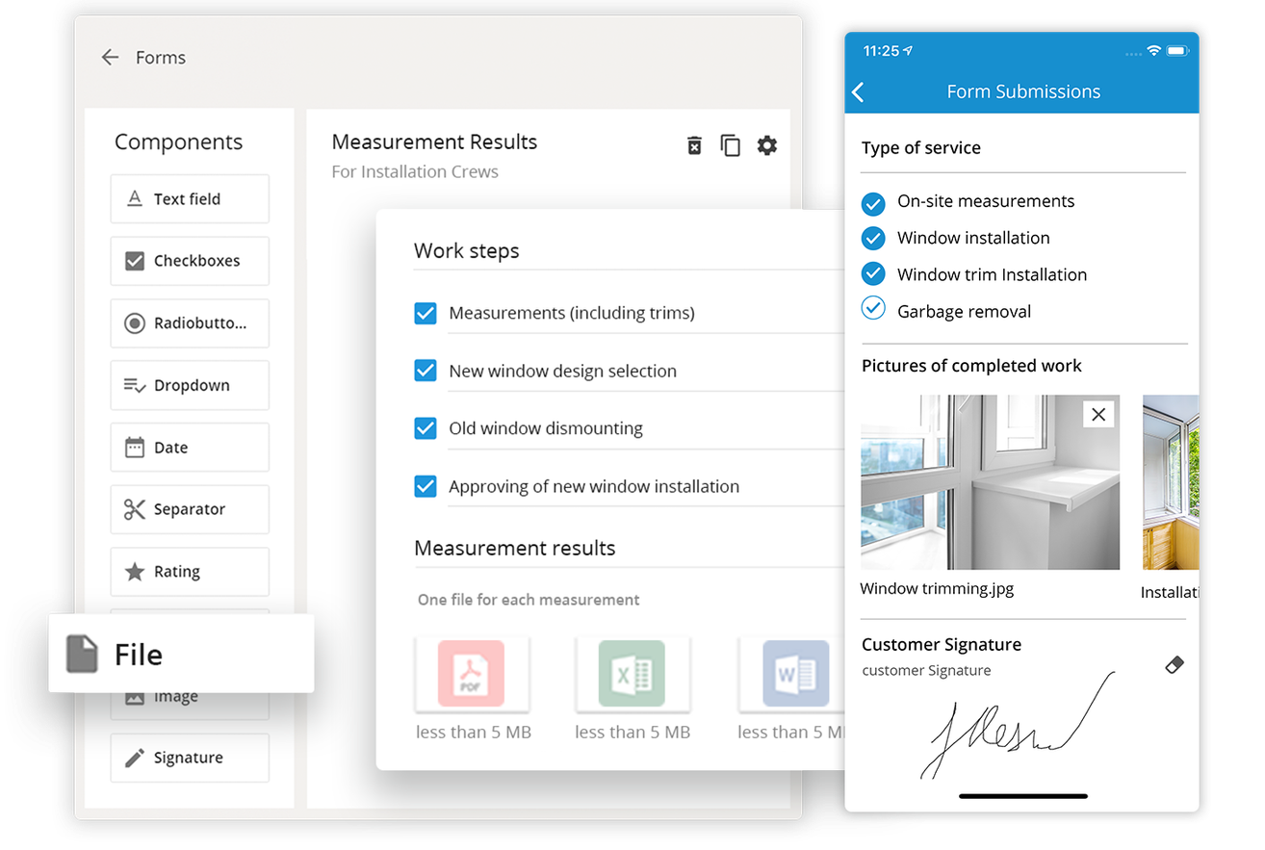
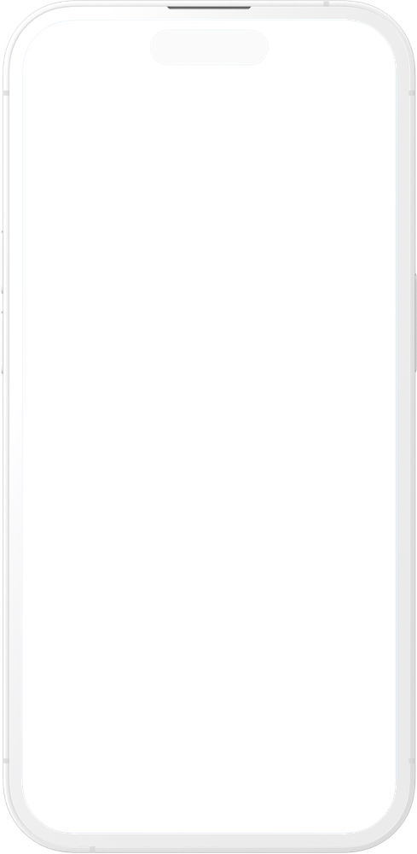
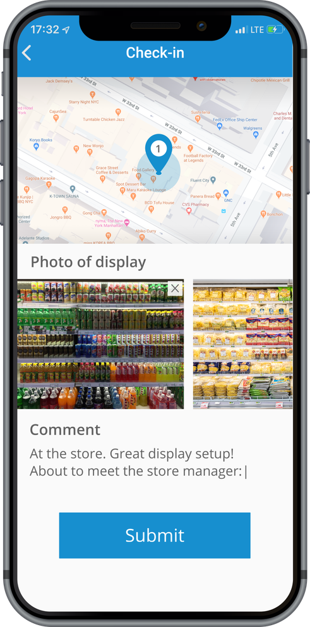
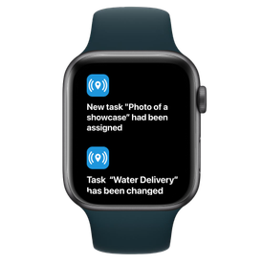
Construction industry
Task assignment
and monitoring
Field workers can be assigned daily tasks through the app, and managers can monitor completion in real time. This ensures that projects stay on schedule, and any potential delays can be addressed immediately.
You can assign tasks to roofers or electricians and receive instant updates from the field, complete with photos and signatures.
Notes:
Task Assignment & Monitoring:
Field workers can be assigned daily tasks through the app, and managers can monitor completion in real time. This ensures that projects stay on schedule, and any potential delays can be addressed immediately.
You can assign tasks to roofers or electricians and receive instant updates from the field, complete with photos and signatures.

Slide 6

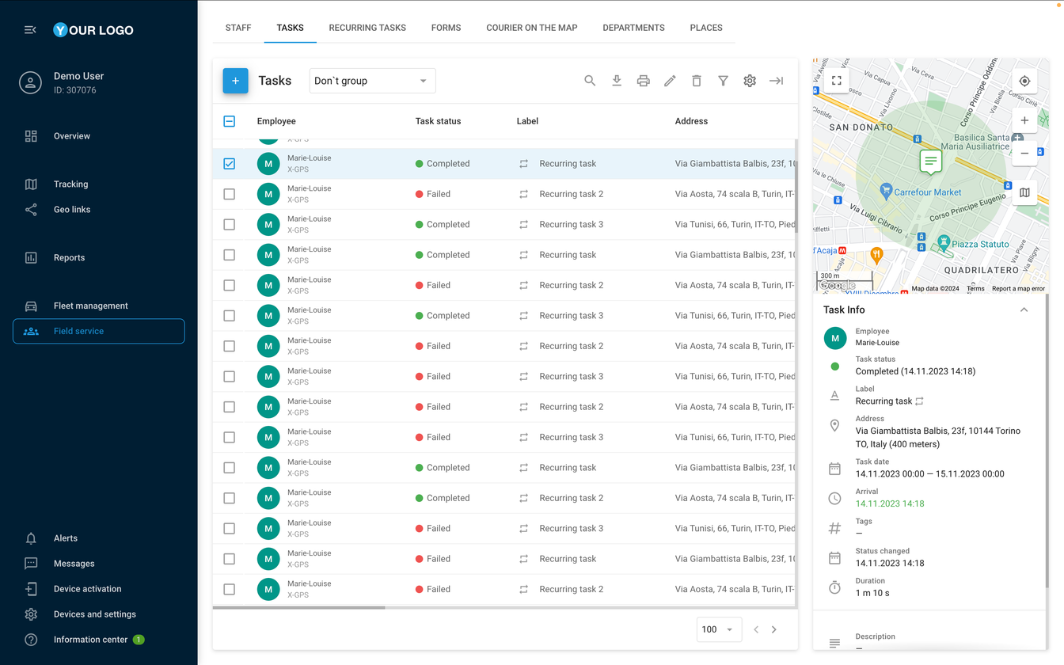
Construction industry
Real-time tracking
The X-GPS Tracker app's real-time tracking capability allows construction companies to monitor not only their vehicles but also their workers, ensuring that work sites are being attended to and productivity remains high.
It offers features like check-in capabilities, which act as a clock-in system, helping managers better understand how time is spent on site.
Notes:
Real-Time Tracking:
The X-GPS Tracker app's real-time tracking capability allows construction companies to monitor not only their vehicles but also their workers, ensuring that work sites are being attended to and productivity remains high.
It offers features like check-in capabilities, which act as a clock-in system, helping managers better understand how time is spent on site.

Slide 7

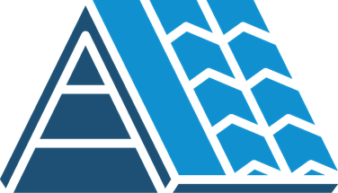

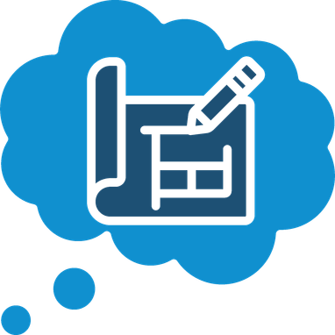
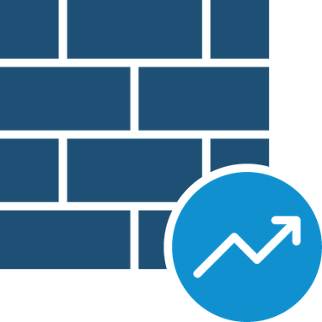

Construction industry
Real industry examples
Roofing companies:
scheduling tasks for their field workers and tracking progress in real-time.
Well drilling companies:
tracking vehicles arriving on-site and documenting completed work, helping avoid any discrepancies.
Restoration companies:
sharing before-and-after photos
of work, providing a clear and transparent process to stakeholders.
Remodeling firms:
daily progress updates through images, allowing task routing to contractors as projects advance.
Electric companies:
allowing field electricians to file quick feedback to managers on the job, ensuring smooth operations.
Notes:
We’ve already seen great success across various sectors within the construction industry.
For example, roofing companies use the app to assign and track progress in real-time, while restoration companies share before-and-after photos to ensure transparency.

Slide 8


Construction industry
Why choose Navixy?
Tested and validated for the
construction industry
Enhanced productivity, reduced errors,
and improved compliance
Two free mobile apps for seamless field service management
Fully customizable to fit any
business size or operation
Notes:
So, why choose Navixy? Our solution has been tested and validated for construction companies.
It enhances productivity, reduces errors, and improves compliance. Plus, it's fully customizable to fit businesses of any size.
We are ready to provide you with the demo access to try the X-GPS Tracker app.

Slide 9



Learn more about Navixy
Opportunities for your Business
Technical side of our platform
Explore blog
Learn more
Thanks for your attention!

