Slide 1
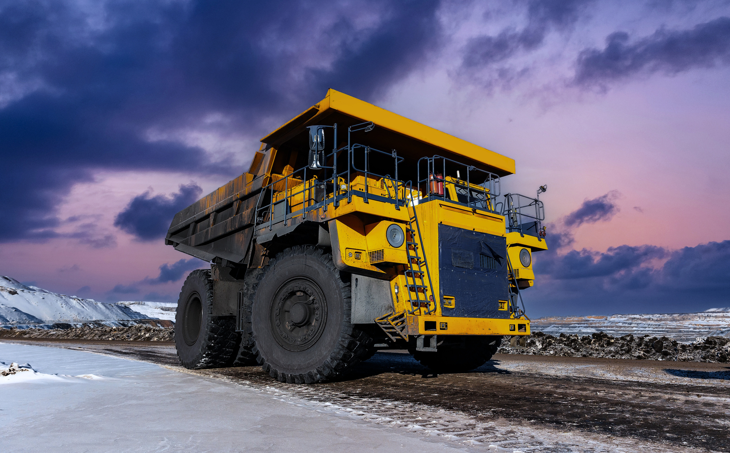




Preventive maintenance compliance | The number of equipment that requires scheduled inspection | Reduces breakdowns and unplanned downtime
Maintenance cost per operating hour | Total maintenance cost / actual operating hours | Clear lifecycle economics, exposes aging vehicles that should be retired
MTTR (Mean time to repair) | Total repair time / number of repairs | Reduces downtime, informs staffing and spare-parts decisions
Equipment availability | % of (scheduled hours – downtime) / scheduled hours | Measures readiness; low availability directly threatens project timelines
Geofence safety alerts | Quantity of entries into hazardous / restricted zones | Prevents accidents (e.g., unauthorized blast-zone entry)
Overspeed incidents | Times equipment exceeds site speed thresholds | Lowers accident risk and insurance costs; strengthens operator discipline
After-hours usage | Equipment used outside approved schedules | Detects misuse, unauthorized jobs, or theft attempts
Tampering alerts | Average utilization across all equipment | Strategic sizing of fleet; supports “buy, rent, or reallocate” decisions
Profit pulse: key metrics
for heavy machinery
Track operational, maintenance, and safety metrics that drive fleet performance at a glance. Build custom views in minutes using Dashboard Studio's template.
WHAT
HOW
is it measured?
WHY
it is important to know?
For an Executive & Operations director
Overall fleet utilization | Average utilization across all equipment | Strategic sizing of fleet; supports “buy, rent, or reallocate” decisions
Total fleet downtime | Aggregated downtime hours or % | High-level reliability insight; directly affects jobsite throughput
For a Fleet operations manager
Equipment utilization rate | % of available time the machine is actually working | Identifies under / overused machines; informs fleet right-sizing and allocation
Idle time | % of time engine running while not moving | Helps to cut fuel waste, improves operational discipline
Geofence compliance | Quantity of events when equipment leaves assigned zones or enters restricted ones | Prevents misuse, equipment hoarding, and unauthorized movement
For a Maintenance manager
For a Safety & compliance manager
Share this cheat sheet with your team and partners!
Visit our Industries page to learn more about Navixy IoT Query capabilities for your business!

Slide 2

Profit pulse: key metrics
for leasing fleet
Use this cheat sheet for a quick, clear view of the operational, maintenance, and safety metrics that directly impact profitability, reliability, and overall fleet performance.
WHAT
HOW
is it measured?
WHY
it is important to know?
For a Fleet operations manager
Idle time | % of engine-on but stationary time | Cuts fuel waste and unnecessary engine wear
Avg distance / Hours per vehicle | Typical use intensity per asset | Detects underused or overworked units to rebalance utilization
Vehicle availability / Uptime | % of time asset is operational vs in repair | Ensures high availability to lessees, reduces service disruptions
Route plan vs actual | Actual vs planned time/distance | Exposes systemic inefficiencies in routing
Empty miles | % of miles with no cargo | Improves load planning, increases profitability
Stops / Deliveries per day | Productivity indicator for leased vehicles | Increases revenue per vehicle, detects underperforming runs
For a Maintenance manager
Downtime (planned + unplanned) | Hours / days out of service | Direct capacity loss; key indicator of maintenance efficiency
MTBF | Average operating hours between failures | Reliability benchmark. Key for replacement decisions
Maintenance cost per mile | Total maintenance spend ÷ miles driven | Signals aging / expensive units, supports retire / replace decisions
For a Safety & compliance manager
Harsh events count | Hard braking / acceleration / cornering per 1,000 miles | Predicts risk & mechanical stress; reduces accidents and wear
Speeding violations | Speed limit breaches / time overspeed | Key safety & fuel KPI; lowers insurance premiums
Share this cheat sheet with your team and partners!
Visit our Industries page to learn more about Navixy IoT Query capabilities for your business!

Slide 3

Compliance dashboard | Quantity of violations, alerts, % of shipments fully compliant | Monitors quality in real time; drives continuous improvement
Profit pulse: key metrics
for cold chain
Track operational, maintenance, and safety metrics that drive fleet performance at a glance. Build custom views in minutes using Dashboard Studio's template.
WHAT
HOW
is it measured?
WHY
it is important to know?
For a Fleet operations manager
Real-time fleet status | Live GPS tracking and real-time temperature for each reefer unit | Immediate visibility; helps to detect issue instantly
On-time delivery rate | % of deliveries arriving on schedule | Ensures product integrity and service quality
Temperature / equipment alerts | Automatic alerts for high temp, reefer failure, route deviation | Enables rapid intervention before product loss
Door open / reefer status | Real-time door events and reefer on/off status | Prevents temperature rise due to negligence or tampering
Dwell time | Time spent waiting at depots, warehouses, customer sites | Reduces heat-exposure risk; improves flow and efficiency
Fleet utilization & availability | % of reefer trucks in use; downtime tracking | Optimizes fleet size; reduces idle assets and service delays
Cost per mile / shipment | Fuel, labor, maintenance per mile or per delivery | Identifies inefficiencies; improves route economics
For a Safety & compliance manager
Share this cheat sheet with your team and partners!
Visit our Industries page to learn more about Navixy IoT Query capabilities for your business!

Slide 4

Geofence alerts | Quantity of unauthorized exits / entries or after-hours movement | Prevents theft/misuse, strengthens route adherence
Speeding incidents | Number of over-speed events | Reduces accident risk and insurance cost
Preventive maintenance compliance | The number of equipment that requires scheduled inspection | Reduces breakdowns and unplanned downtime
TCO / Maintenance cost per mile | Cost to operate / maintain per mile and over lifecycle | Highlights when to retire or replace vehicles
Profit pulse: key metrics
for logistics fleet
Track operational, maintenance, and safety metrics that drive fleet performance at a glance. Build custom views in minutes using Dashboard Studio's logistics template.
WHAT
HOW
is it measured?
WHY
it is important to know?
For a Fleet operations manager
Vehicle utilization rate | % of time the asset is actually in use vs idle | Optimizes fleet size and exposes under-used assets
Idle time | % of time engine running while not moving | Helps to cut fuel waste, improves operational discipline
TCO / Maintenance cost per mile | Cost to operate / maintain per mile and over lifecycle | Highlights when to retire or replace vehicles
Stops / Deliveries per day | Productivity indicator for leased vehicles | Increases route density, decreases unit cost
Dwell time | Time spent waiting at depots, warehouses, customer sites | Identifies process bottlenecks, increases throughput
On-time delivery rate | % of deliveries made on or before schedule | Improves customer satisfaction and SLA compliance
For a Maintenance manager
For a Safety & compliance manager
Share this cheat sheet with your team and partners!
Visit our Industries page to learn more about Navixy IoT Query capabilities for your business!

