Slide 1



Data Stream Analyzer
Monitor, analyse, and focus on what matters most
Notes:
Cover Slide
- Subtitle text: max 1 line
- Title text: max 2 lines
Brand font-family
- Proxima Nova

Slide 2

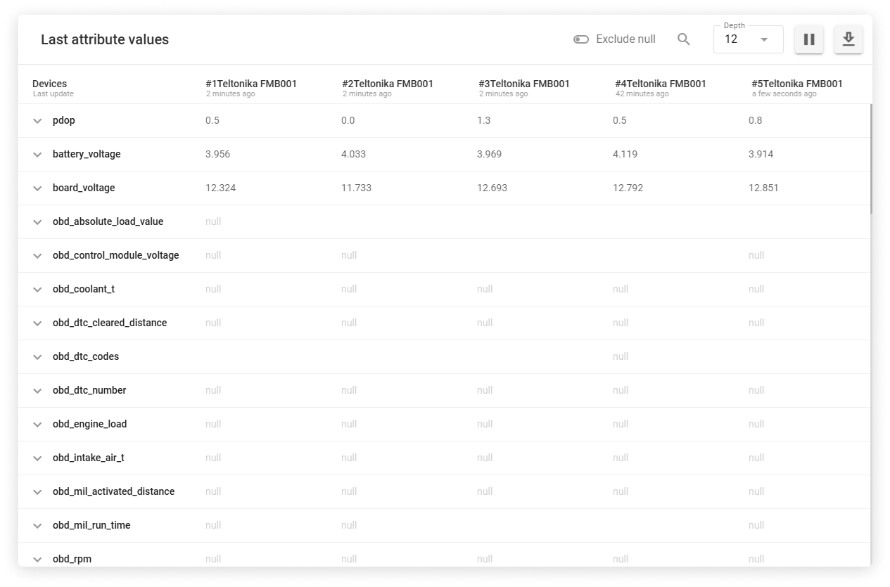

Meet Data Stream Analyzer
Data Stream Analyzer allows you to analyze telematics data from multiple devices, providing a precise view of tracker attributes. Acting like an X-ray for your data, it enables faster device setup and troubleshooting.
Device agnosticism
Connectivity
Remote device management
Notes:
Two-factor authentication (2FA) for users

Slide 3
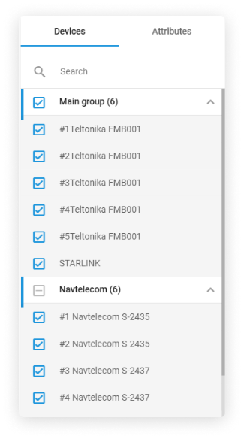
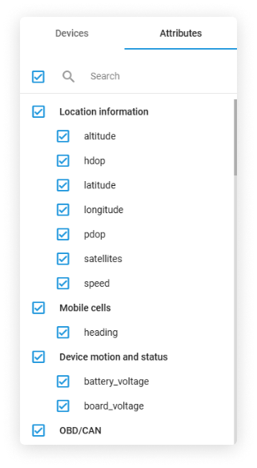



Precise tracker data monitoring
Target and analyze only the data that matters to your business.
Filter and focus on the data that’s most important for quick decision-making.
Track up to 10 devices simultaneously, viewing their key attributes for detailed insights.
Select specific trackers and parameters to focus on, without the noise of irrelevant data.

Slide 4
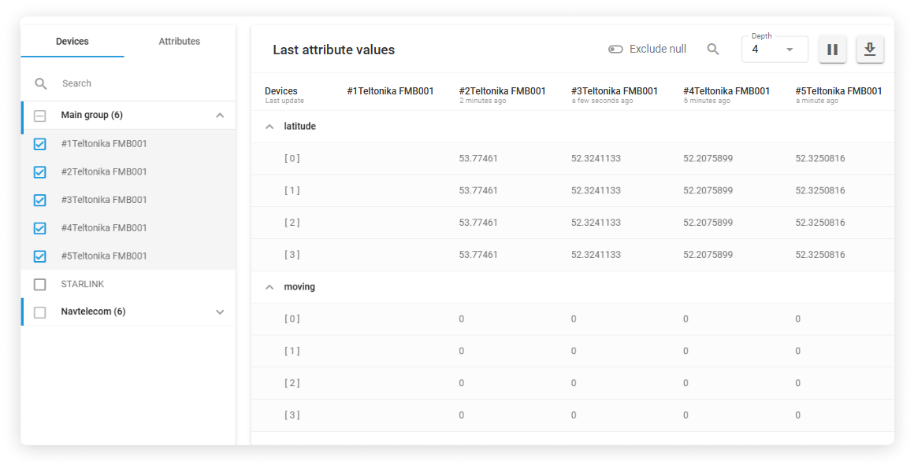

Access to real-time
and historical data
Observe data as it streams into your platform for immediate visibility.
Pause data updates to dive deeper into historical data slices.
View live data, pause for analysis, and explore up to 12 past data points for deeper insights.
Explore up to 12 past attribute values to see trends and changes.
Notes:
Two-factor authentication (2FA) for users

Slide 5
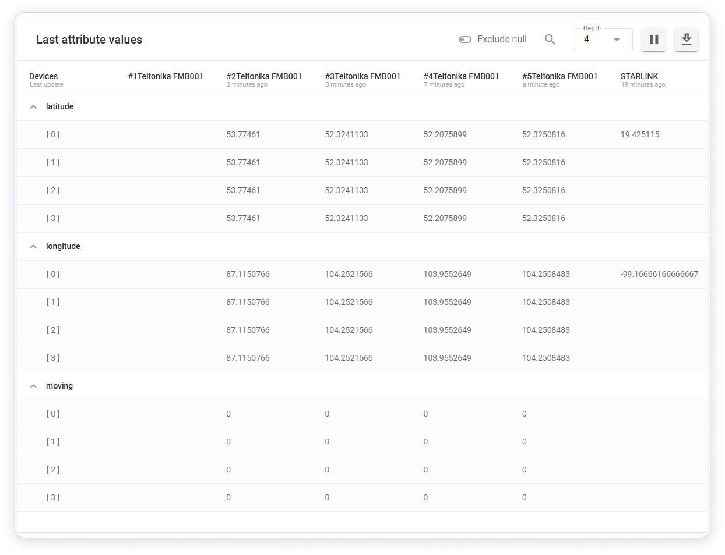




Faster hardware setup
and troubleshooting
Up to 30% faster setup and 90% troubleshooting success with advanced tools.
Spot connection issues and incorrect configurations instantly as data flows.
Switch seamlessly between real-time and historical views for deeper debugging flexibility.
Coming soon:
Advanced tools for debugging and analysis.

Slide 6
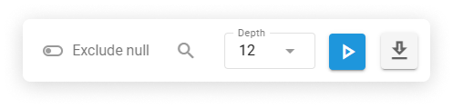
Convenient data analysis
Streamline data analysis with powerful search, export, and table views, plus null value filtering
Quickly find historical data from multiple devices by attributes for faster analysis.
View real-time data in a clear, categorised table for multiple devices.
Exclude or include null values for more precise insights.
Export records in JSON format for use with third-party tools and applications.
Notes:
Two-factor authentication (2FA) for users

Slide 7

Facilitate telematics data management
with Navixy
700K+
1600+
700+
objects around
the globe
devices integrated
resellers and system integrators
130+
34
100+
countries
languages
employees in four
global offices

Slide 8


Contact us to get your questions answered
Sales:
sales@navixy.com
Support:
support@navixy.com
  US/International: +1 213 786 12 80
  Latin America: +52 55 85 26 18 30
  Europe: +44 204 577 23 50
Thanks for your attention!
Notes:
Cover Slide
- Subtitle text: max 1 line
- Title text: max 2 lines
Brand font-family
- Proxima Nova

