Slide 1


Customizable,
user-centered MRM platform
for effective fleet management
Notes:
This presentation is devoted to Navixy's solutions for different industries.
It showcases how Navixy can help to enhance and the business processes add clarity to the workflow.
How to use it?
1) Copy it for your needs.
2) Tailor it for a specific client. The presentation design makes it easy to cut off a part without corrupting the main idea. (Please do not forget to delete it from slide 5 too).

Slide 2


User-centered Mobile Resource Management platform
You are free to create solutions effective for fleet management, field service, and GPS asset tracking – all at once.
800K+
1600+
700+
objects around the globe
devices integrated
resellers and system integrators
130+
34
100+
countries
languages supported
employees in four global offices
Notes:
WoW-facts about the Navixy platform. Evidences that witness our credibility.

Slide 3





Solutions for fleets of all sizes
Precise fleet data
Driver behavior
Safety on the route
Fuel monitoring
  Vehicle data in real time.
  Alerts on key parameters.
  Reports for in-depth data analysis.
  Multiple devices connection to build solutions for complex
and multi-dimensional projects
with MDVR.
  Automated scheduling maintenance tied to mileage, engine hours, or set dates.
  Eco driving reports for monitoring bad driving habits.
  DMS warnings to check driver behavior inside the vehicle.
  Instant notifications.
  Enhanced workflow management with driver identification and anti-theft functionalities.
  The Driver journal for a comprehensive record of
a driver's activity.
  Detailed data about every trip.
  Video evidence of accidents
or cargo theft to store in the
cloud.
  Accidents prevention with ADAS alerts.
  Real-time alerts to prevent fuel theft.
  Fuel consumption analytics for cost reduction.
Notes:
Here are key features that a re common for all industries.

Slide 4
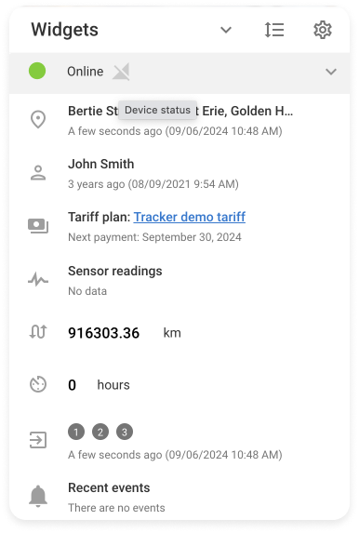

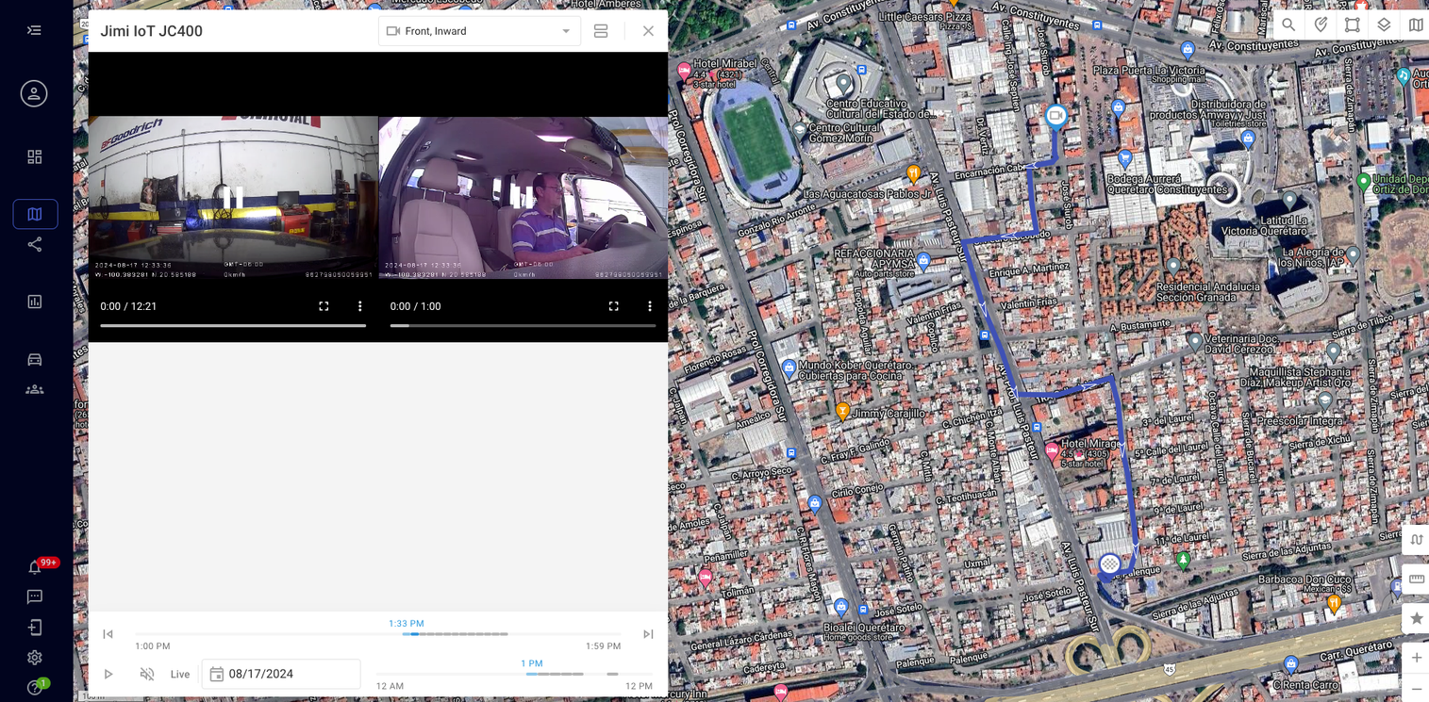
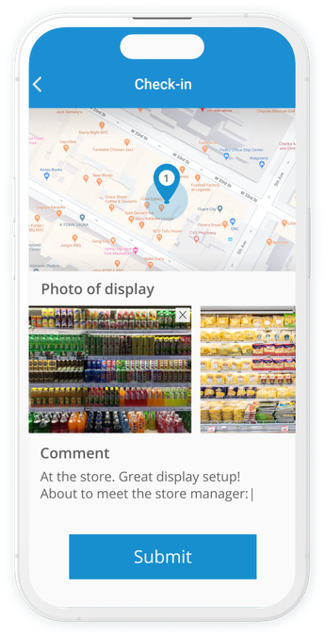
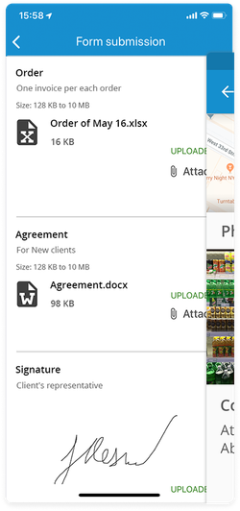
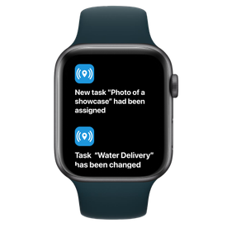
Why Navixy?
Intuitive interface
Spend less time training your team and more time growing your business.
Seamless device integration
With support for over 1,600 GPS devices, compatibility is never
a concern.
Activate devices remotely
Just add the serial number and phone number of the tracker.
Flexible app integration
Connect non-standart features with Navixy Marketplace apps
Support team
Resolve any issues, ensuring smoother operations and happier customers.
Customizable solution
Tailor the platform to your exact needs.
Real-time data access
Stay in control with instant updates.
Notes:
Why Navixy is an outstanding MRM-platform? Explore key benefits which help to reshape your business and the businesses of your customers.

Slide 5








Personalized solution for
Taxi
Public transport
Rentals
and leasing
03
06 slide
12 slide
19 slide
Logistics and transportation
Mining
Constructions and heavy equipment
24 slide
31 slide
37 slide
Banks and cash-in-transit services
Agriculture
42 slide
46 slide
Notes:
Use the page as a table of contents.

Slide 6


Industries
Taxi
Safety and automation
of taxi fleet operations
Track taxi vehicles with GPS monitoring, control driving quality, and protect your fleet from theft and towing.

Slide 7
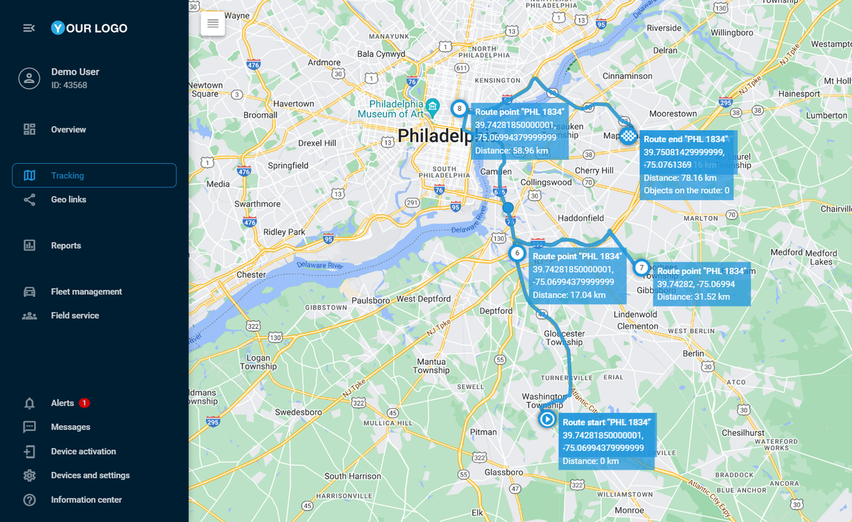

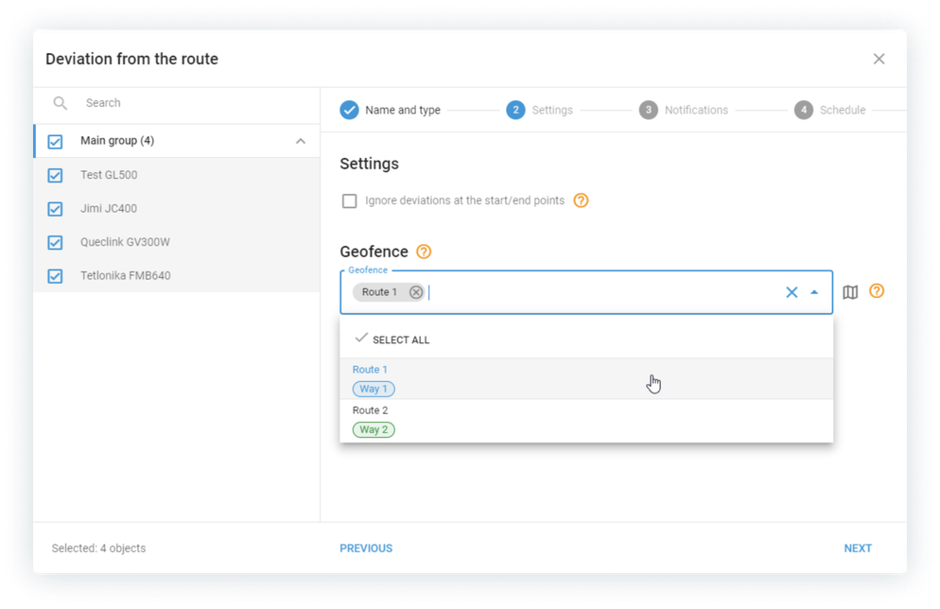

Provide zero-delay service
Enable automatic route planning to visit all locations faster.
Avoid traffic jams and ensure on-time arrival with smart route optimization.
See the whole fleet on a single map.
Stay aware of ETAs. Receive alerts if your drivers might be running late or deviate from the route.
up to
GPS tracking software with route planning can help reduce transportation costs*.
20%
According to a study by the National Institute of Standards and Technology.

Slide 8
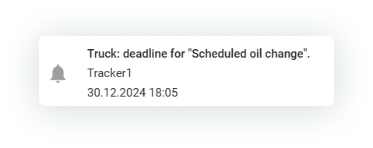
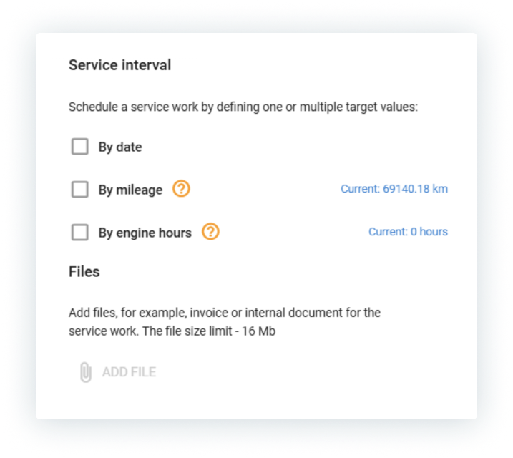
Ensure vehicle health
Monitor vehicle conditions without additional equipment or technicians. Reduce the risks of unexpected breakdowns, downtime, and emergency repair costs.
The Navixy platform provides essential data, such as:
Accurate mileage
Engine load
Engine errors
Engine temperature
Engine hours
And more
The system notifies managers in advance about upcoming maintenance needs. Operators can also set the inspection date manually, and timely reminders will be provided.

Slide 9
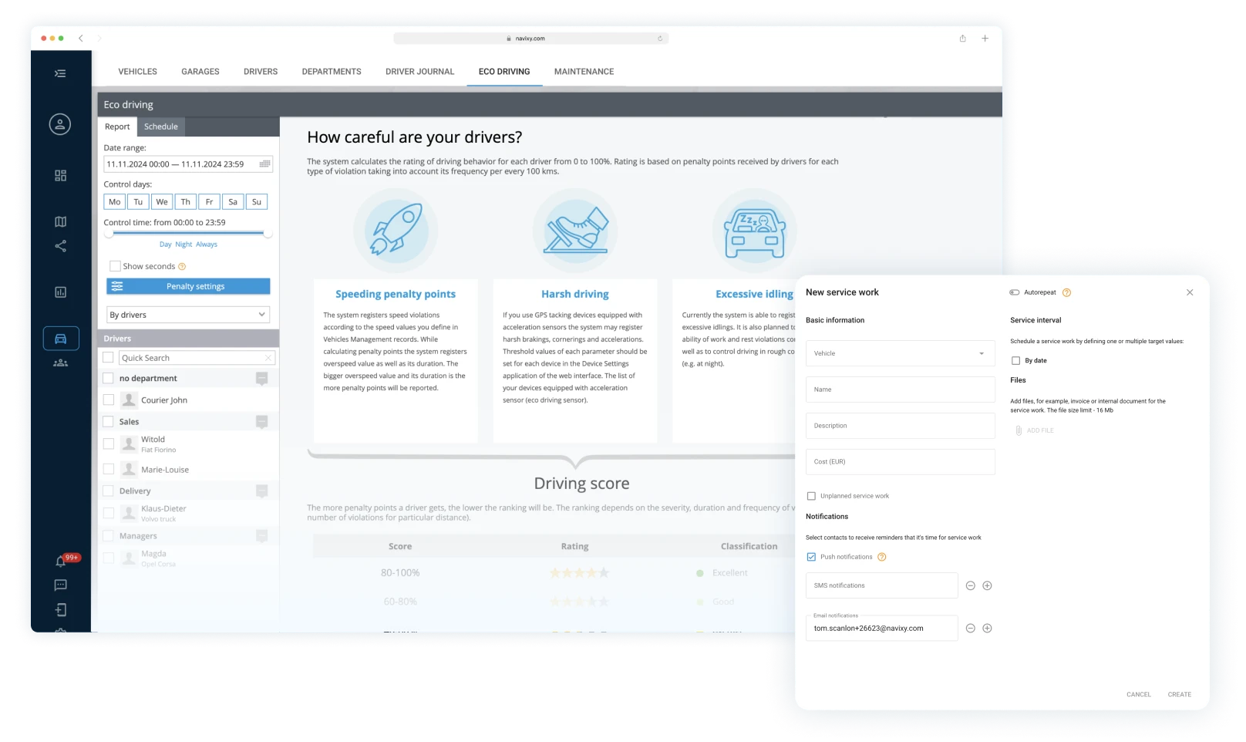
Keep the eye on taxi drivers
Discover driving habits with ease.
Navixy helps to detect traffic violations, speeding, and dangerous maneuvers automatically.
Choose alerts to receive real-time information with detailed reports about violations on the road.
The Eco driving report ranks drivers based on their behavior.
Automated trip sheets help to reduce time devoted
to bureaucracy.

Slide 10


Automate payment control
Integrate Navixy with a CRM for taxi services. Working in a unified interface with automation tools ensures you don’t miss critical information:
Payments
Downtime
Instant notifications for missed rental payments, allowing you to take immediate action and block access.
Weekly reports will highlight which vehicles in the fleet are idle without a contract or driver.

Slide 11

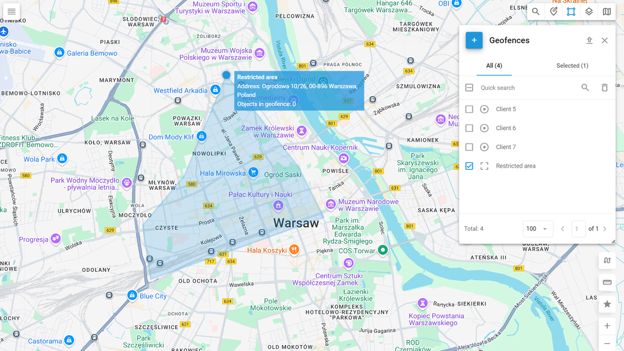
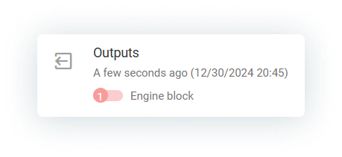
Protect vehicle remotely
Safeguard your vehicle against break-ins or theft
by setting up geofences, engine-blocking relays,
and event monitoring tools.
Receive an alert and remotely disable the engine in case the vehicle exits
a designated Geofence or enters
a Restricted area.

Slide 12
Industries
Public Transportation
Enhance the productivity, cost-efficiency, and safety of passenger-carrying vehicles (PCVs) by optimizing routes, utilizing ADAS and MDVR functionality, and ensuring compliance with environmental regulations.

Slide 13
Manage effectively
with GPS Monitoring
Track the movement of school, shuttle, and intercity buses along their routes using GPS tracking.
Cut unnecessary mileage and decrease fuel consumption with advanced algorithms that optimize routes for distance and efficiency.
Add an extra layer of control with route deviation alerts, enabling dispatchers to respond swiftly
to emergencies or unexpected changes.
Control the routes by creating Geofences
and Points of interests.
Share a real-time vehicle location with Geo links.

Slide 14
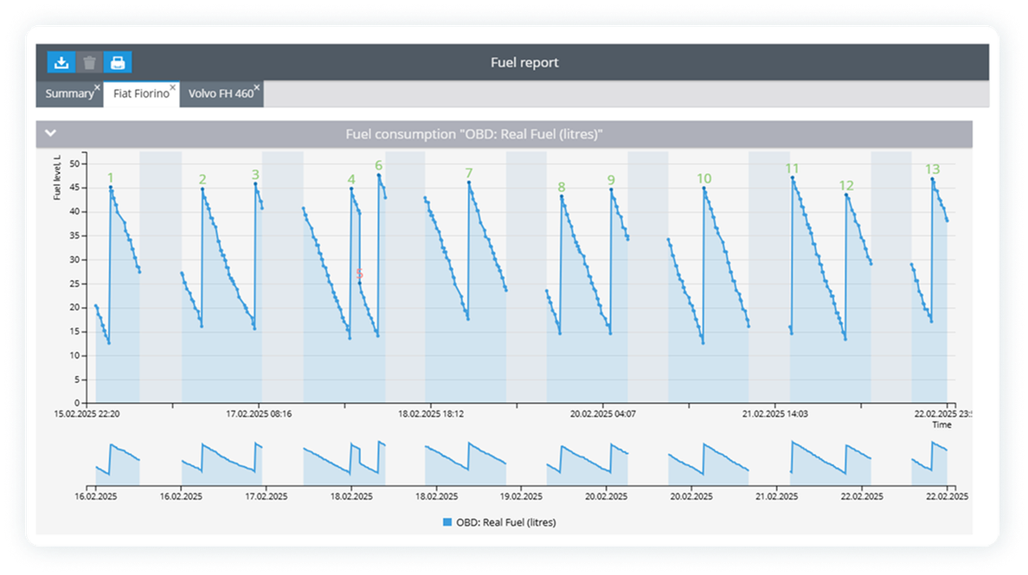
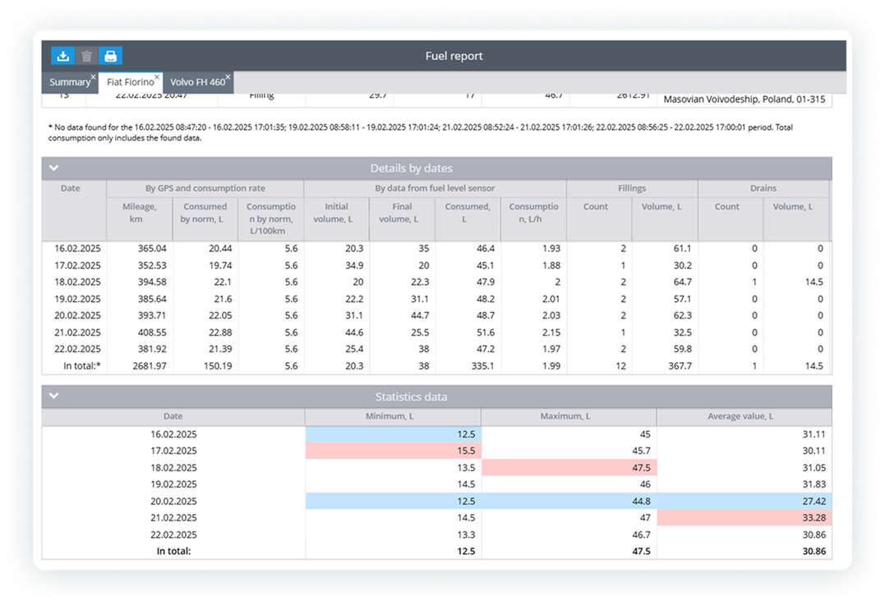
Reduce fleet costs
Plan service works based on vehicle usage
to prevent breakdowns and malfunctioning.
Keep all your PCVs road ready and reduce downtime costs.
Monitor fuel consumption effectively to eliminate drains and idling.
Get the best insurance rates and reconstruct
accidents with insurance telematics.

Slide 15
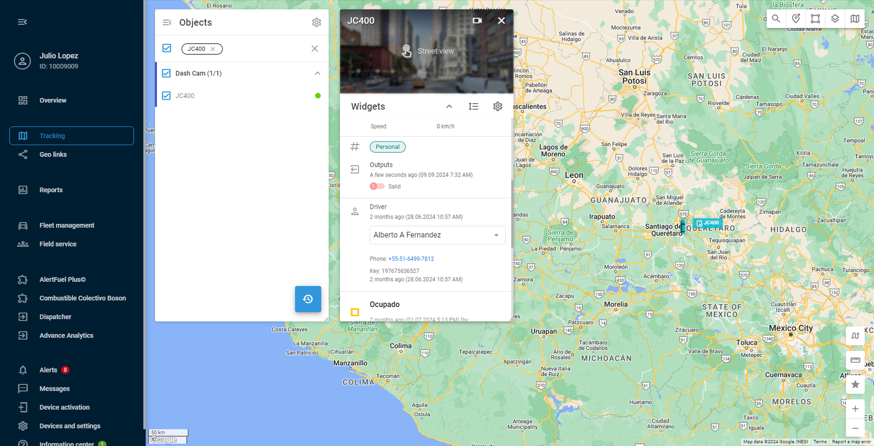
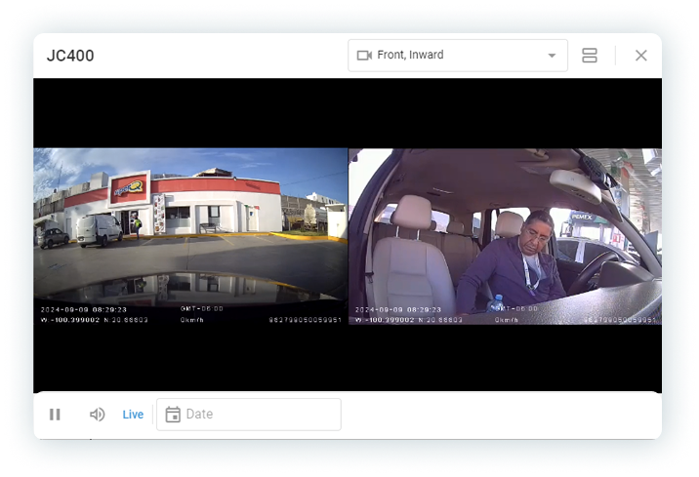
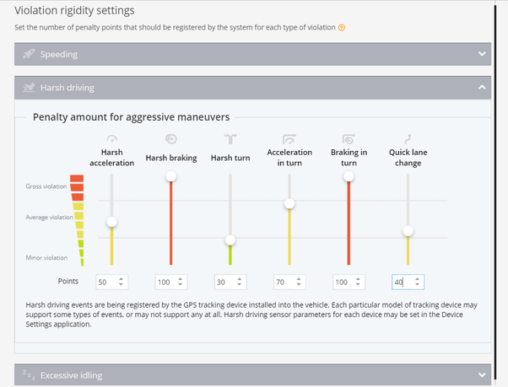
Guarantee
passenger safety
1.
2.
Receive real-time alerts
and analyze data for past periods.
Set penalty points for drivers
to eliminate speeding and other violations with Eco driving report.
3.
4.
Enhance vehicle safety
with ADAS warnings, Ignition interlock and other additional devices.
Transmit seat belt alarms to fleet operators and avoid injuries and fines.
5.
6.
Control situations inside
the bus with in-cabin monitoring.
Monitor driver condition
with DMS warnings, such as fatigue, sleep, smoking, phone use.

Slide 16
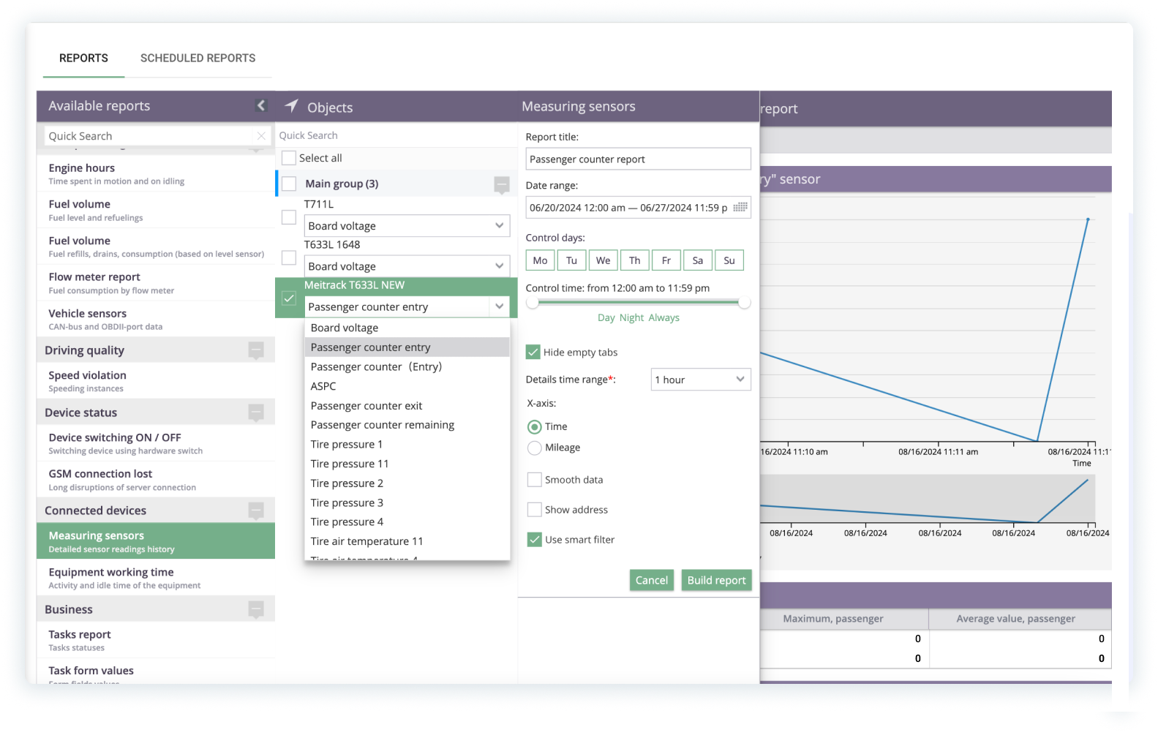
Minimize revenue loss
Track the movement of school, shuttle, and intercity buses along their routes using GPS tracking.
Uplift your business with Navixy by
Monitoring bus occupancy in real time.
Controlling the purchase of tickets and
the presence of ticket inspectors on the line.
Enabling the Points of interest feature to ensure that the driver only picks up passengers at stops along the route.

Slide 17
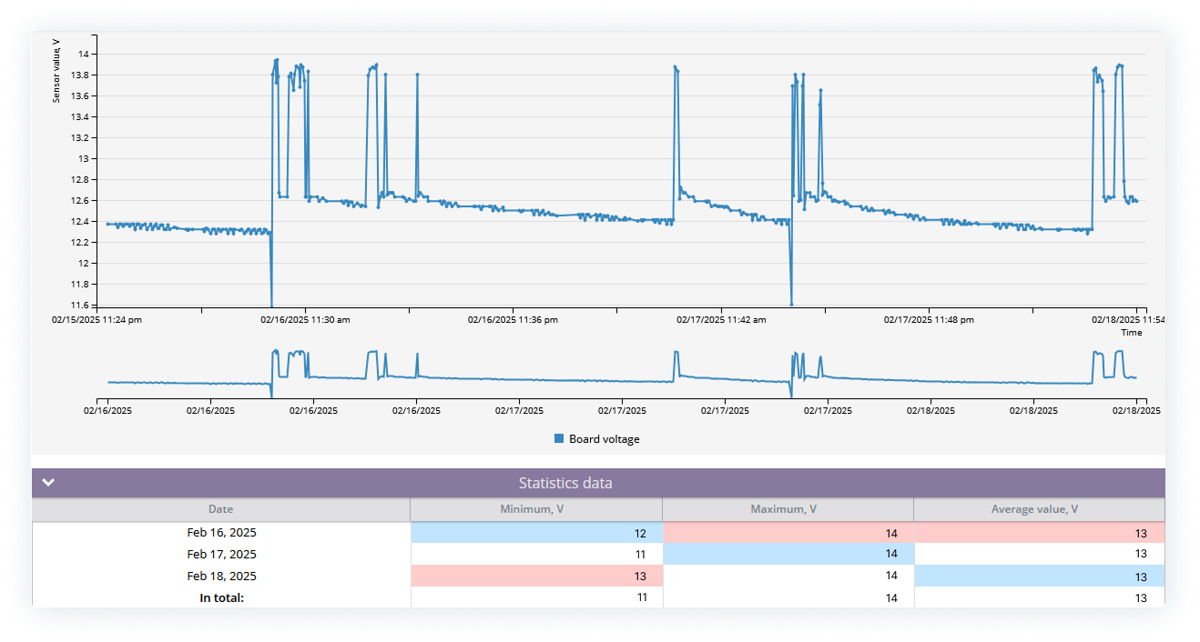
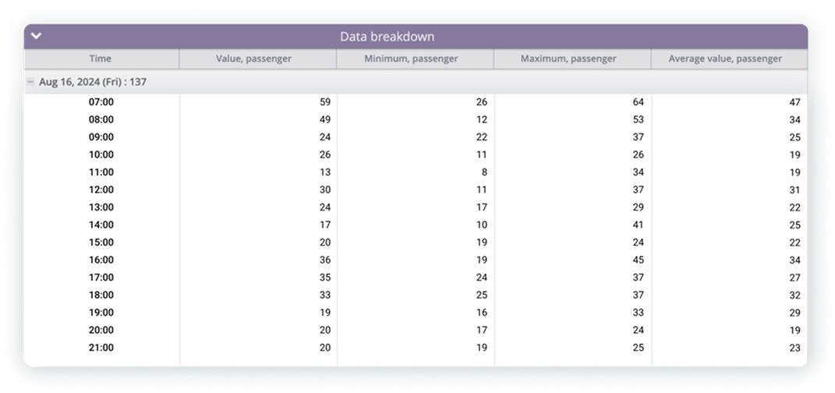
Develop effective schedule
Manage your buses effectively to improve passengers satisfaction.
Detect peak load times to optimize operations.
Develop effective schedules using passenger load data as well as information about
the speed of movement along the route
at different times of the day.
Deploy additional buses in rush hours.

Slide 18






More features
Driver ID
Control which driver is using the vehicle right now. Track shift change, run reports by driver and make accurate payroll calculations.
Automatic passenger counter
Count passengers with photo cells, CCTV, IR and other sensors. Prevent fare dodging. Analyze stats and improve the service.
Business vs personal miles
Try Driver journal to classify trips into business and personal. Get maximum tax reimbursement and spot unauthorized trips.
Anti-theft protection
Get alerts if a vehicle leaves geofences, operates at unusual hours or is being towed. Enable remote ignition control.
Comprehensive diagnostics
Monitor vehicle health with telemetry data, including DTC. Control oil level. Eliminate flaws before they develop into problems.
Compliance and safety
Meet tachograph/ELD regulations. Visualize work and rest data with fog computing to prevent driver fatigue
and fines.

Slide 19
Industries
Rentals
and leasing
Track the usage, prevent unauthorized use, encourage careful driving behavior, and get evidence for insurance and dispute resolutions.

Slide 20
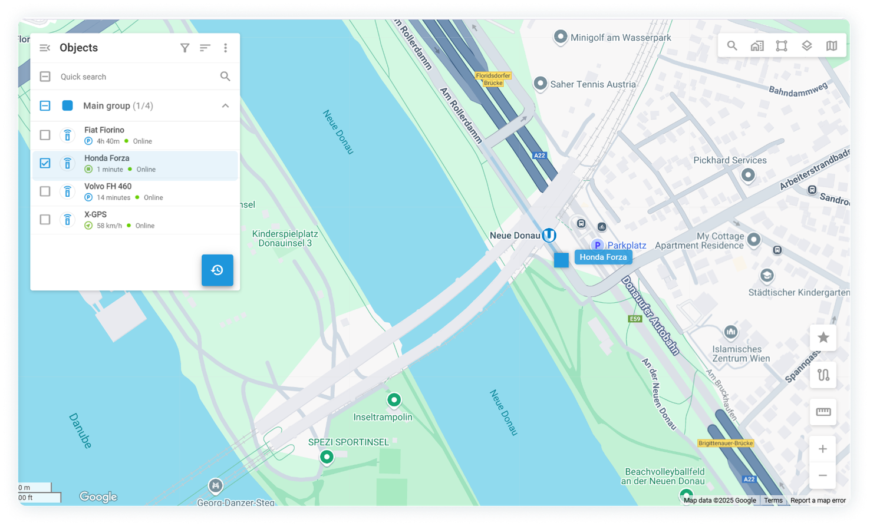

Track a vehicle
in real-time
Monitor more than just vehicle locations—track key parameters, ensure proper usage, and stay on top
of leasing agreement compliance.
GPS asset tracking
Customizable event alerts
Prevent unauthorized use and theft.

Slide 21

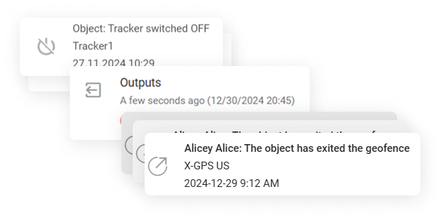
Stay alert
to potential risks
Respond instantly when managing leased assets
by automating monitoring with key triggers:
Entry into or exit from a geozone
Towing detection
Removal or disconnection of the GPS tracker
Extended vehicle idling
Remotely disable the vehicle's engine using the web interface or mobile app.

Slide 22
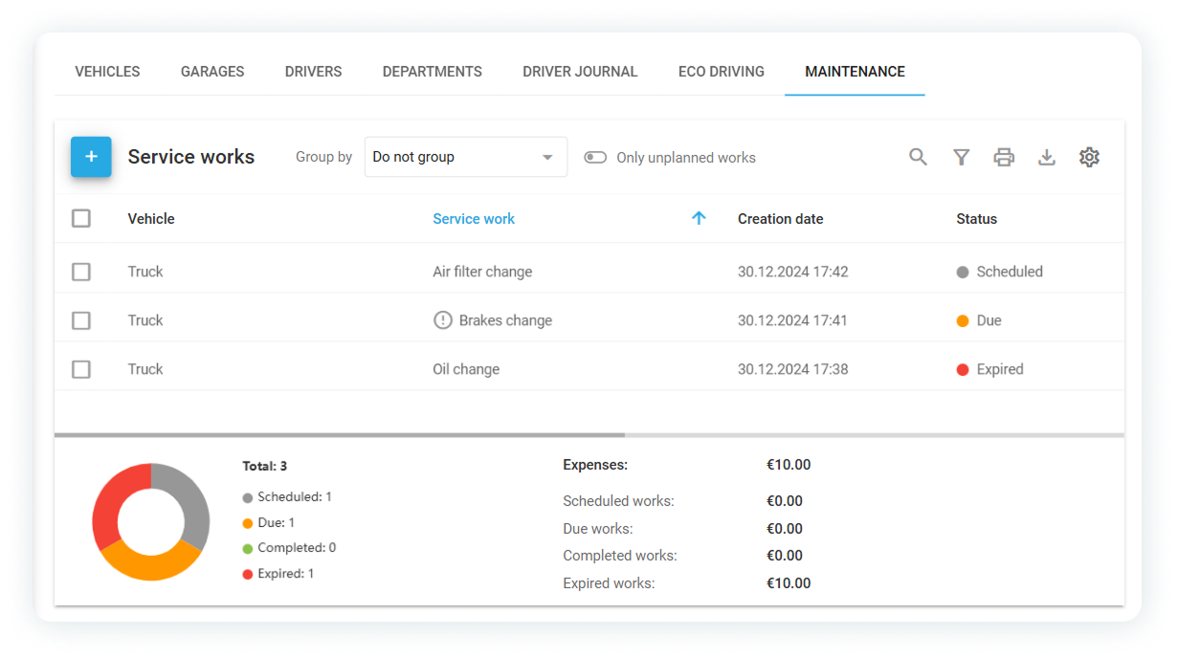
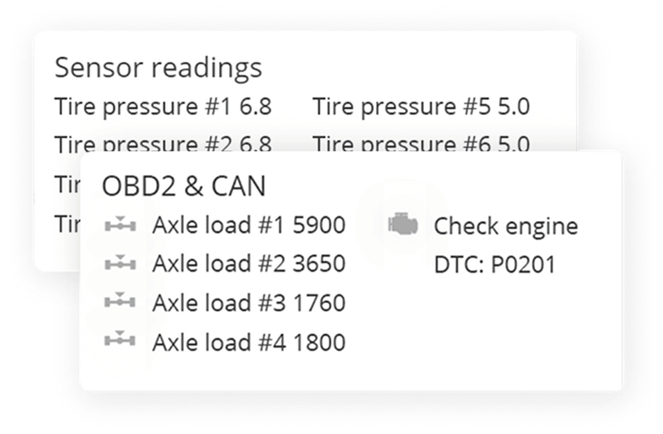
Ensure proper use
Improper asset use can significantly reduce
its lifespan. Navixy offers a set of features to enhance vehicle management.
Monitor the condition of vehicles and equipment with CAN data and automated reports on engine hours and load.
Simplify warranty and repair planning
with the Maintenance features.
Track completed work and receive timely reminders about upcoming service or repairs to keep everything running smoothly.

Slide 23






More features
Vehicle use
and maintenance
Careful driving behavior
Crash detection
Make sure the vehicles get returned
with the agreed-upon fuel level. Get alerts
on vehicle health and maintenance schedules to ensure timely repairs, reducing downtime.
Encourage drivers to use vehicles more carefully. Track harsh driving and speeding incidents and set up penalties or incentives based on the driving patterns.
Get notified of crashes and accidents. Quickly react to ensure help
and evacuation.
Vehicle recovery
Insurance optimization
Compliance
Recover assets quickly in the event
of non-returned or stolen vehicles with
the help of the tracking feature.
Automatically track mileage to ensure
it stays within the contractual limits, avoiding extra charges. Monitor compliance with rental agreement terms, such as returning vehicles to designated areas.
Use telematics data to reduce insurance premiums by demonstrating safe usage patterns.

Slide 24
Industries
Transportation
and logistics
Provide fast product delivery and build smart supply chains. Reduce transportation costs and improve delivery operations with digital monitoring, optimized route planning, and accurate delivery time predictions.

Slide 25
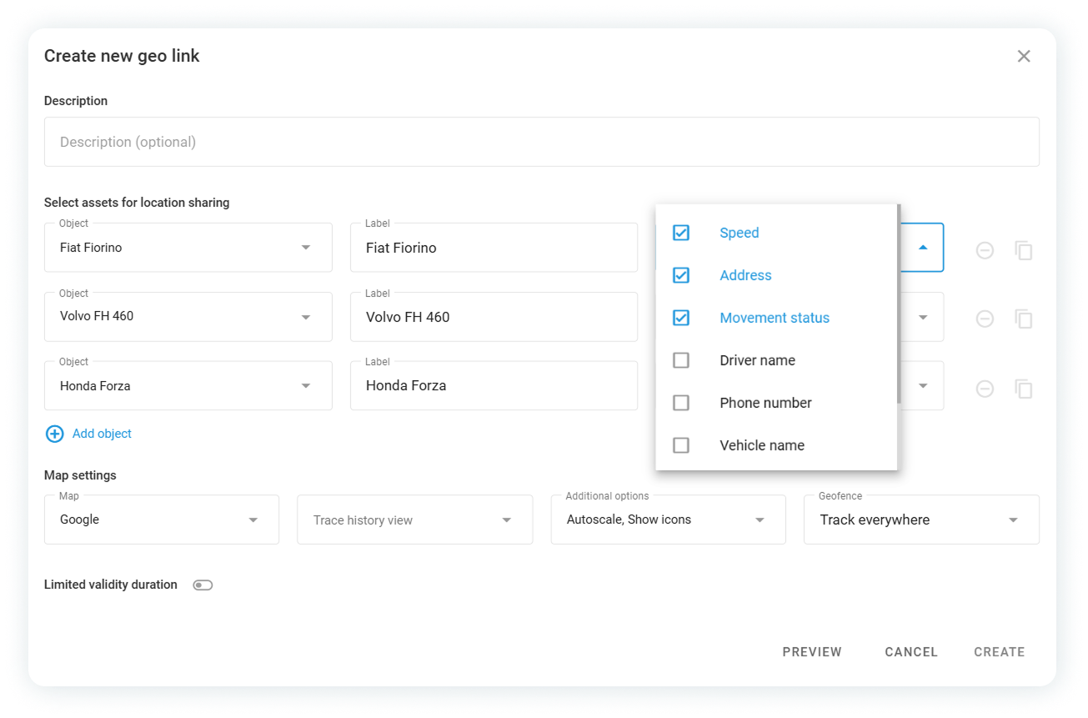
Reduce delivery times and enhance customer service
1.
2.
Accurately predict delivery times and ensure on-time shipments to your customers with advanced route planning.
Reduce costly production delays using precise GPS tracking. Strengthen customer loyalty sharing vehicle location with Geo links.
3.
4.
Stay in control by monitoring driver performance, responding swiftly to schedule changes, and proactively addressing potential delays.
Receive instant notifications about route deviations, personal trips, or unexpected events, enabling you to act quickly.

Slide 26
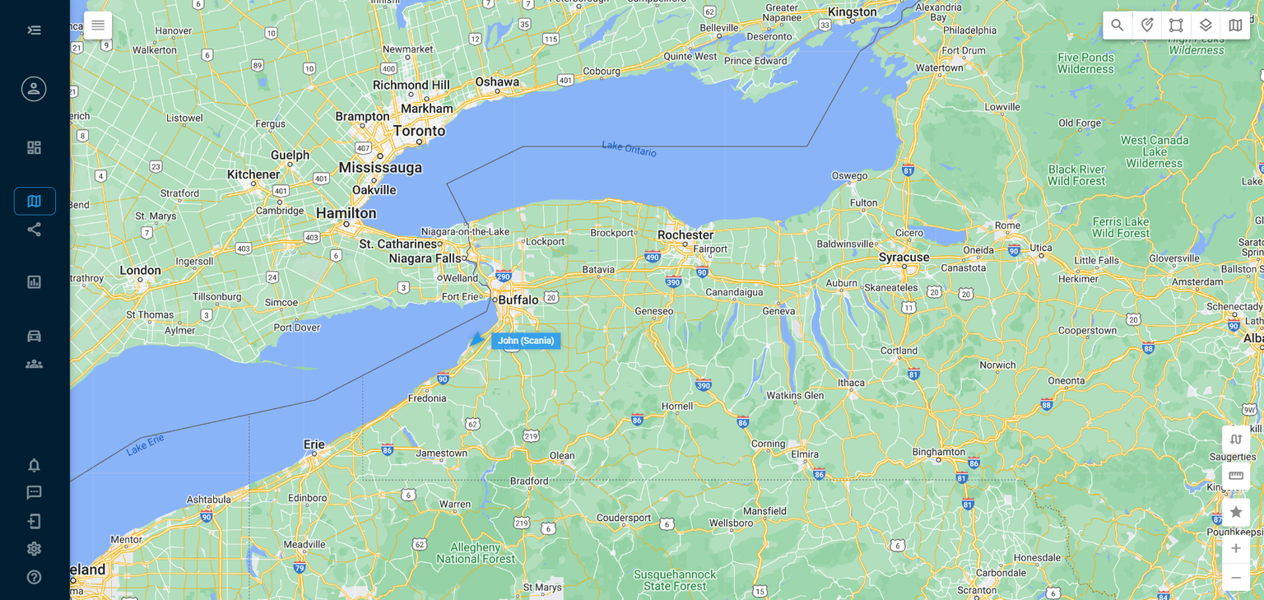
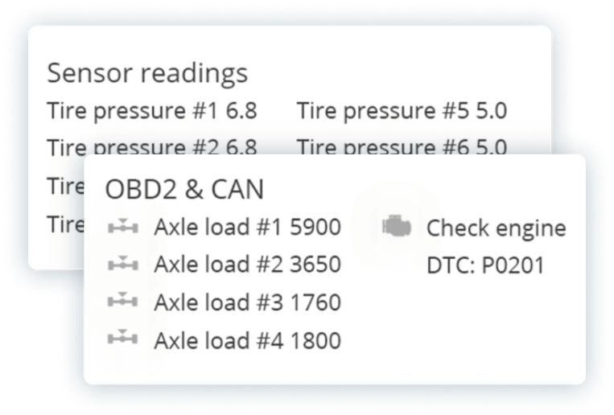
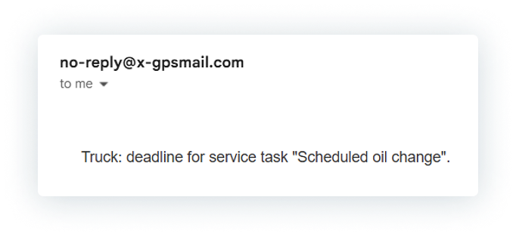
Keep fleet in top shape
Stay updated on telemetry sensors readings
and upcoming fleet maintenance works. Enable alerts
by email, SMS, push or sound alarms.
Ensure your fleet's technical reliability with reminders about upcoming maintenance, expiring insurance policies, and detected vehicle malfunctions.

Slide 27
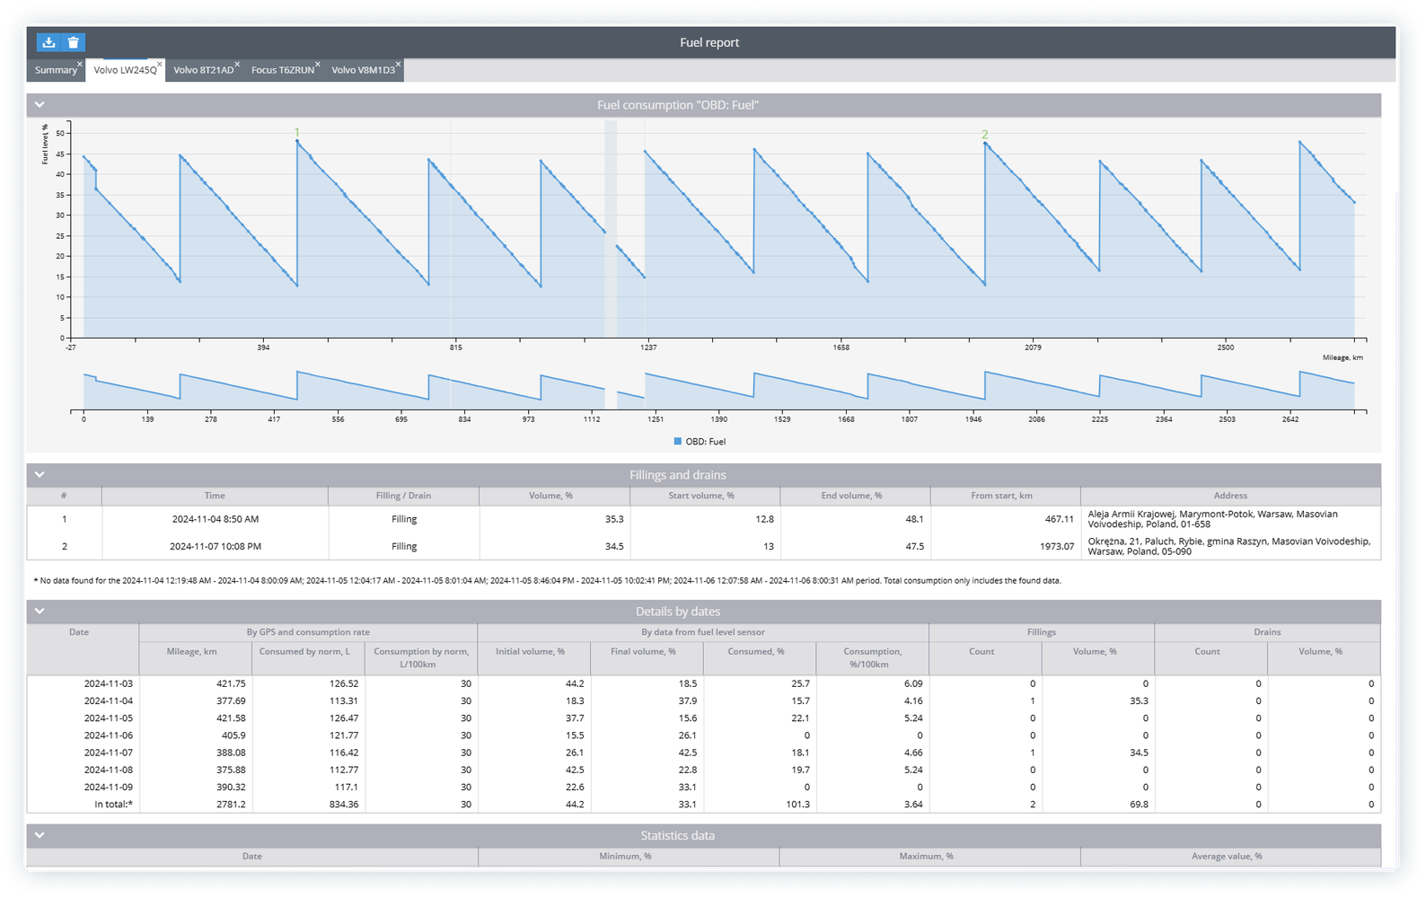
Cut the fuel costs
Track exact mileage, vehicle load, refueling volume, and fuel consumption to eliminate frauds.
Detect fuel frauds on the spot with timely notifications. Browse through fuel reports to identify drains and analyze losses.
Optimize the route on the move to avoid traffic jams, incidents on the road.
up to
30%
reduce fuel expenses thanks
to monitoring system*.
Based on our customers experience.

Slide 28
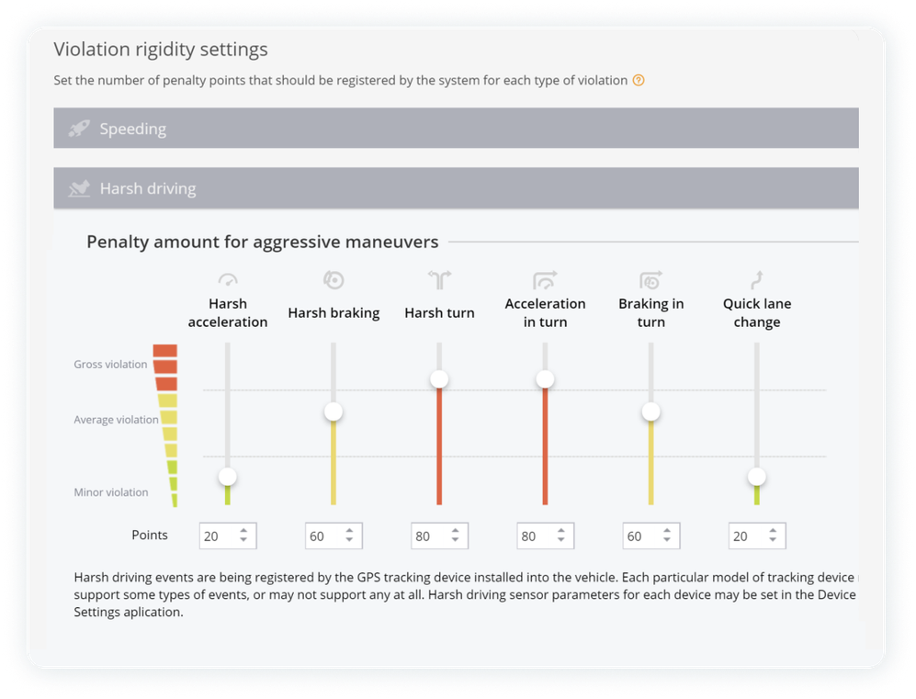
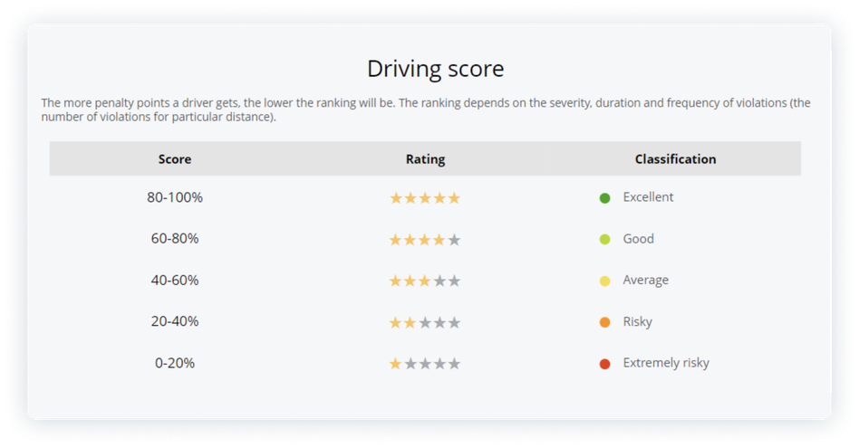
Minimize accidents and insurance costs
Analyze Eco driving reports to promote safe behind-the-wheel behavior and refine drivers’ discipline.
Benefit from usage-based insurance and reconstruct road accidents effectively.
Adopt video telematics features, such as ADAS
and DMS warnings, to reduce traffic violations, fatigue driving and hazardous situations. Prevent collisions and damages with sound warnings and alerts.

Slide 29

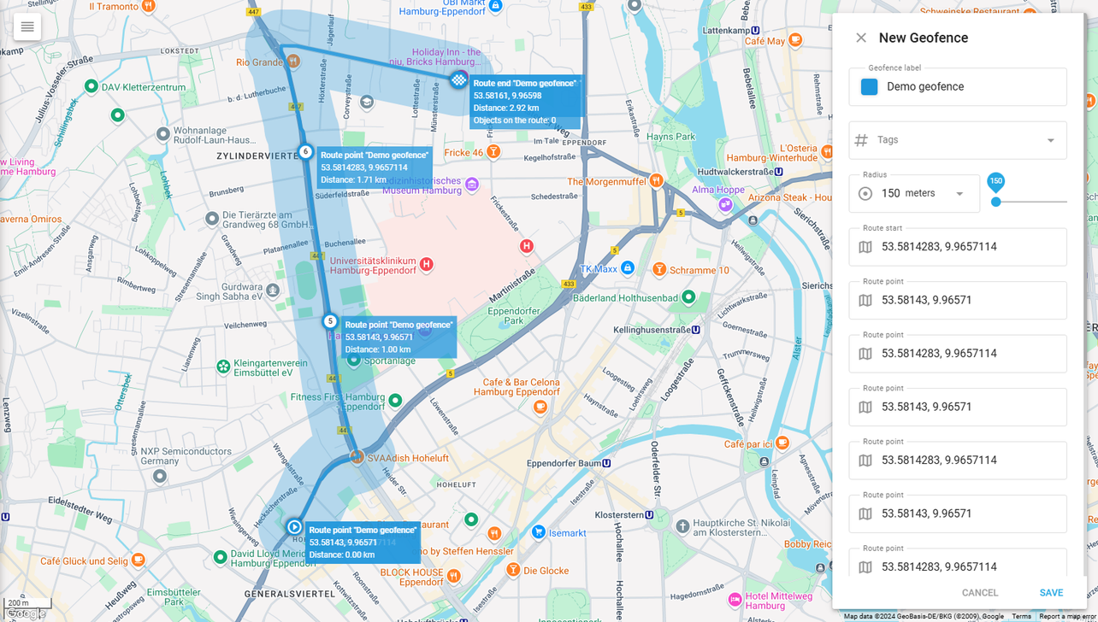
Prevent thefts
Ensure the safety of your vehicles and transported goods with advanced security features:
Real-time monitoring: Stay informed with instant alerts triggered by light sensors, padlocks,
and security cameras.
Geofencing: Plan routes to avoid high-risk areas
and ensure safer transportation.
Remote engine blocking: Respond quickly
to emergencies by remotely disabling the engine
to prevent theft.

Slide 30






More features
Maximize tax refunds with auto logs
Plan fastest routes
Cargo quality guaranteed
Use Driver Journal to calculate business mileage for any time periods. Check locations, time and odometer values
to effortlessly sort trips into business
or private.
Experience smart route optimization
to reach all clients faster and guarantee delivery without delays. The best routes will be planned automatically on a click.
Enable temperature, humidity and fall detection sensors to receive alerts if the values are out of range. Prove that goods quality was not affected during transportation.
Control work and rest hours
Prevent extra cargo
Driver Identification
Comply with tachograph and ELD regulation policy. Monitor shift duration
for each driver in real time and enable remote ddd-files download at required intervals.
Monitor axle load to avoid excessive wear-and-tear and fines for overloading. Make sure drivers aren’t using corporate vehicles for transportation of their own goods.
Apply driver ID to know who’s driving
the truck now and when a new shift
has started. Enjoy personalized metrics and protect your fleet against unauthorized use.

Slide 31
Industries
Mining
Protect fleet and valuable assets from frauds, downtimes and accidents. Monitor fuel level in real time along the route.

Slide 32

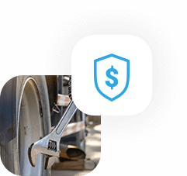
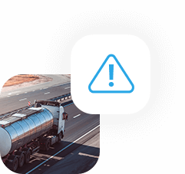
Significant advantages
Prevent fuel theft
Cut maintenance costs
Eliminate downtime
Enable instant alerts for fuel level changes. Minimize losses with
an immediate response and the most accurate telemetry and GPS data.
Use benchmark reports to analyze complete fuel consumption
per driver. Make data-driven decisions to optimize business processes.
Effortlessly add new service tasks based on DTC error codes and tanker truck usage, including mileage
and engine hours. Anticipate potential damages with timely alarms and notifications. Set maintenance reminders and assign recurring tasks.
Control pre-trip inspection (PTI) results in real time to prevent penalties or unexpected breakdowns. Implement smart, stable communication to send and receive urgent updates and notifications. Monitor in real time and analyze data through reports.

Slide 33
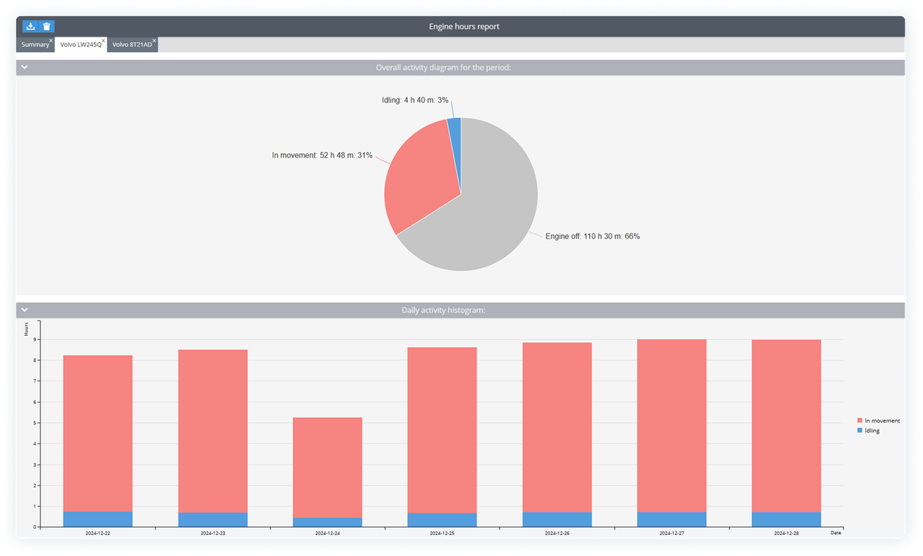
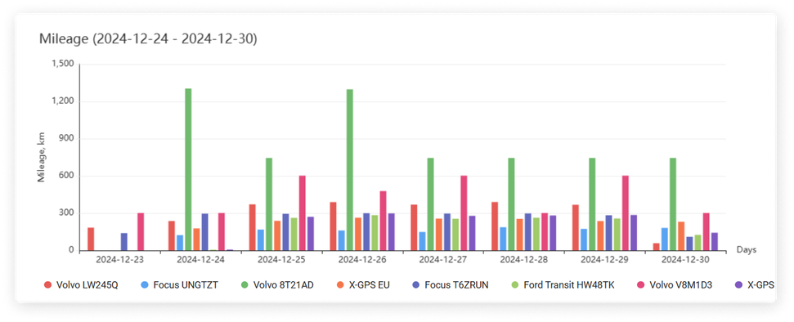
Instant access to fleet and equipment data
Plan routes and stop locations effortlessly. Prevent unauthorized vehicle use and unapproved downtime.
Track the number of trips, mileage, and operating
hours for vehicles and specialized equipment.
Keep tabs on engine hours for precise reporting.
Monitor the performance of individual machinery components. Track the drilling rotation speed, control excavator bucket operations, and more.

Slide 34
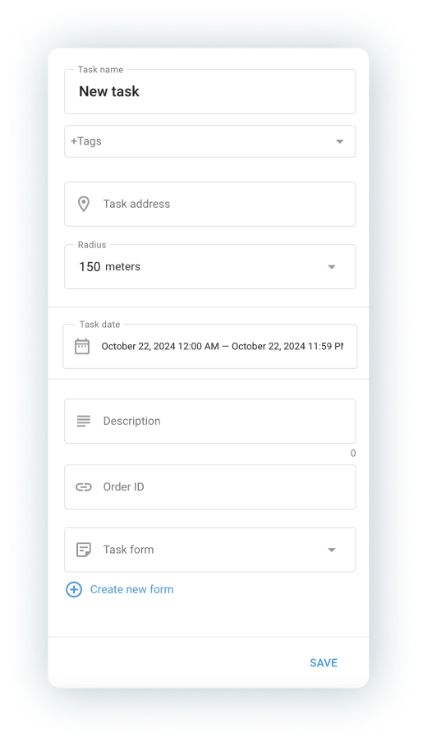
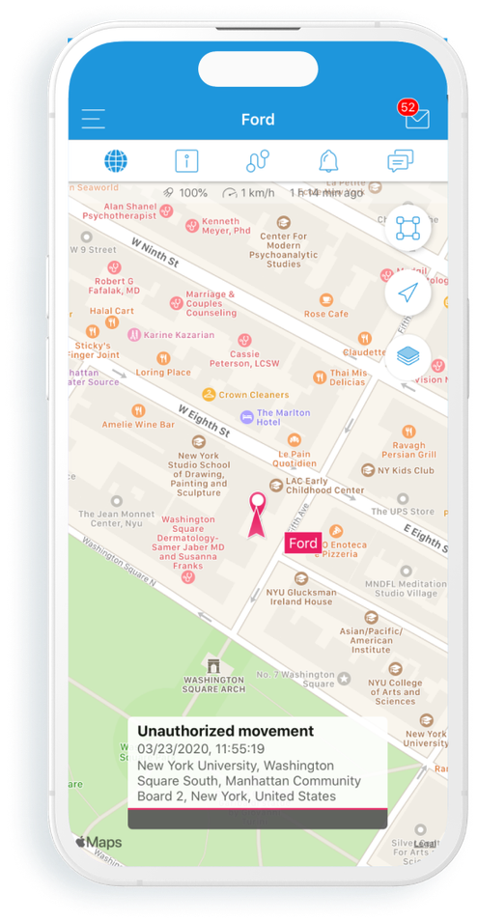
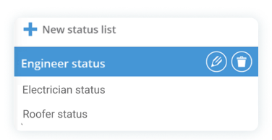

Enhance performance
Track the location and movements of your employees, including field engineers and pipeline or power grid inspectors.
Plan visits in advance directly within the system, then monitor task completion, time spent at each location, and overall performance.
Ensure employee safety with features such
as an SOS button or real-time chat with dispatchers, enabling instant responses to critical situations.
X-GPS Tracker app

Slide 35
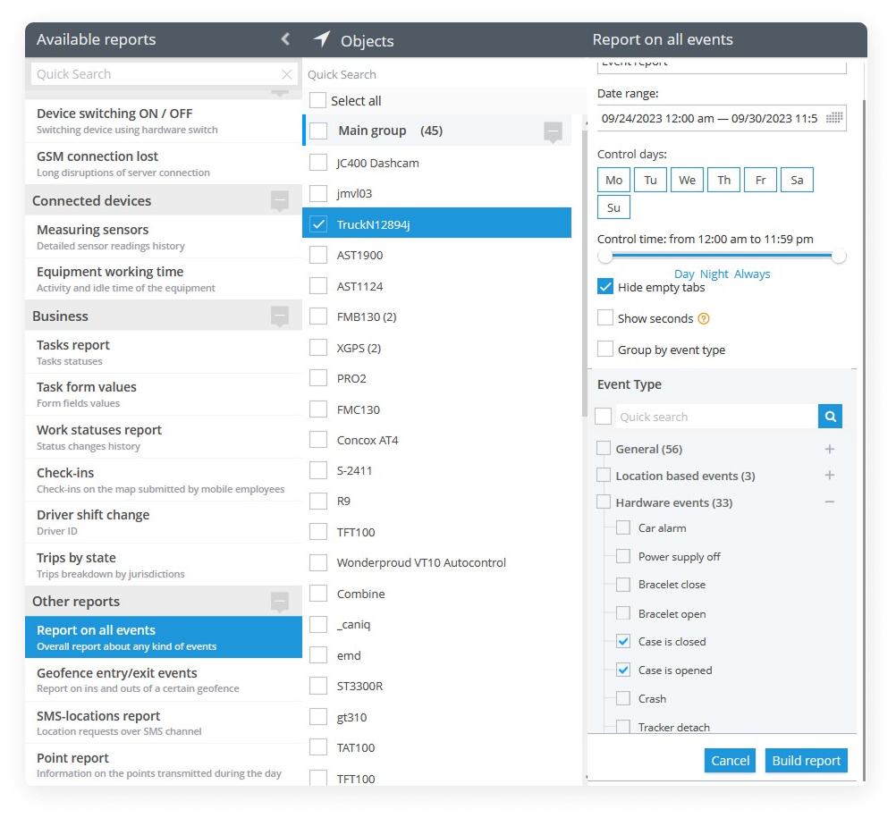
Safeguard valuable cargo
Fuel theft, unauthorized access, and equipment hijacking pose serious risks during transportation.
With the Navixy platform, gain real-time visibility into your cargo and receive instant alerts for unauthorized actions, such as tampered tanker seals.
In the event of vehicle theft, remote engine immobilization halts criminals in their tracks, ensuring your cargo stays secure.

Slide 36




More features
Bring any fuel sensor
Careful driving behavior
Road assistance 24/7
Calibrate fuel sensors with the most intuitive process. Get accurate fuel data
in real time. Generate reports for any time period and visualize insights with detailed graphs and charts.
Encourage drivers to use vehicles more responsibly. Track harsh driving and speeding incidents and set up penalties
or incentives based on the driving patterns.
Enhance the safety and security of your vehicles and drivers with a panic button solution. Provide instant assistance
to prevent disasters and mitigate
the effects of dangerous situations.
Calculate reimbursements
Optimize routes
Control fuel temperature
Transport high-priority cargo in the safest way possible. Use automatic route optimization to reach all locations faster and more efficiently while considering road restrictions and limitations.
Use digital timesheets for precise payroll calculations. Classify trips as business
or personal to maximize tax deductions and improve financial efficiency.
Transporting flammable liquids requires enhanced security measures. Monitor fuel temperature and track its fluctuations
to detect and prevent dangerous situations.

Slide 37
Industries
Construction
and heavy equipment
Reduce corporate expenses through optimized fleet utilization. Increase driver accountability
to minimize idling and ensure preventive maintenance.

Slide 38
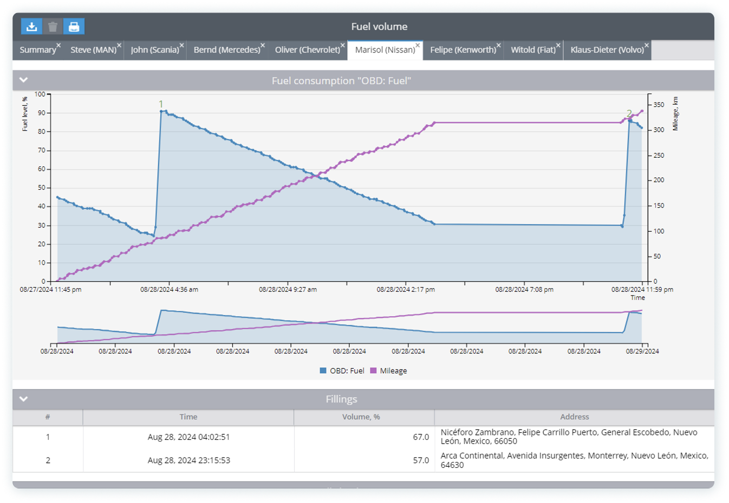
Keep focus on efficiency
Monitor productivity using engine hours and PTO
for each unit. Whether it’s raising or lowering a dump truck bed, operating a tow truck winch or other functions.
Ensure equipment is not idling or leaving the job site. Track it in real time via widgets, MDVR
or generate reports for any time periods.
Approximately
39%
of drivers report idling for 3—4 hours per day.

Slide 39
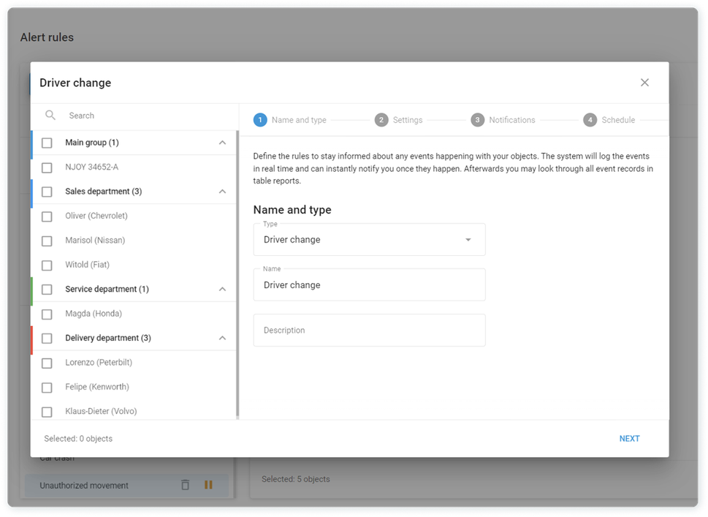
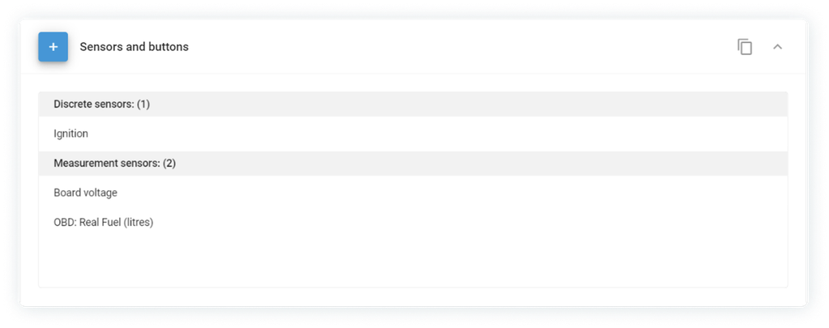
Protect equipment remotely
Secure fleet and heavy equipment from theft and misuse.
Use Driver ID to ensure that only authorized personnel operate the vehicle.
Implement continuous fuel monitoring to prevent fuel drains and other types of fraud. Set alerts
to respond immediately to drastic fuel level changes.
Protect your equipment from theft and vandalism with instant alerts for unauthorized tampering, tilting, or impact.

Slide 40
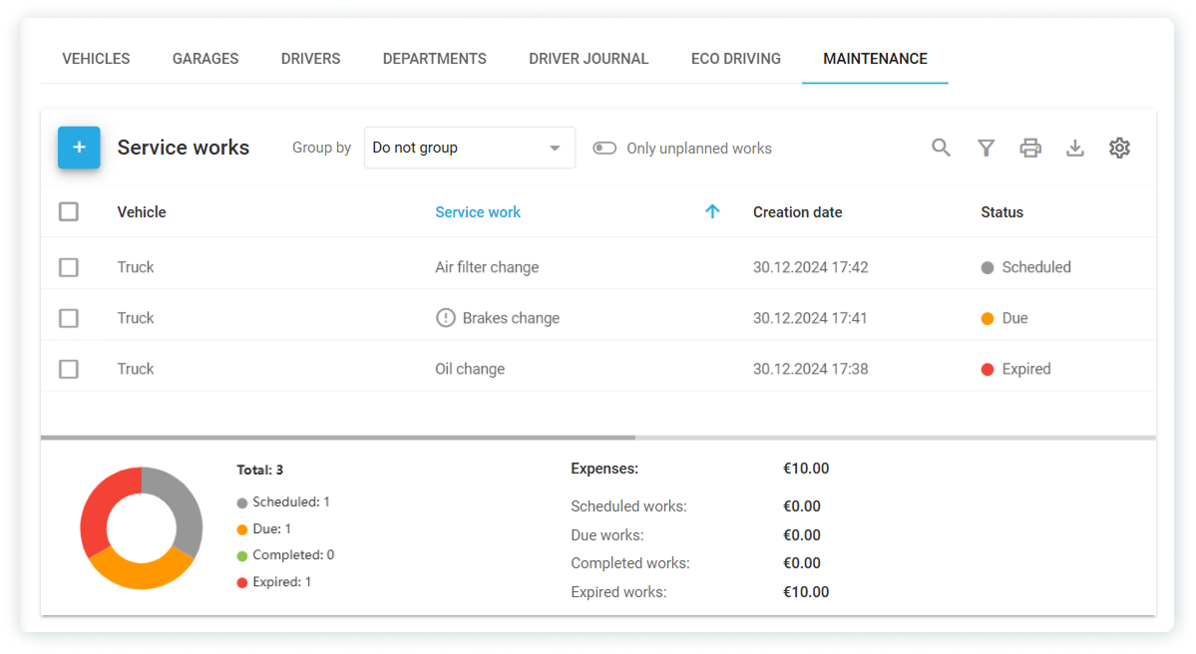
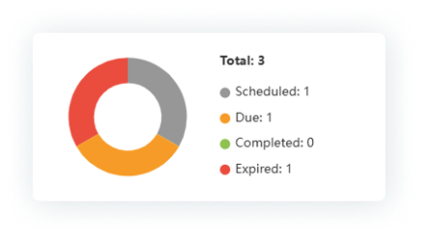
Optimize maintenance: predict and prevent
Extend equipment’s lifespan and prevent extra costs and breakdowns.
Plan maintenance tasks based on equipment usage—by date, mileage or engine hours.
Set target values, estimate expenses, schedule recurring maintenance tasks, and designate recipients for service job notifications—all within a single interface.

Slide 41



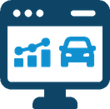


Common use cases
Crane trucks
Garbage trucks
Construction equipment
Use engine hours to track the crane’s actual working time. Monitor jib position with a tilt sensor to ensure safe operation. Prevent accidents and unsafe transportation.
Enjoy the best automatically generated routes—add required addresses, and they will be arranged in the optimal order. Create Points of interest to ensure
no client is overlooked.
Protect hydraulic and pneumatic equipment from excessive use and overheating. Prevent malfunctions, breakdowns, and costly repairs.
Mobile drilling rigs
Dump trucks
Cleaning trucks
Monitor working hours and key operating parameters, including drilling depth. Calculate payroll for rig operators
and estimate the number of vehicles needed.
Assist drivers in safely maneuvering heavy-load trucks. Enable ADAS alerts and sound warnings to maintain a safe distance, factoring in vehicle weight
with or without cargo.
Monitor fuel consumption efficiently. Prevent engine idling with detailed fuel reports. Detect fuel drains and prevent fraud using flow meters and fuel sensors.

Slide 42
Industries
Banks and collection services
Streamline field operations and reduce costs
by accurately tracking vehicles and armored trucks. Empower your mobile workforce
to serve clients more efficiently.

Slide 43
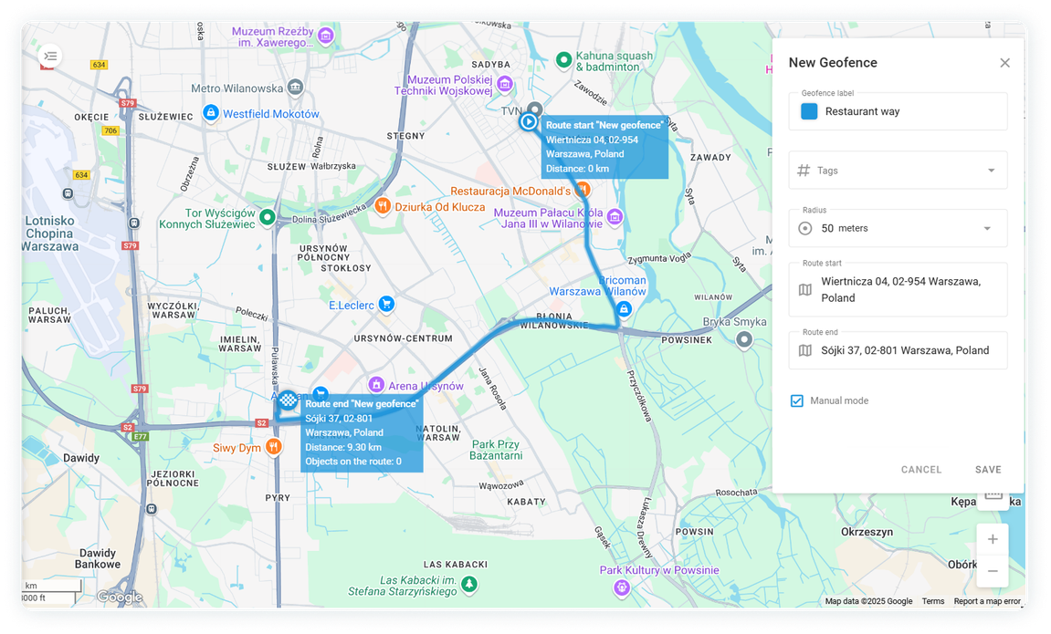
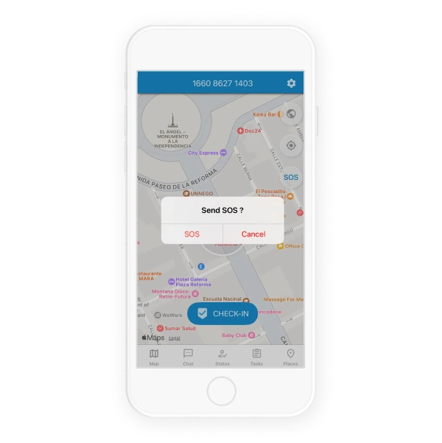
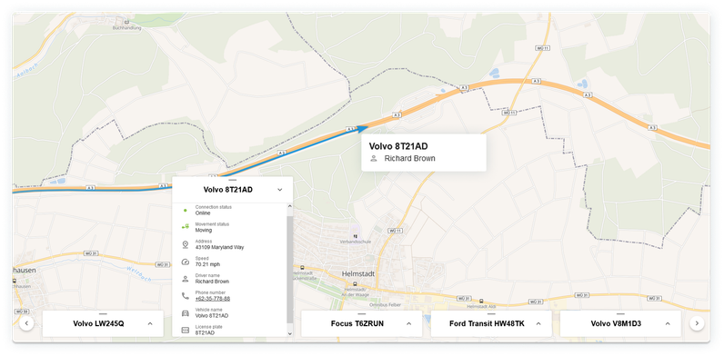
Keep safety at the forefront
Plan and optimize secure routes for cash-in-transit vehicles with real-time alerts for any route deviations.
Mark high-risk geozones and plan routes
to avoid them.
Receive notifications for prolonged delays
along the route.
Share a Geo link with security teams in case
of violation for a quick response.
Use the engine block feature to disable a vehicle in the event of theft.
The SOS button in the app ensures a rapid response in the event of an assault.

Slide 44
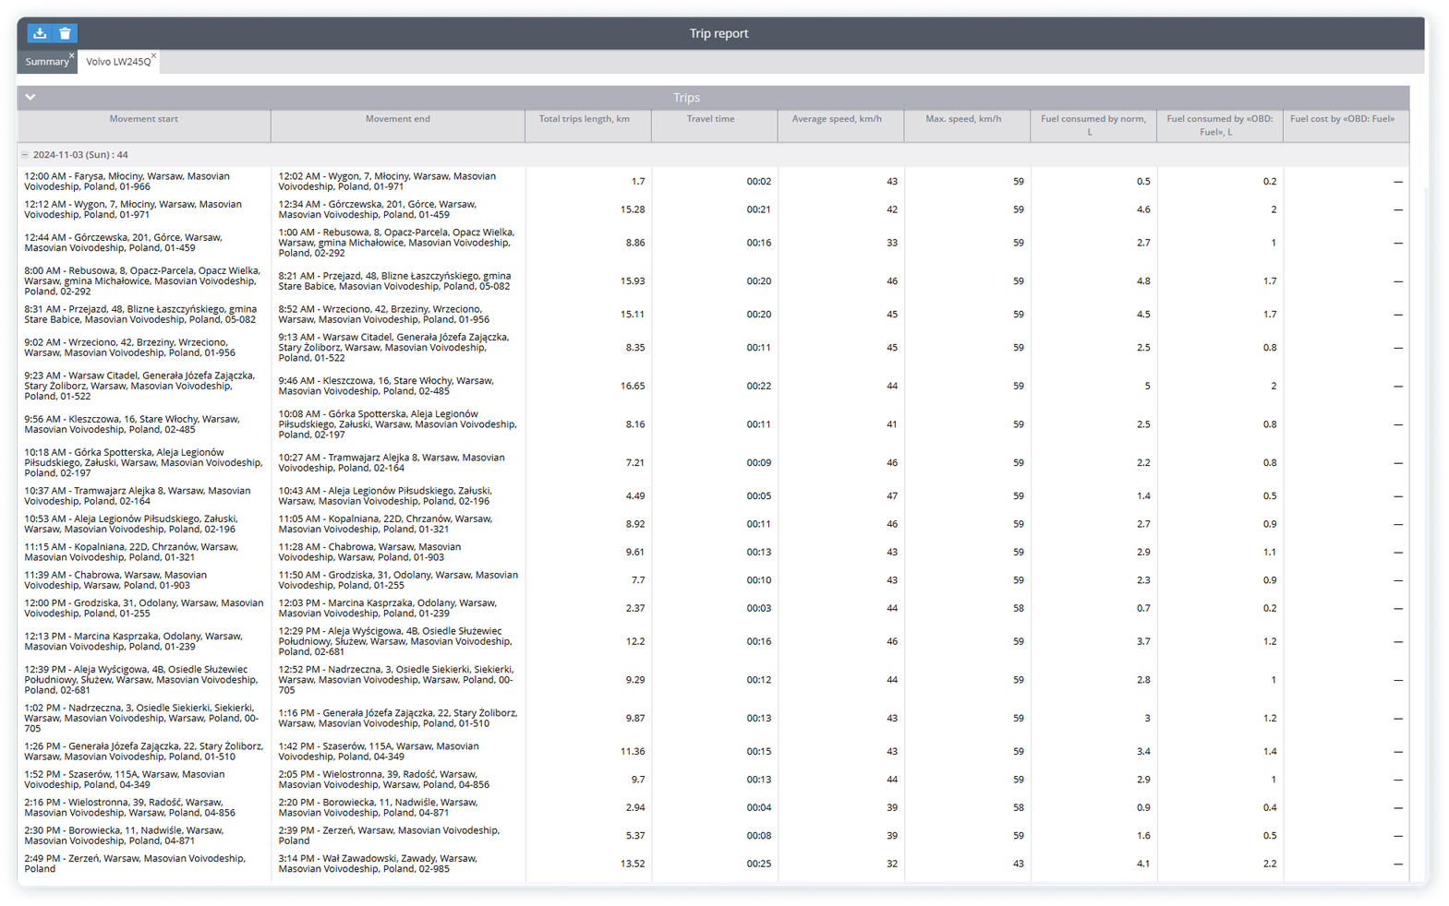
Ensure fleet reliability
Automate fuel consumption reports, streamline trip log management, and gain complete control over driver activities.
Reduce maintenance costs by scheduling diagnostics and implementing preventive measures to avoid expensive repairs.
Eco driving reports and alerts on aggressive driving encourage drivers to stay cautious
on the road.

Slide 45

More features
Road assistance 24/7
Plan fastest routes
Crash detection
Calibrate fuel sensors with the most intuitive process. Access accurate fuel data in real time. Generate reports
for past period and visualize insights
with detailed graphs and charts.
Experience smart route optimization
to reach all clients faster and guarantee delivery without delays. The best routes will be planned automatically on a click.
Detect potential collisions in real time
with crash detection and ADAS warnings, enabling proactive accident prevention. Improve safety with a panic button solution.
Mobile apps
Insurance optimization
Compliance
Empower your field staff to manage reports and communicate seamlessly
with colleagues through mobile applications.
Leverage telematics data to lower insurance premiums by showcasing
safe usage patterns.
Automatically track mileage to ensure
it remains within contractual limits, avoiding extra charges. Monitor compliance with rental agreement terms, such as returning vehicles to designated areas.

Slide 46
Industries
Agriculture
Grow your harvest and profits by boosting the efficiency of your workflows. Enhance control and optimize costs for equipment and fuel.

Slide 47


Improve efficiency
Monitor your equipment in the field. Set up geofences, plan routes, assign tasks, and track progress—all from a singe platform.
Get instant alerts for equipment downtime
or unauthorized movement outside designated geofenced areas.
Implement a DMS package to monitor driver conditions behind the wheel.

Slide 48
Protect equipment
from misuse
Use Driver ID to ensure that only authorized personnel operate your vehicles.
Adopt real-time fuel monitoring to prevent theft
and fraud. Set up instant alerts for sudden fuel level changes.
Protect your equipment from theft and vandalism
with alerts for unauthorized tampering, tilting,
or impact.

Slide 49



More features
Monitor combines in fields
Optimize field operations
Prevent breakdowns
Use engine hours to track the crane's actual working time. Monitor jib position with a tilt sensor to ensure safe operation. Prevent accidents and unsafe transportation.
Generate routes automatically by entering field locations or delivery points, and let
the system arranges them in the most efficient order. Mark Points of interest (POIs)
to ensure every farm or client is covered.
Set alarms to prevent excessive use
and overheating. Avoid malfunctions, breakdowns, and costly repairs.
Control working hours
Ensure off road safe driving
Control fuel consumption
Monitor each driver's shift duration
in real time and enable remote DDD file downloads at specified intervals.
Enable ADAS alerts and sound warnings to keep a safe distance, considering vehicle weight with/without cargo.
Minimize engine idling with comprehensive fuel reports. Detect fuel drains and prevent fraud using flow meters and fuel sensors.

Slide 50




More industries benefiting from efficient fleet management
Food and beverage
Retail and delivery
Insurance
Services industry
Enable fastest, temperature-controlled deliveries. Provide automatic trips logging to calculate payroll, return tax and prevent unauthorized use of fleet.
Keep fleet owners updated on vehicles health to have them serviced before it leads to a breakdown. Fine-tune drivers behavior to avoid accidents
and goods damage.
Enable insurance companies
to benefit from low-accident driving. Adopt advanced driver assistance system to eliminate human error and, hence, collisions and expensive repairs.
Guarantee vehicle utilization and work progress monitoring
with real-time metrics and reports. Detect frauds, prevent fuel drains, equipment misuse and moonlighting.

Slide 51

Renting
Leasing
Mining
Transportation
INDUSTRIES
Logistic
Food
Retail
Healthcare

Slide 52



Learn more about Navixy
Opportunities for your business
Technical side of our platform
Get quick answers 24/7
Explore blog
Learn more
Use Navixy AI Assistant
Thanks for your attention!

