Slide 1


Heavy machinery telematics:
Redefining efficiency
in the age of smart equipment

Slide 2
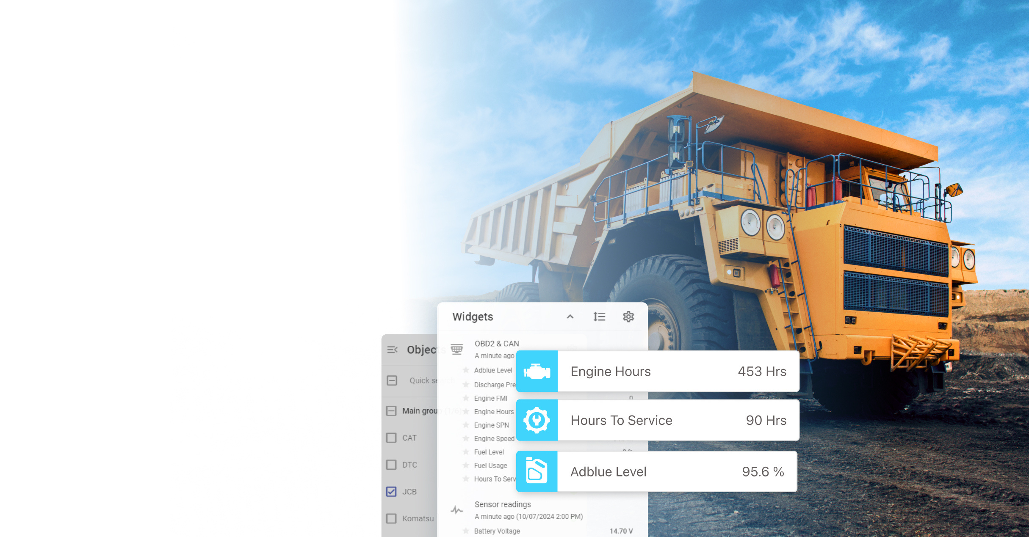

Heavy machinery
Key features and benefits for heavy machinery:
Comprehensive equipment monitoring
Maintenance planning and efficiency
Diagnostics and fault detection
Fuel and emissions management
Safety and environmental monitoring
Notes:
Let's talk about how Navixy can help you transform your heavy machinery operations. In this slide, we highlight the key features and benefits that Navixy brings to the table when it comes to managing heavy machinery fleets. We will cover each of them in this presentation.

Slide 3

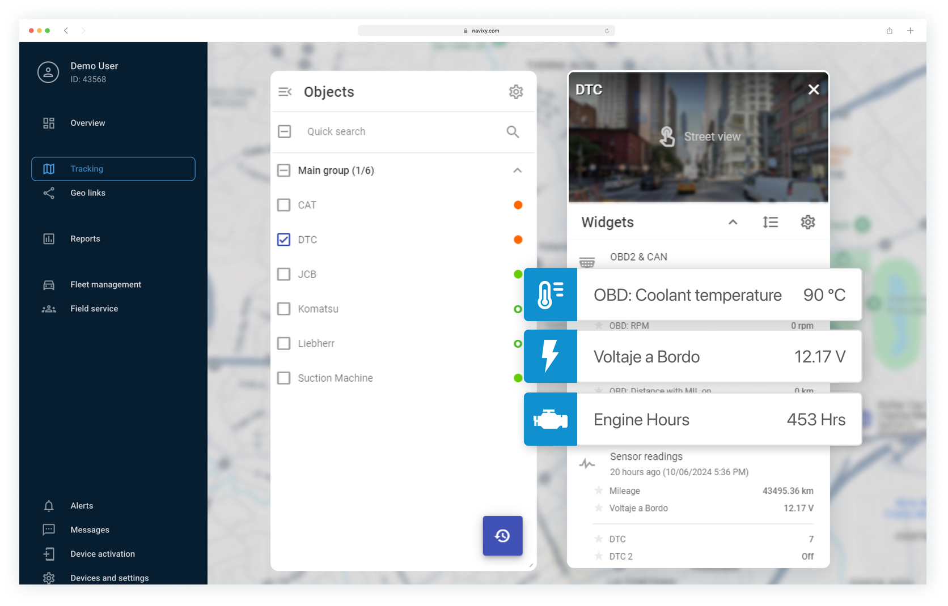
Heavy machinery
Comprehensive equipment monitoring
Real-time data integration
Engine hours: track total engine hours for maintenance scheduling
Example: "JCB" machine has run for 453 hours, coolant at 90°C, battery at 12.17 V
Coolant temperature & battery voltage: monitor critical metrics to prevent damage
Example: "DTC" machine, coolant at 90°C, battery at 12.17 V
Notes:
Comprehensive equipment monitoring
Navixy integrates with OBD2 and CAN systems to capture crucial real-time data from your machines. For instance, by tracking engine hours, we help you stay on top of maintenance schedules, reducing the likelihood of unexpected breakdowns and keeping your equipment running smoothly.

Slide 4
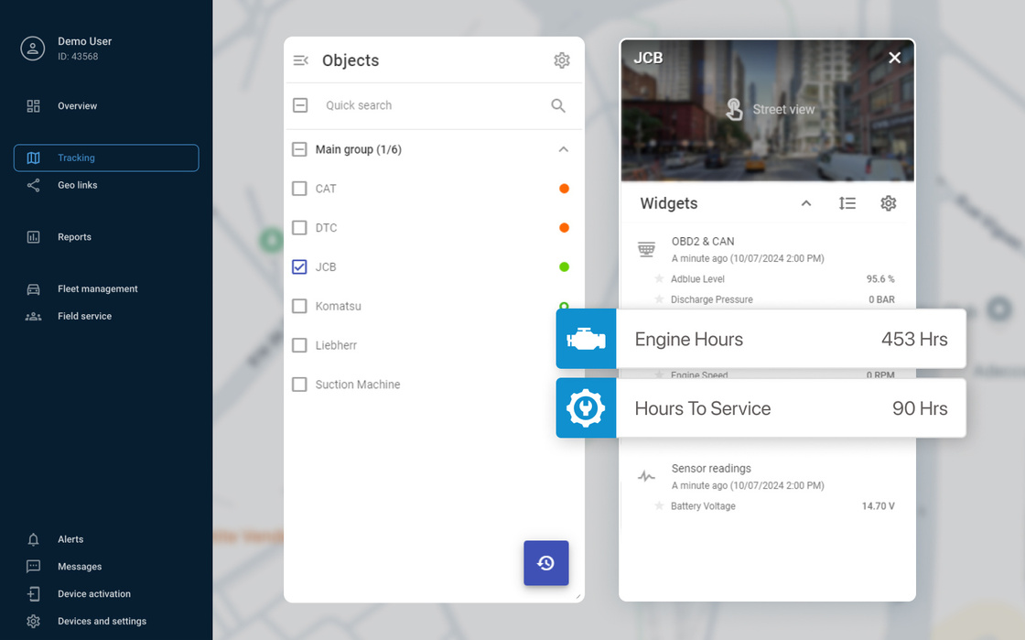
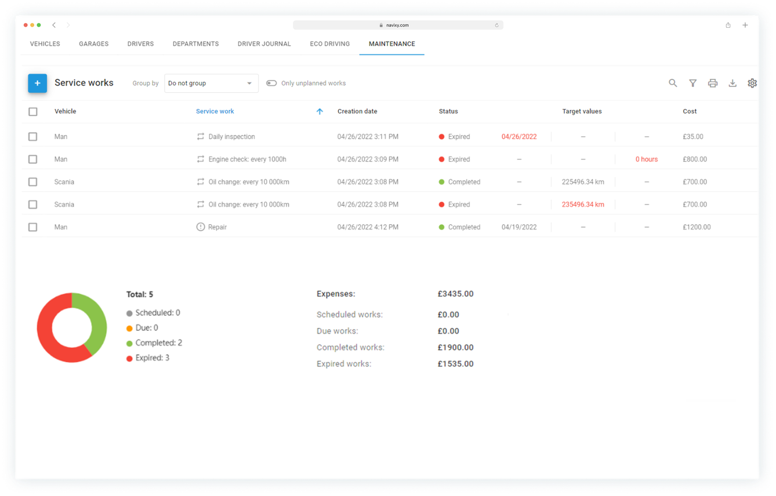
Heavy machinery
Maintenance planning and efficiency
Optimized maintenance cycles
Service intervals: plan maintenance to avoid disruptions
Example: 90 hours left until next service
Track engine hours to schedule servicing
Example: "JCB" machine logs 453 hours
Notes:
Maintenance planning and efficiency
Our system enables precise maintenance scheduling. Take the example of a 'JCB' machine that has logged over 453 hours—knowing this allows you to schedule services before issues arise. You'll also get timely reminders to ensure that none of your machinery falls behind on routine maintenance.
With Navixy, scheduling maintenance is easy. Just head to the Maintenance module, and select the vehicles you need to service. You can even bulk schedule for similar vehicles, add details, attach important files, and keep everyone – from mechanics to accountants – in the loop. For urgent repairs, choose unplanned maintenance, or set auto-repeat for routine tasks.
Our system automatically updates reminders and highlights any unplanned repairs, so you can address them quickly and avoid costly downtime.

Slide 5
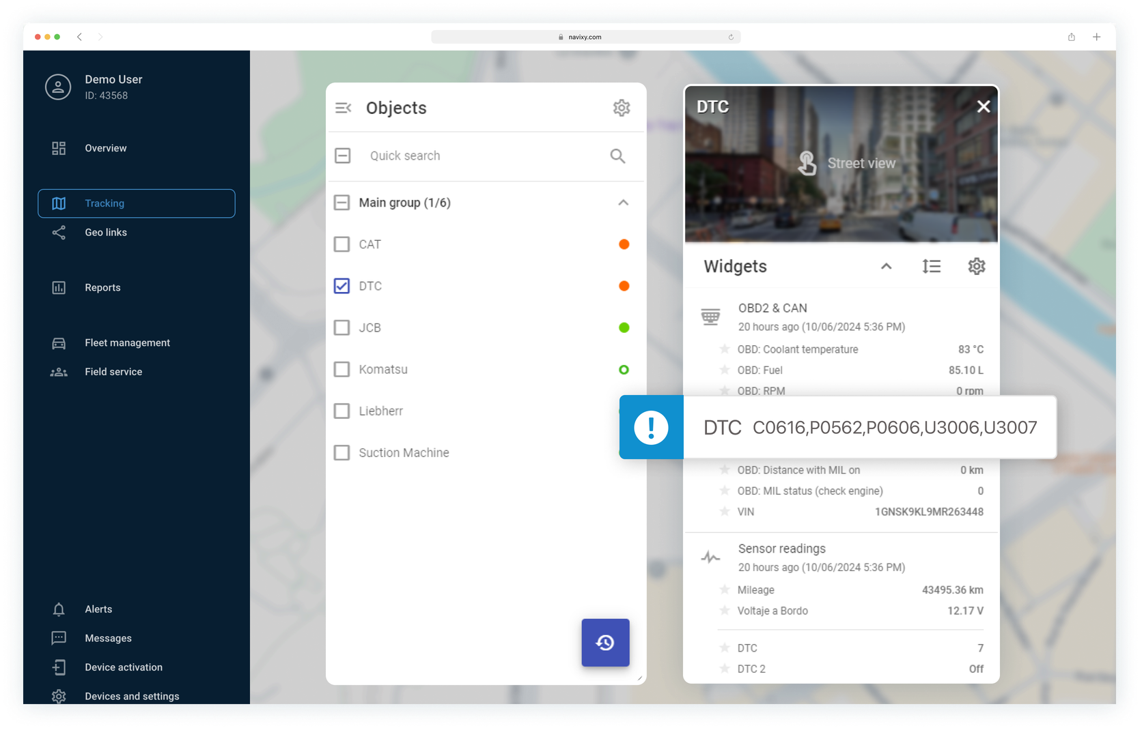
Heavy machinery
Diagnostics and fault
detection
Early fault detection
Diagnostic trouble codes: help technicians to diagnose and resolve issues.
Example: "DTC" machine reports C0616, P0562, U3006 codes
Diagnostic trouble codes: help technicians to diagnose and resolve issues.
Example: "DTC" machine reports C0616, P0562, U3006 codes
Notes:
Diagnostics and fault detection
Early detection is key to avoiding costly repairs. Navixy captures and reports fault codes (DTC), allowing your technicians to address issues before they become major problems. Whether it’s coolant temperature, battery voltage, or engine diagnostics, our platform gives you the critical information you need to act quickly and prevent downtime.

Slide 6
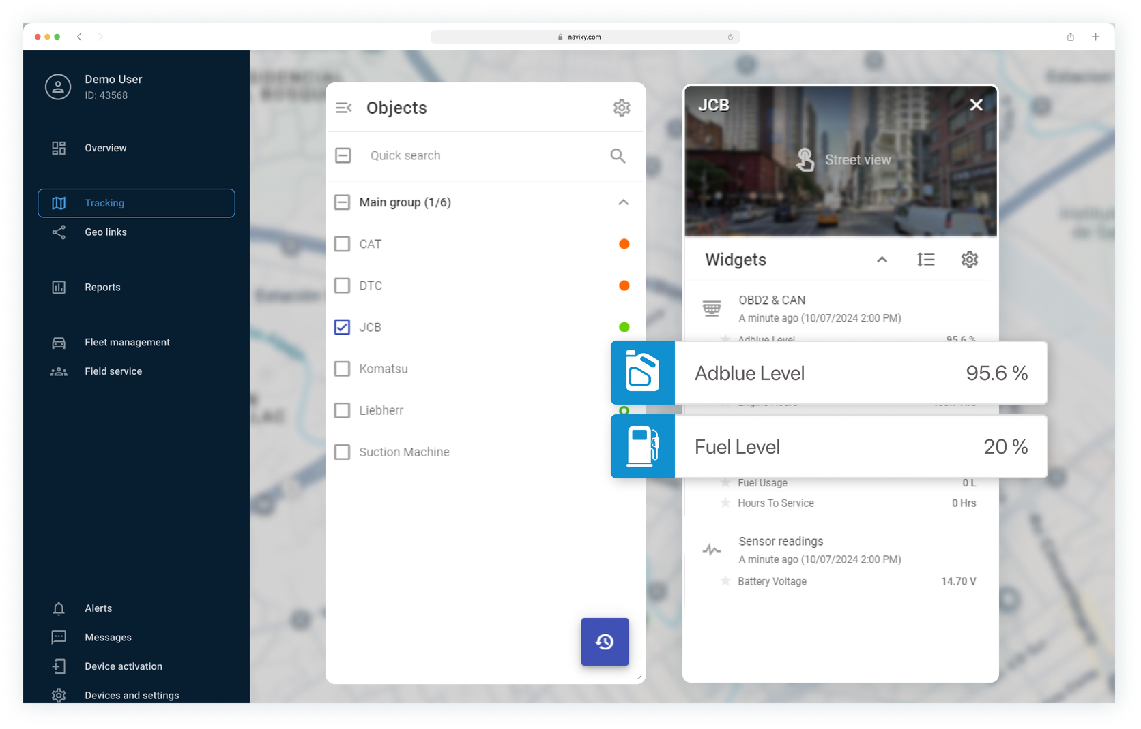
Heavy machinery
Fuel and emissions
management
Compliance and efficiency
Adblue level monitoring: ensure emissions compliance
Example: Adblue level at 95.6%
Fuel level tracking: prevent operational interruptions by refueling in advance
Example: Fuel level at 20%
Notes:
Fuel and emissions management
As industries become more environmentally conscious, staying compliant with emissions regulations is crucial. Navixy helps by tracking fuel consumption and AdBlue levels, ensuring that your machines meet required standards without any extra hassle.

Slide 7
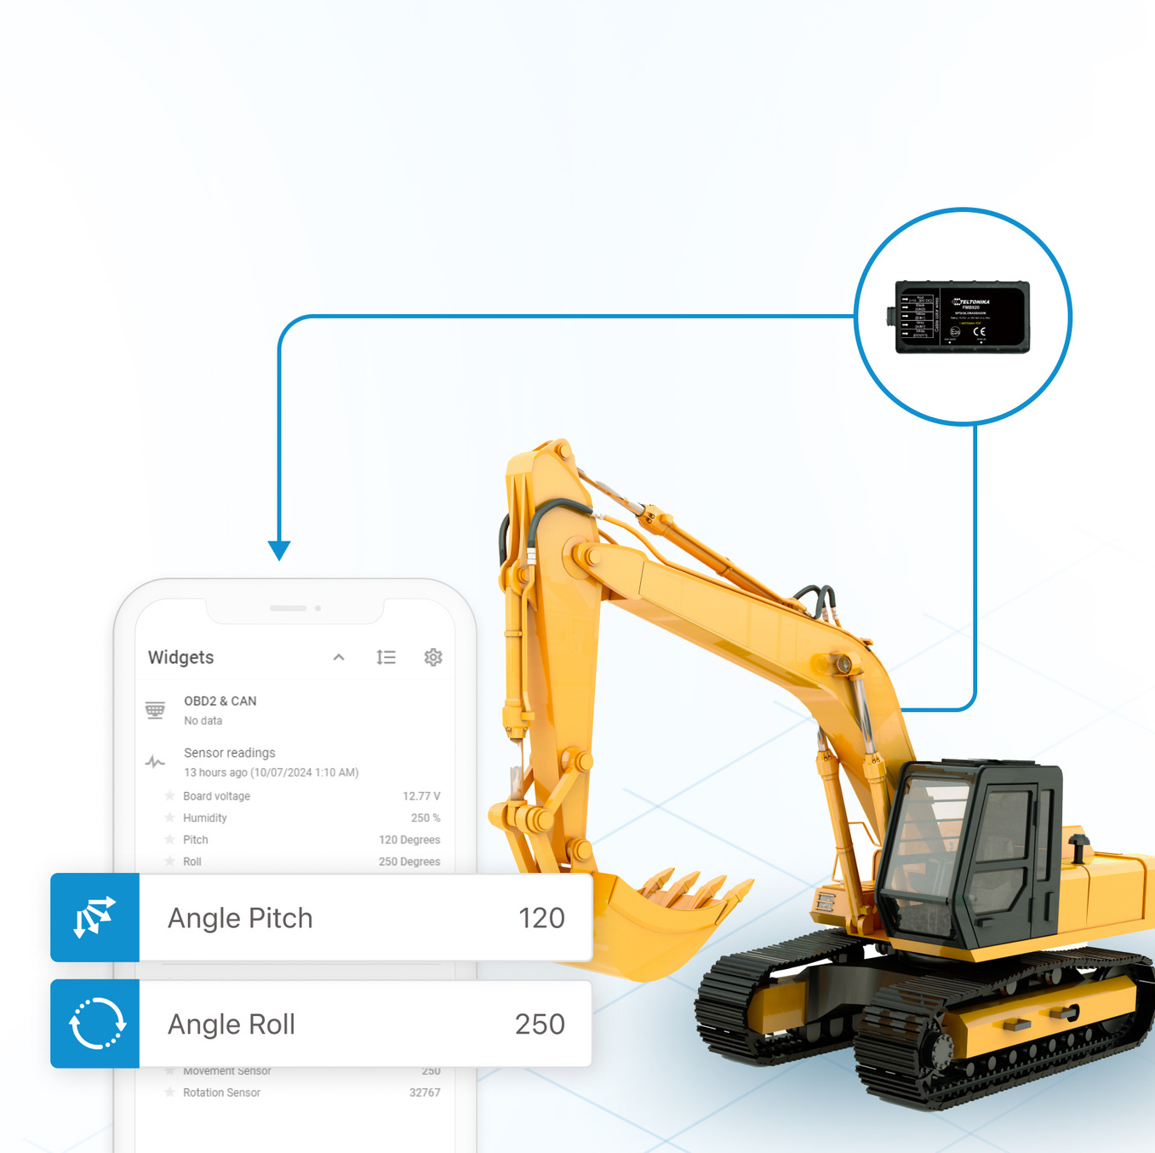
Heavy machinery
Monitoring equipment
position and safety
Ensuring safe operation
Boom angle & tilt monitoring: track the position of machinery components to detect abnormal values to prevent accidents
Movement and rotation sensors: monitor machinery use and ensure safe operation
Example: "Liebherr" machine reports rotation sensor readings
Notes:
Safety and environmental monitoring
Finally, Navixy ensures safety across all operations by monitoring critical machine parameters like boom angles and tilt positions. If a machine is operating under unsafe conditions, you’ll be the first to know, allowing you to take immediate action to prevent accidents.

Slide 8

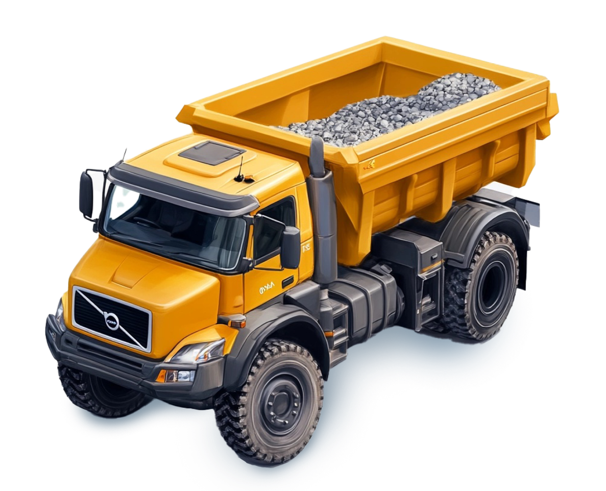



Heavy machinery
Benefits of Navixy for
heavy machinery
Reduce operating costs
Prevent downtime with early issue detection
Diagnostics and fault detection
Ensure safety through real-time monitoring
Ensure safety through real-time monitoring
Notes:
Navixy provides an all-in-one solution that enables smarter decision-making, higher efficiency, and lower operational costs for heavy machinery operations.
With real-time insights and comprehensive data tracking, you’re equipped to tackle both everyday challenges and long-term goals."

Slide 9




Learn more about Navixy
Opportunities for your Business
Technical side of our platform
Explore blog
Learn more
Thanks for your attention!

