Slide 1
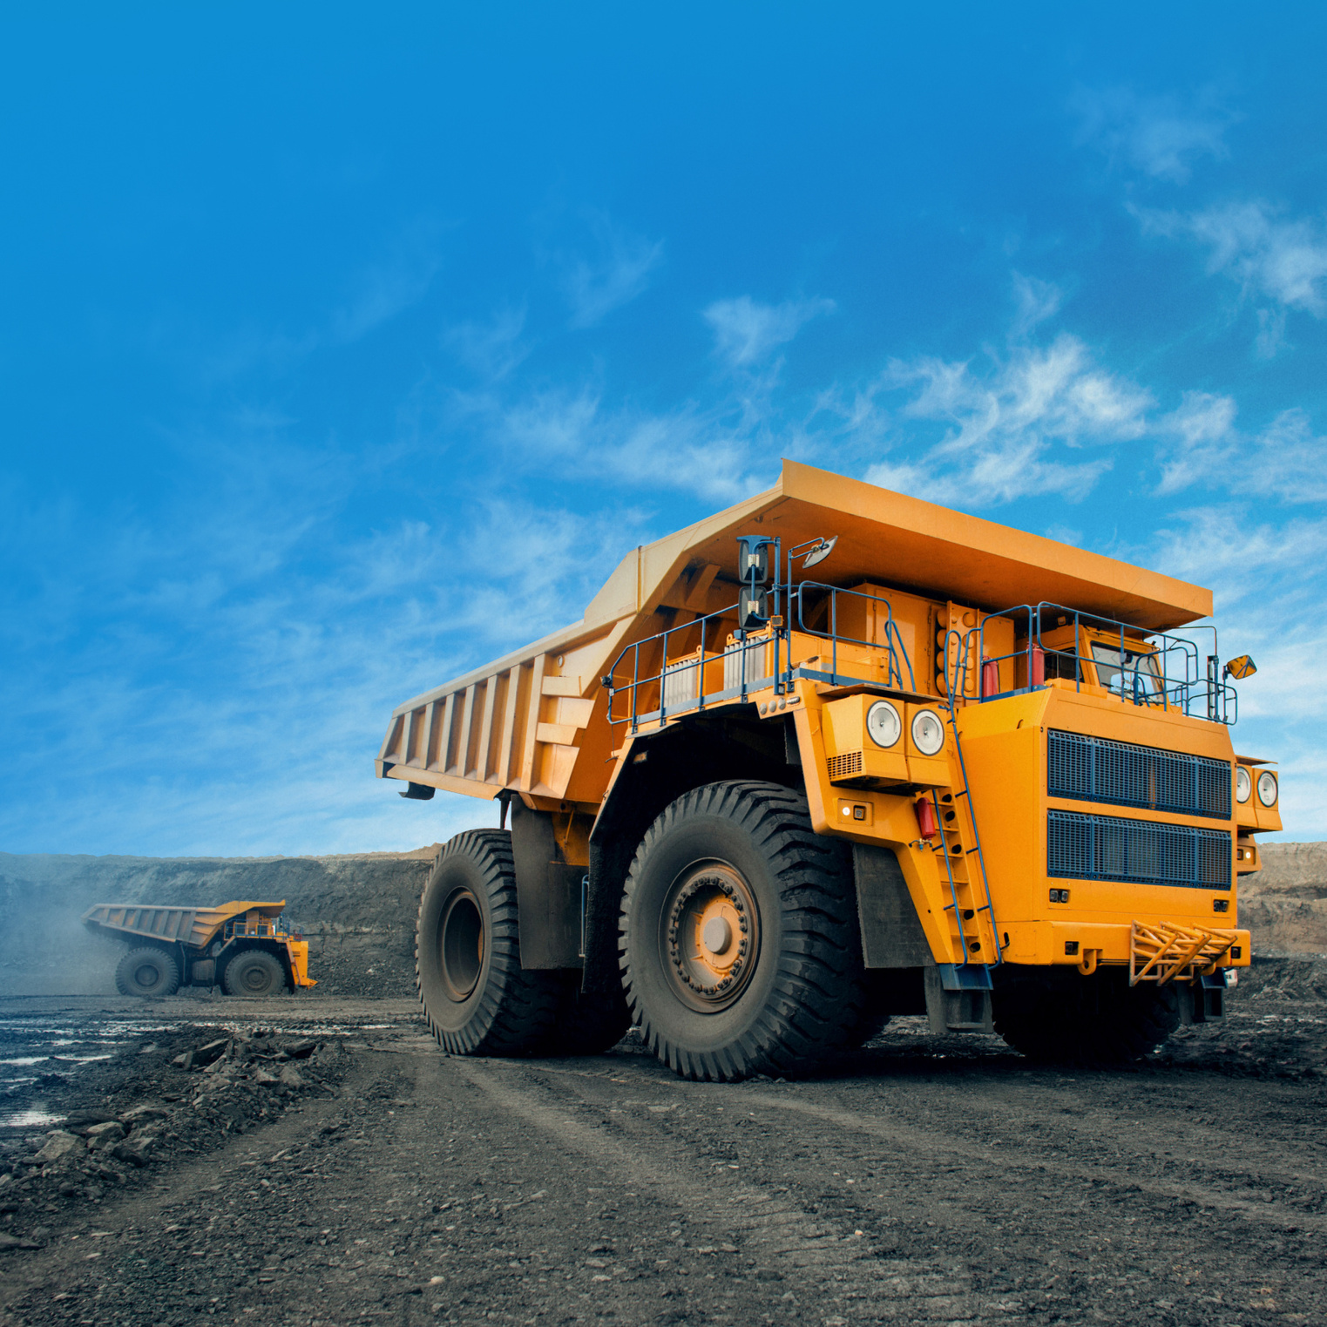

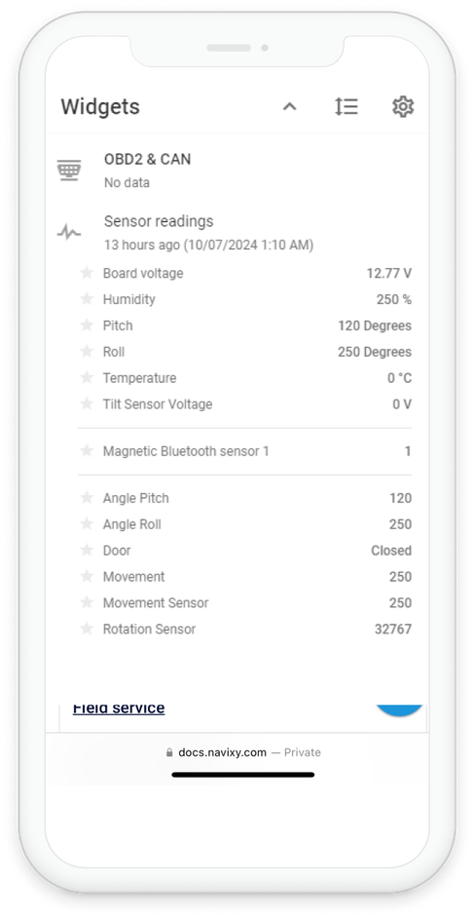
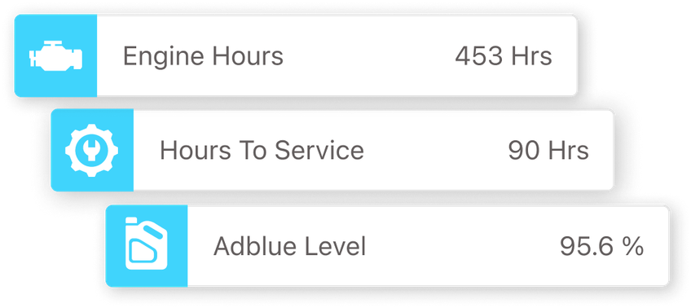
How to increase efficiency
of Heavy machinery telematics?

Slide 2


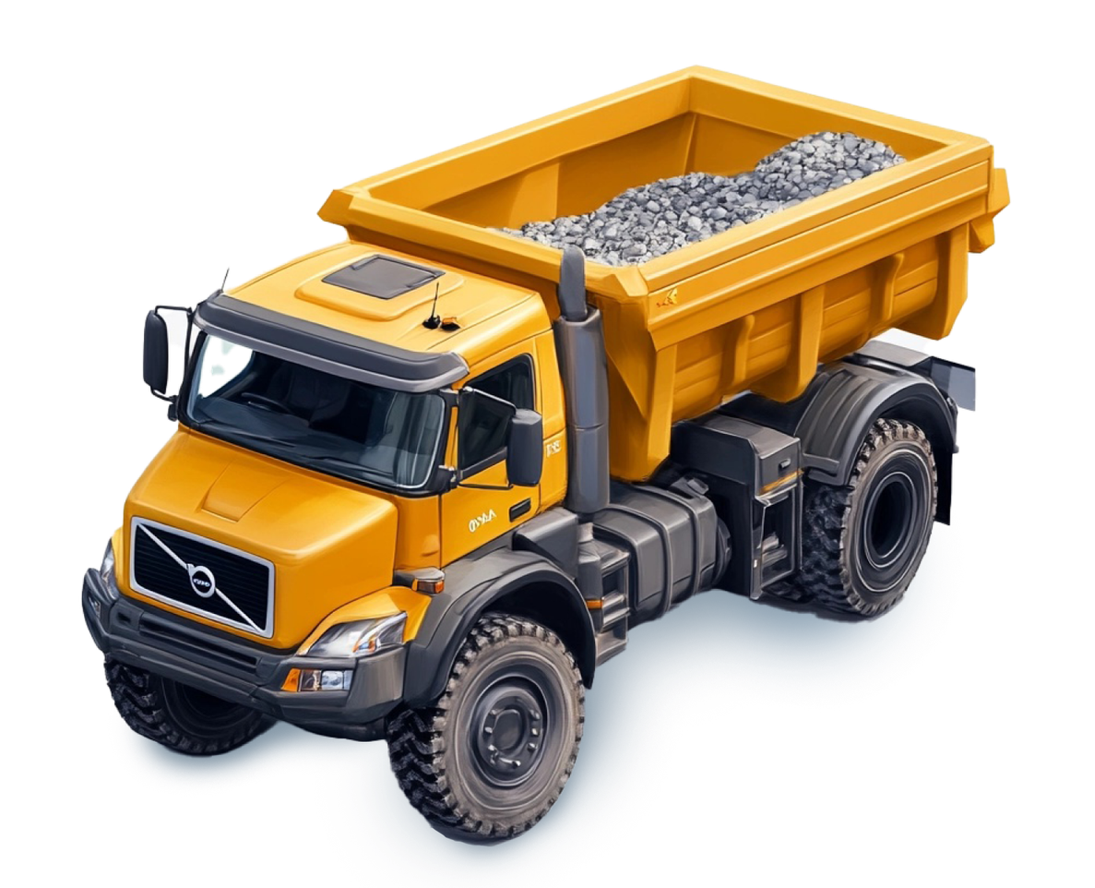



Navixy’s key features
and benefits for heavy machinery:
Comprehensive equipment monitoring
Maintenance planning and efficiency
Diagnostics and fault detection
Fuel and emissions management
Safety and environmental monitoring

Slide 3

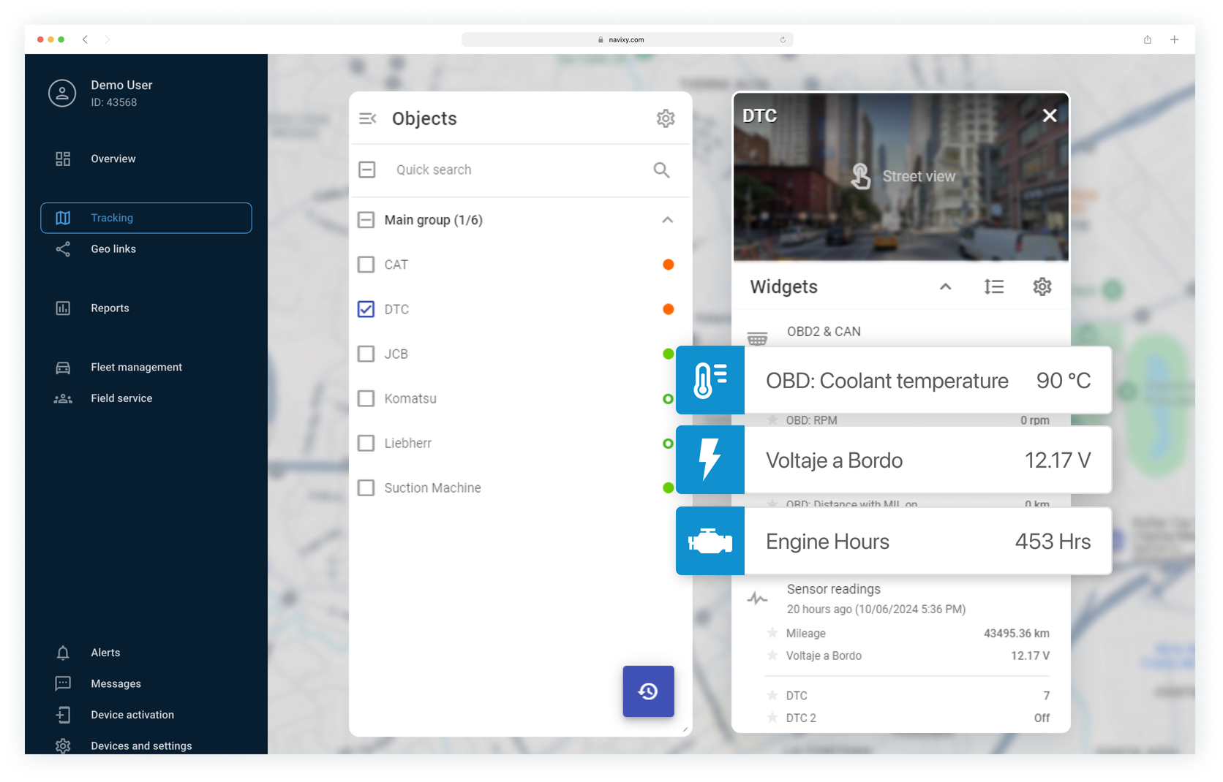

Comprehensive real-time equipment monitoring
Coolant temperature
& battery voltage:
Engine hours:
track total engine hours for maintenance scheduling
monitor critical metrics to prevent damage
Example: "JCB" machine has run for 453 hours, coolant at 90°C, battery at 12.17 V

Slide 4
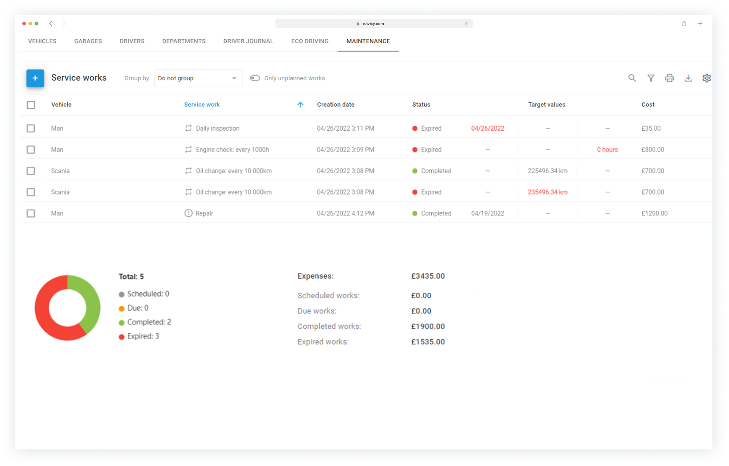
Maintenance planning
and efficiency
1.
Track engine hours
2.
Service intervals:
to schedule servicing
plan maintenance to avoid disruptions
Example: "JCB" machine logs 453 hours, 90 hours left until next service

Slide 5
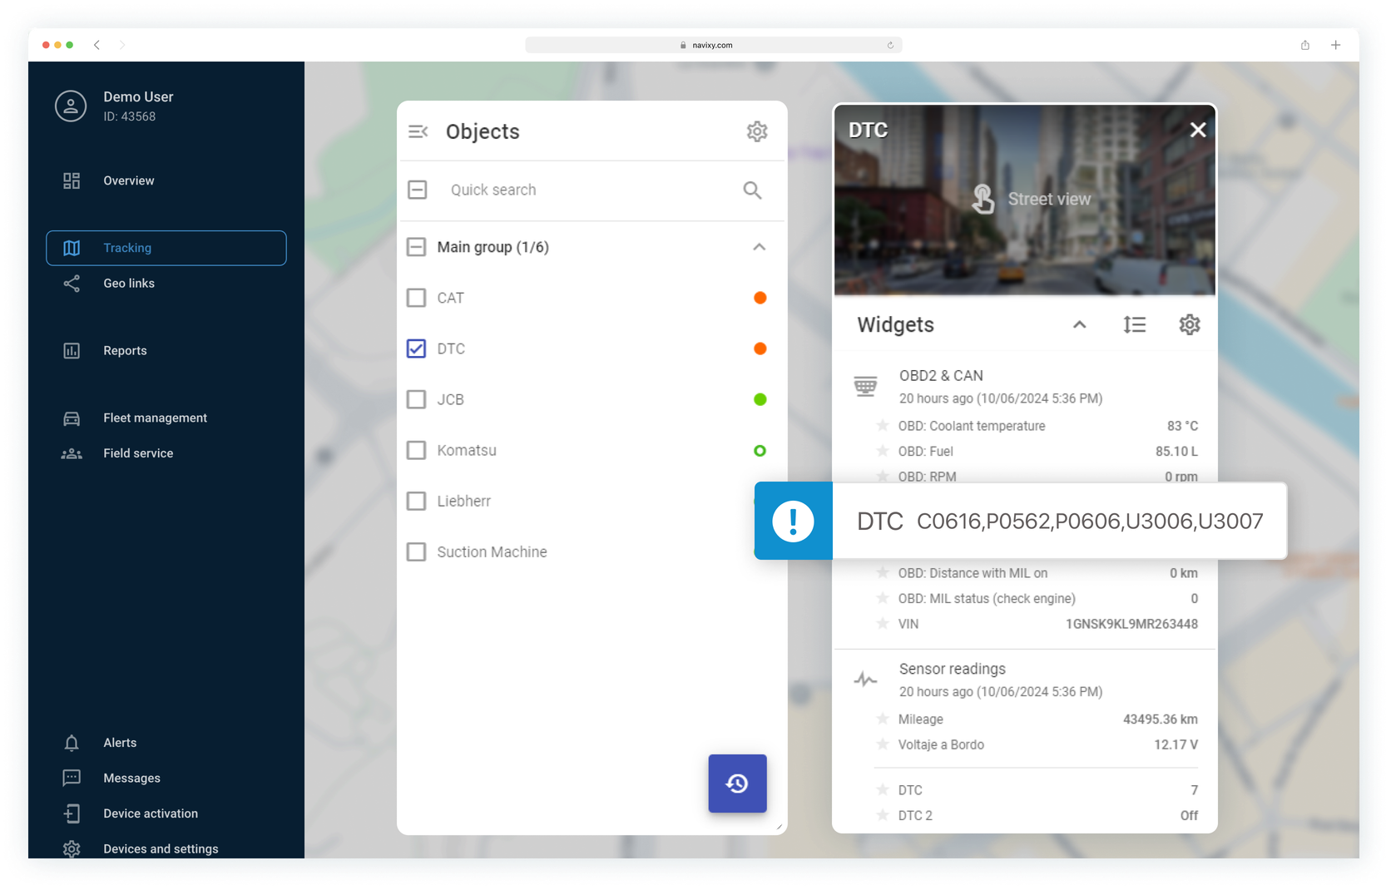
Diagnostics and early
fault detection
Diagnostic trouble codes:
help technicians to diagnose and resolve issues.
Example: "DTC" machine reports C0616, P0562, U3006 codes

Slide 6
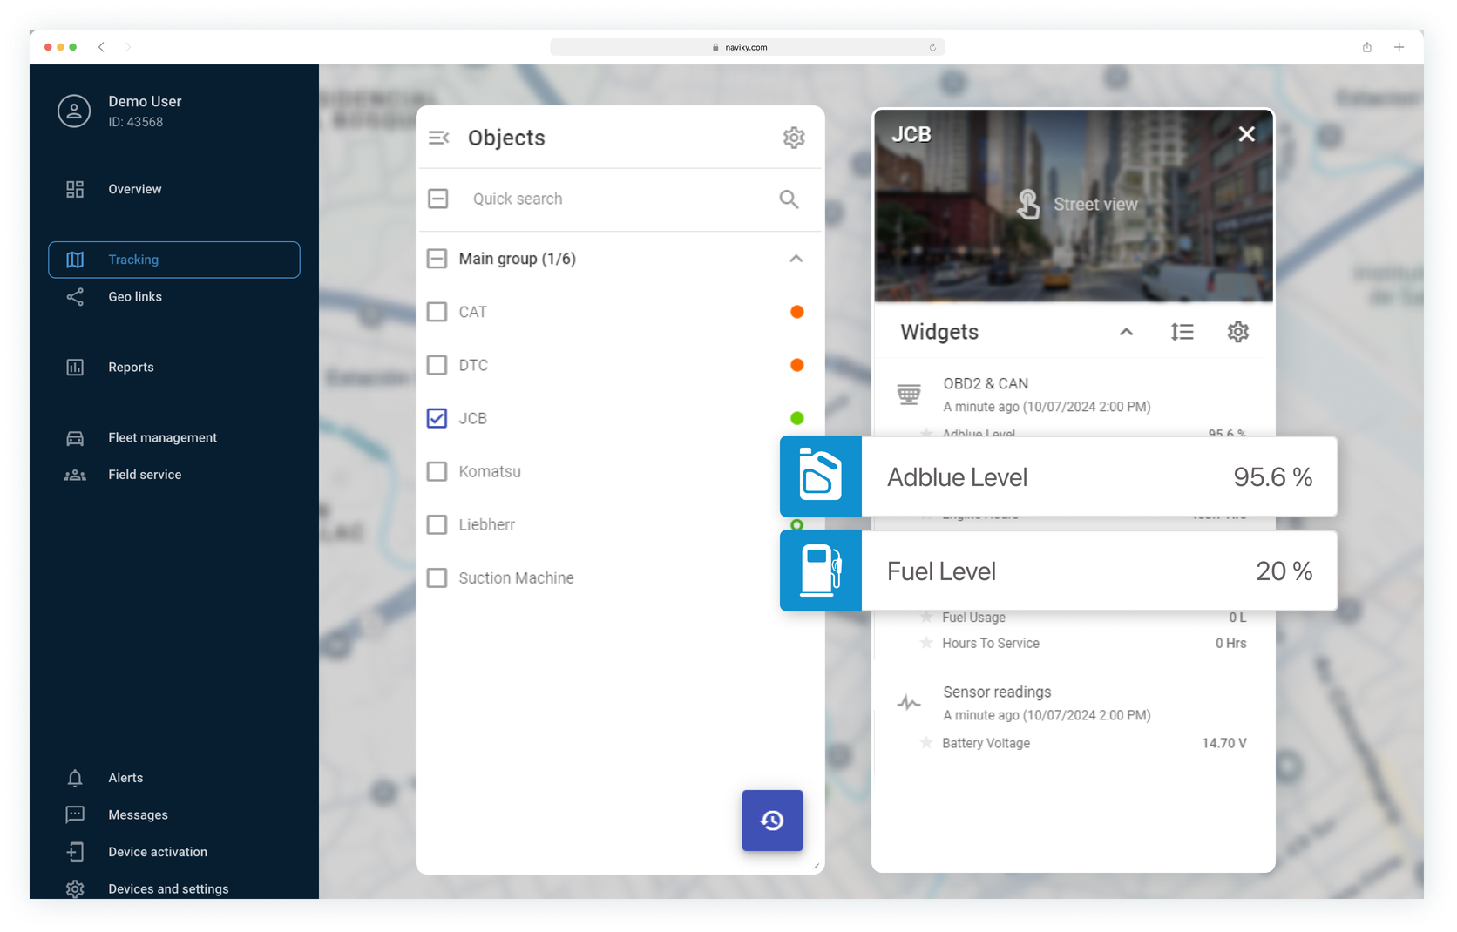
Fuel and emissions
management
Adblue level monitoring:
Fuel level tracking:
ensure emissions compliance
prevent operational interruptions by refueling in advance
Example: Adblue level at 95.6%, Fuel level at 20%

Slide 7
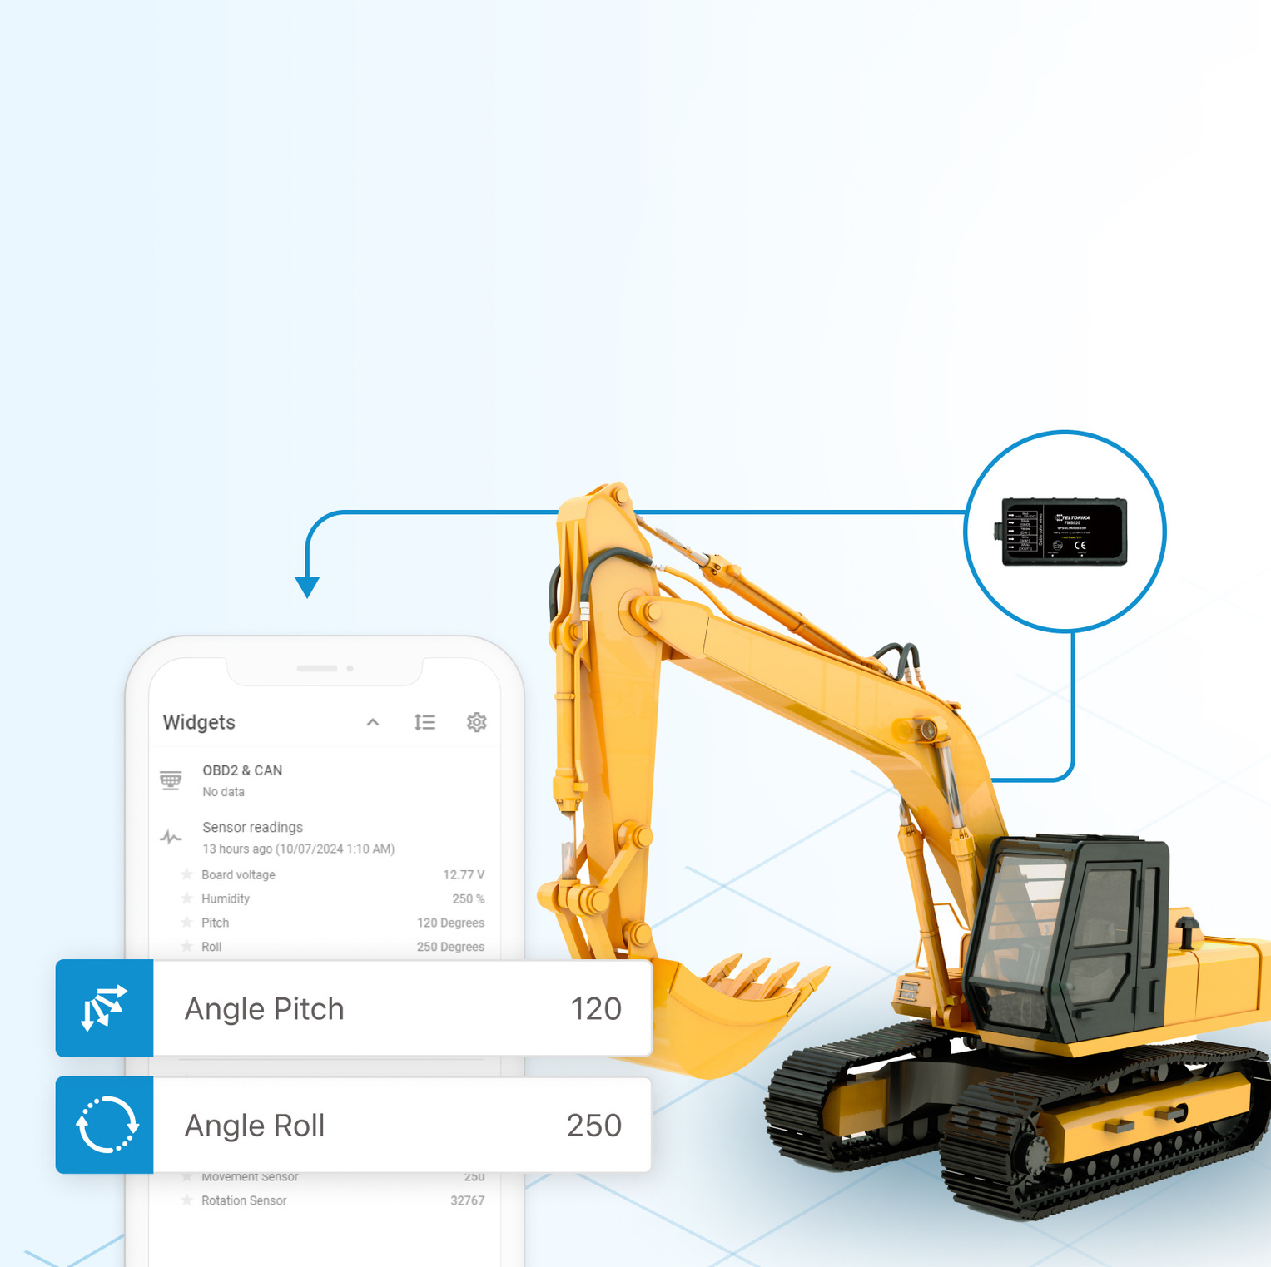
Monitoring equipment
position and safety
Example: "Liebherr" machine reports rotation sensor readings
Boom angle & tilt monitoring:
Movement and rotation sensors:
track the position of machinery components to detect abnormal values to prevent accidents
monitor machinery use and ensure safe operation

Slide 8
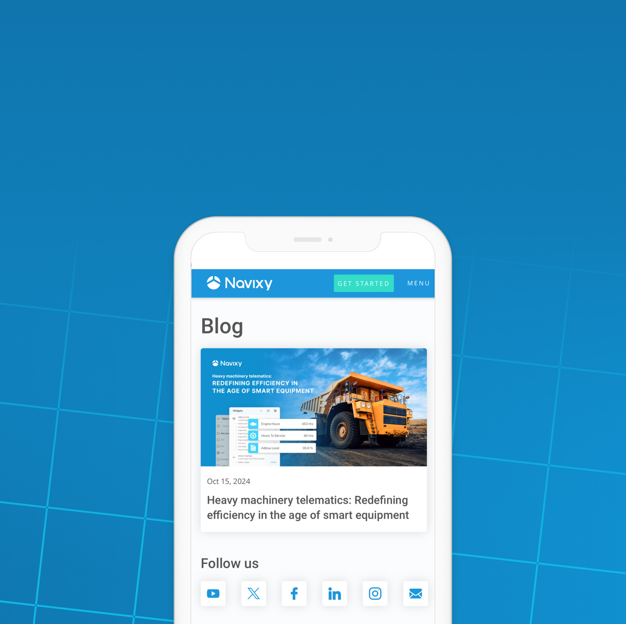
Read the full article
on our blog post

