Slide 1



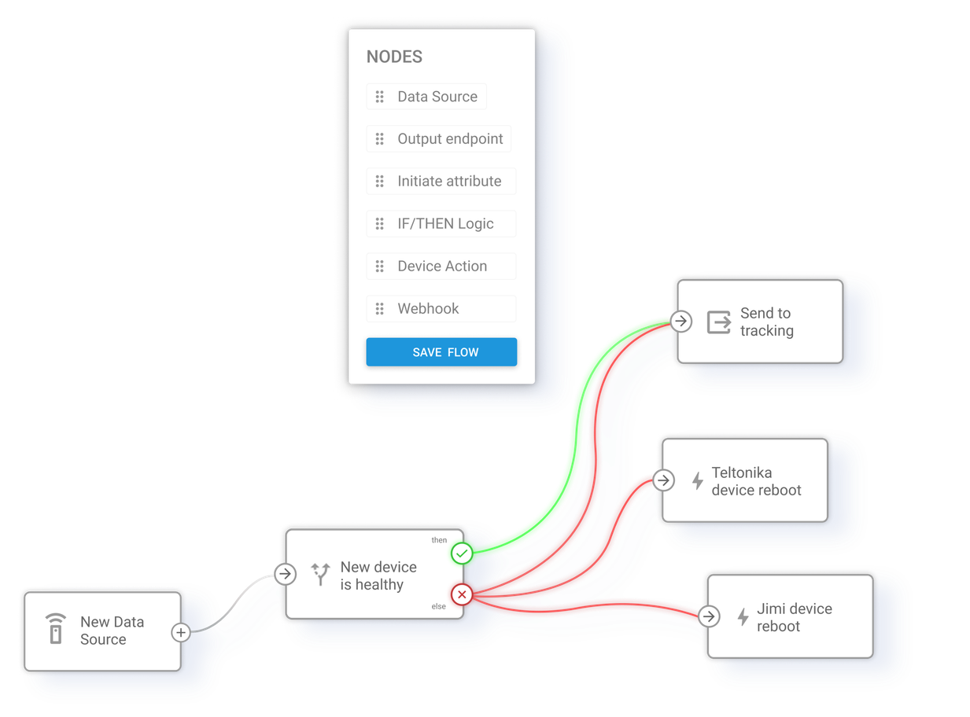








IoT Logic:
smarter telematics automation
Automate business operations, reduce engineering effort, and deliver real-time insights, reliability, and better asset performance.
Build custom telematics solutions
on top of IoT Logic tools
Connect telemetry from virtually any source
Trigger actions across devices
and external systems
(Data Source node)
(Device Action & Webhook nodes)
Receive and decode telemetry from GPS devices, OEM platforms, sensors, MQTT streams, and third-party systems inside a unified workflow.
Execute remote hardware commands, switch outputs, and send real-time events to APIs, cloud platforms, and business systems.
Turn raw telemetry into operational data
Route processed telemetry where it is needed
(Initiate Attribute node)
(Output Endpoint & Webhook nodes)
Normalize values, calculate metrics, decode sensor data, and create custom attributes using configurable transformation logic.
Deliver transformed data to Navixy, MQTT brokers, analytics platforms, and connected operational systems.
Automate decisions and operational logic in real time
JEXL-based formulas for custom calculations and data transformations
(IF/THEN Logic node)
Flow Inspector for real-time telemetry validation and troubleshooting
Build conditional workflows with branching logic, thresholds, and geozone-aware conditions for automated operational control.

Slide 2


Deploy custom telematics
workflows in minutes
with drag-and-drop simplicity
Use cases
Device health monitoring
(Data Source + Logic Node)
Automatically flag malfunctioning GPS devices, based on your criteria (weak signal, low battery, outdated status). Cuts support tickets and improves SLA compliance.
Define what matters
Select the telemetry, sensors, and business metrics you want to monitor.
Predictive maintenance
(Data Source + Initiate Attribute Node + Logic Node + Webhook Node)
Set your conditions
Monitor CAN-bus parameters, fault codes, and vehicle health indicators in real time. Automatically create maintenance tickets in external systems such as HubSpot, ServiceNow, or internal service platforms before issues lead to downtime.
Create rules based on location, sensors, device status, thresholds, and more.
Automate responses
Cold-chain protection
Trigger device commands, alerts, or actions in external systems.
(Logic Node + Action Node)
Monitor trailer temperature and instantly activate cooling systems when thresholds are exceeded, preventing cargo spoilage.
Share the results
Data compliance in one workflow
Send data to Navixy, cloud platforms, analytics tools, or business applications.
(Output Endpoint Node +
Initiate Attribute Node)
Send enriched data simultaneously
to multiple destinations, like Navixy, ERPs, and government compliance systems.
Kick-start automation with ready-to-use
flow templates
Device control in bulk
(Logic Node + Action Node)
Bulk commands (e.g., enable heaters across all EVs during a cold snap) executed in seconds, ensuring consistent fleet-wide response.
Select a template and adapt it to your devices and systems.
Learn more
Navixy IoT Logic documentation
Ready to see it in your data flows?
Contact your Navixy representative for a quick demo and start building smarter automations today

