Slide 1



Your data, your rules

Slide 2





Does your telematics data actually work for your needs?
You want:
consistent data across your business
metrics that match how your business measures performance
detect issues like fuel loss, idle time, or misuse automatically
data to trigger actions, not just appear in dashboards
it to be connected to your existing systems, not isolated

Slide 3


Why do you need IoT Logic?

Slide 4
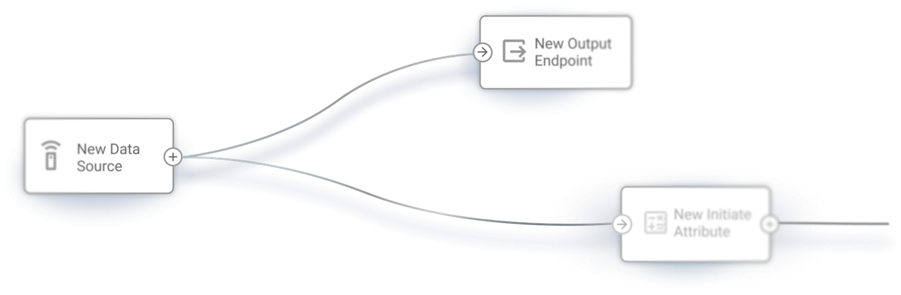
You already have the data. Now make it work your way
IoT Logic is a data processing and automation tool inside Navixy that works with data from any connected devices and systems, standardizes it,
applies business logic, and triggers actions or integrations in real time.
Act on data in real time instead of relying on reports
Reduce reliance on engineering and custom integrations
Launch new automations in hours, not months
Move from monitoring data to controlling outcomes
Get your data ready for analytics, automation,
and AI-driven use cases

Slide 5
Examples of IoT Logic in real-world operations
Device performance
Mass device control
Vehicle diagnostics
Detect low battery, connectivity issues, or offline devices
and automatically trigger alerts
or corrective actions such
as device reboot.
Automatically trigger outputs
or commands across your entire fleet.
For example, stop an engine
if a trailer is disconnected while
the vehicle is moving.
Monitor vehicle health parameters using CAN bus data (motor, refrigerant, DTCs) in real time.
Detect failures early, reduce downtime, and extend asset lifespan.
Cold chain protection
Automated driver alerts
Compliance & reporting
Monitor trailer temperature
and automatically activate refrigeration systems when thresholds are exceeded, preventing cargo spoilage.
Automatically notify drivers
when unsafe conditions occur.
For example, trigger an in-cab alert when tire pressure goes outside
the safe range.
Send enriched data simultaneously
to multiple destinations such as ERP systems or government platforms.
For example, automate billing based
on real-time odometer data.

Slide 6
How workflow automation is built in IoT Logic
IoT Logic uses a visual builder where workflows are created by connecting nodes into a flow. Each node represents a step in how your data is processed and acted on.

Slide 7



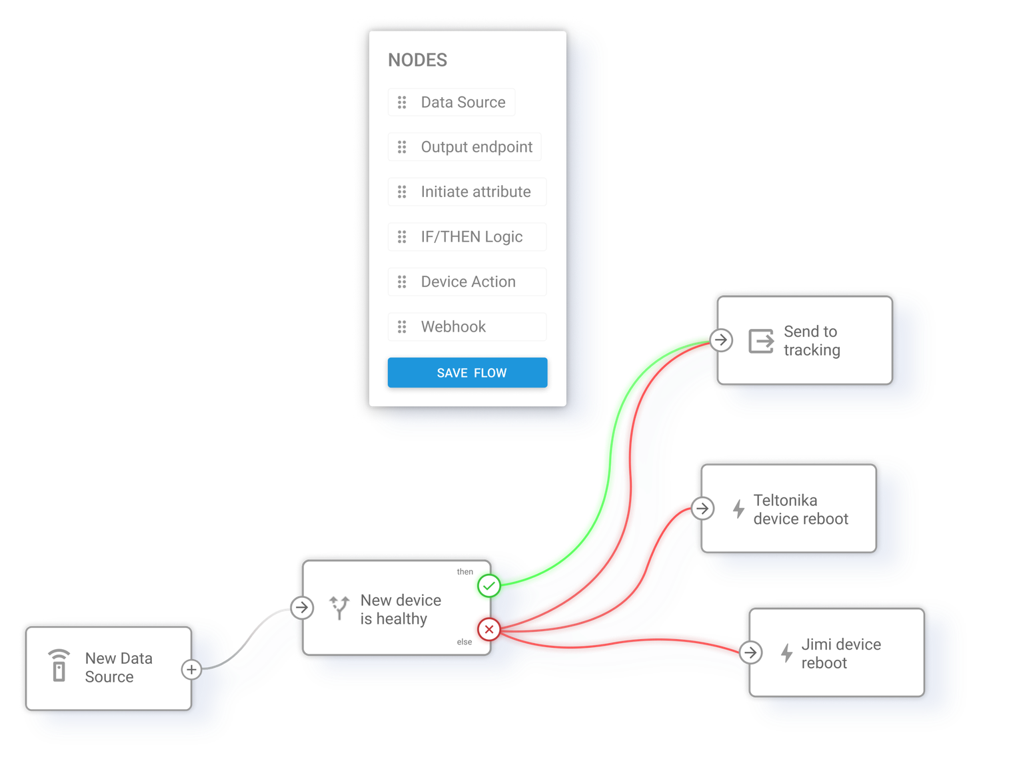
  Data Source: select the data to enter the flow
  Output Endpoint: route processed data to Navixy or external systems
  Initiate Attribute: transform and calculate data using formulas
  IF/THEN Logic: define conditions and decision points
  Device Action: trigger commands and actions on devices
  Webhook: send data to external systems via API

Slide 8
Kick-start with predefined automation templates
Device healthcheck
Metric ↔ Imperial converter
Actions in external systems
Monitor device health signals
and reboot when values fall outside set thresholds.
Trigger a webhook based on
a sample speed condition to perform external actions, adaptable to any parameter and system.
Convert telemetry units and add converted values to each data packet.
Idling detection
Driver access control
Detect prolonged idling using ignition and speed, and flag it in the data
for alerts or reporting, adaptable to any duration-based condition.
Check hardware key authorization on ignition and block the engine
with a notification if the key
is unauthorized.

Slide 9
Nodes
in IoT Logic

Slide 10

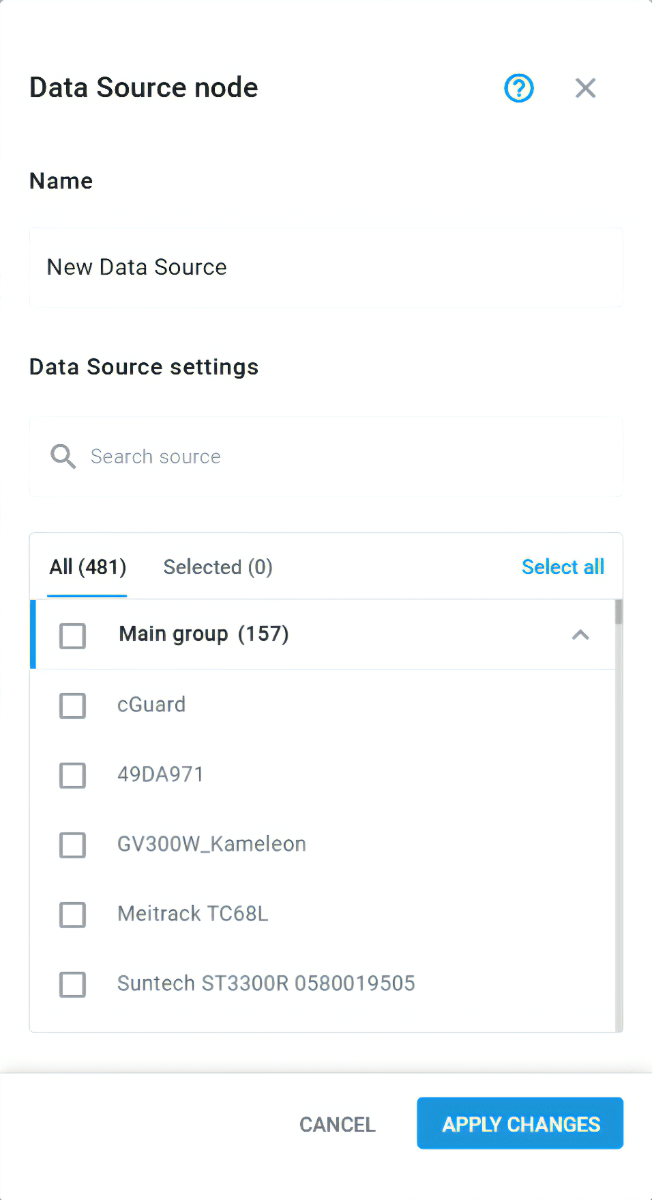
Data Source node:
Bring in data from any connected device
Define which devices, data streams, and parameters enter your workflow across fleets and regions.
Select devices, groups, or multiple assets as input
Receive full incoming data streams from selected devices
Process real-time telematics data as it arrives

Slide 11
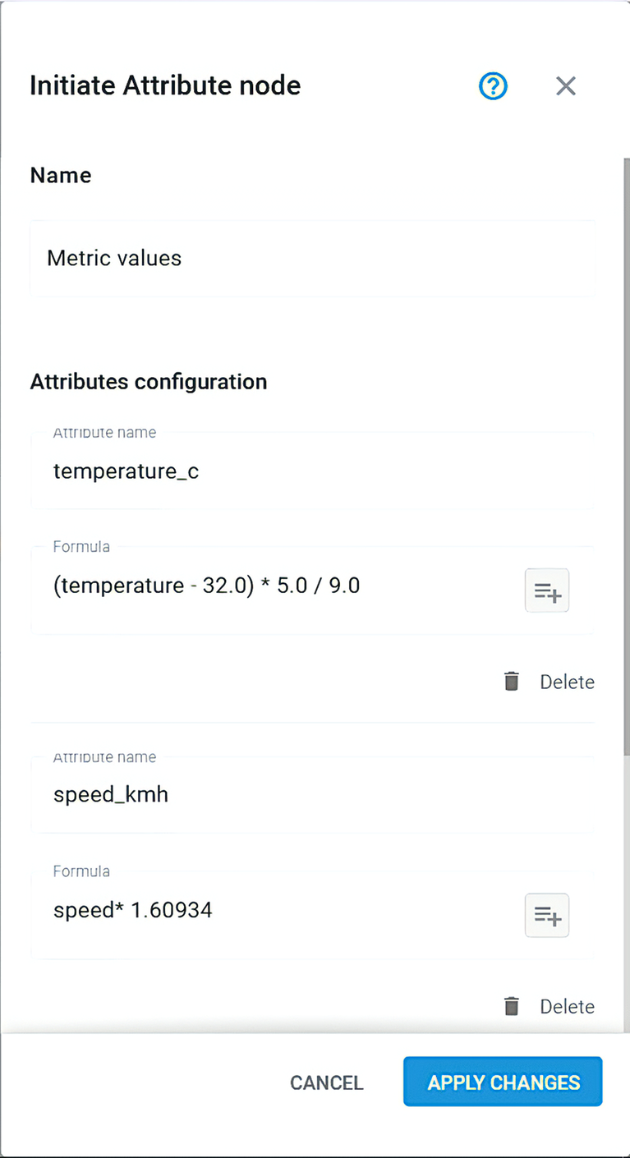
Initiate Attribute node:
Transform raw data into usable metrics
Create new attributes by transforming, calculating,
and enriching incoming data based on your business logic.
Convert units and normalize incoming data
Combine multiple parameters into new attributes and create custom sensors
Use formulas (JEXL) for custom calculations and data enrichment

Slide 12
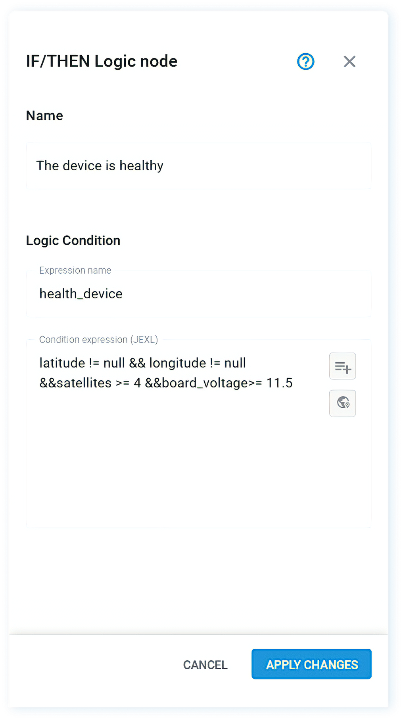
IF/THEN Logic node:
Control how data is interpreted and used
Define conditions and decision rules that determine how your workflows respond to incoming data.
Set thresholds, geozones, and complex conditional logic
Combine multiple parameters into decision rules
Route data through different paths based on conditions

Slide 13
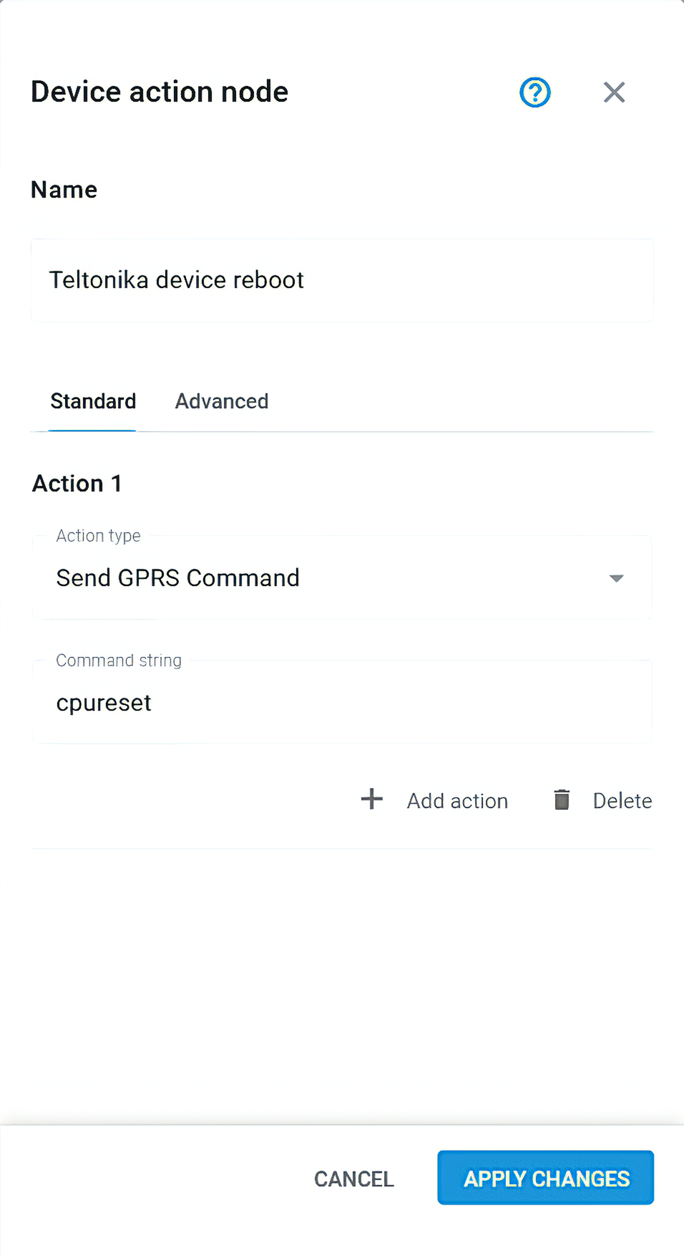
Device Action node:
Act on events automatically in real time
Send commands to devices automatically based on defined conditions, enabling real-time control without manual intervention.
Trigger actions instantly based on real-time events
Execute machine-to-machine (M2M) commands across devices
based on incoming data
Execute multiple actions within a single workflow

Slide 14
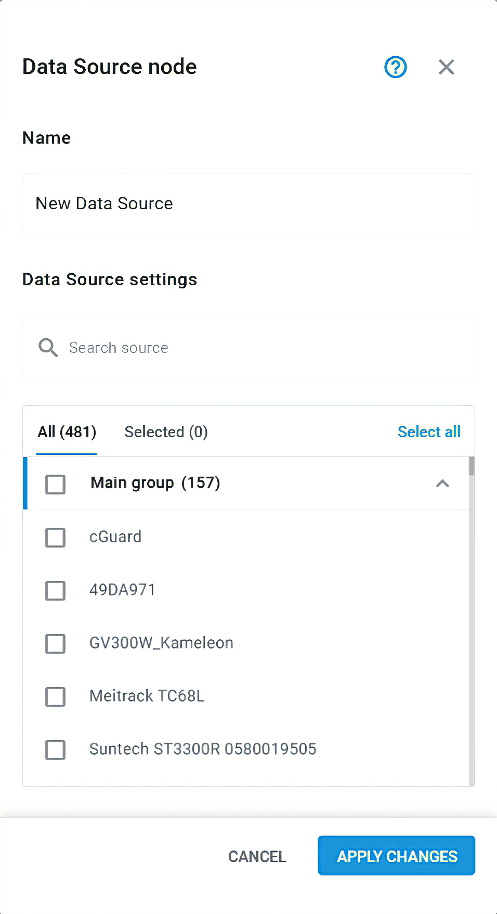
Webhook node:
Send data to external systems in real time
Push processed data to external systems and APIs as part of your workflow, enabling seamless integration with your business tools.
Send and receive data via HTTP requests (webhooks/APIs)
Customize payloads and headers based on your logic and requirements
Integrate with ERP, CRM, or custom platforms

Slide 15
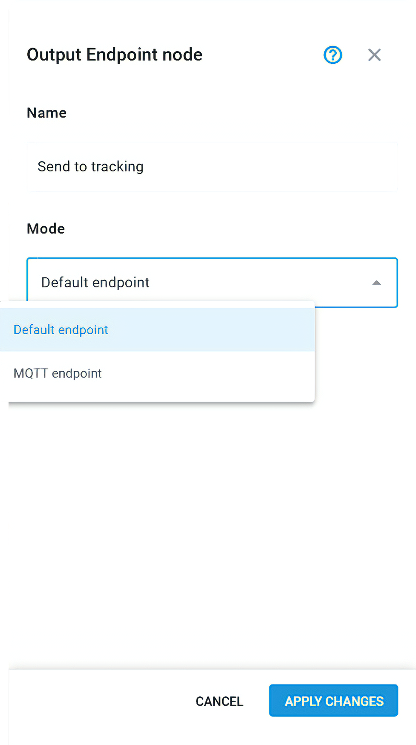
Output Endpoint node:
Deliver data wherever it’s needed
Define where processed data is delivered, whether back into Navixy or to external platforms, ensuring consistent and scalable data distribution.
Send data to multiple destinations simultaneously
Deliver data in a standardized format regardless of device type
Stream data to external systems via various protocols

Slide 16
Built for real-world use
Reusable flows you can export, share, and adapt across deployments
Formula editor with
auto-complete for faster and easier configuration
Built-in validation highlights errors and ensures flows run reliably
Works with any device through flexible
protocol support
Comprehensive documentation to support setup and scaling
AI-ready infrastructure
to support seamless data exchange with AI and analytics systems

Slide 17


Start building your own flows!
Our team is ready to help you get started
Sales:
sales@navixy.com
Support:
support@navixy.com
US/International: +1 213 786 12 80
Latin America: +52 55 85 26 18 30
Europe: +44 204 577 23 50

