Slide 1


Get API-less data solution
for telematics intelligence

Slide 2



direct SQL access
to fleet and geo data
IoT Query ensuring seamless integration with BI tools, ML models, and custom logic for enterprise fleets with 500+ assets.

Slide 3


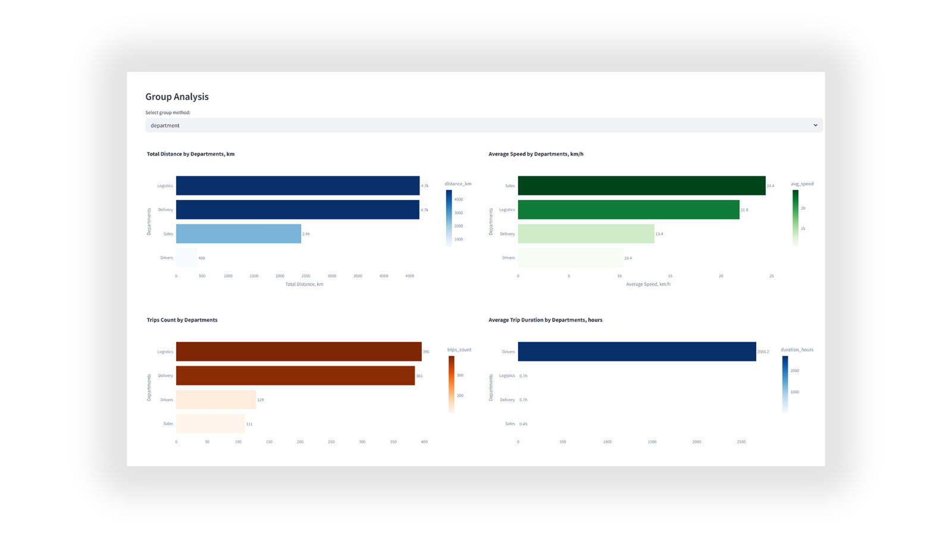

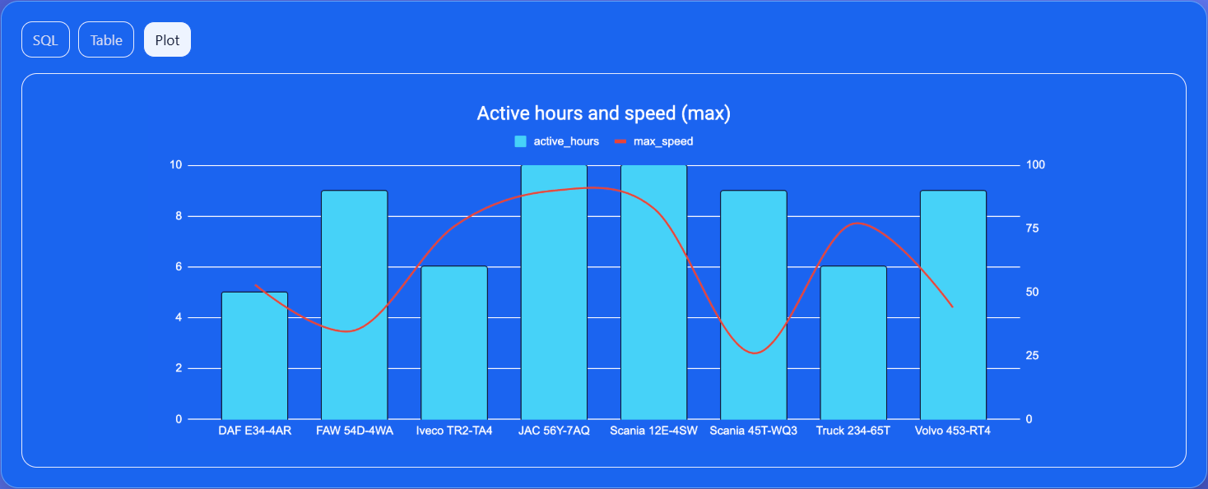
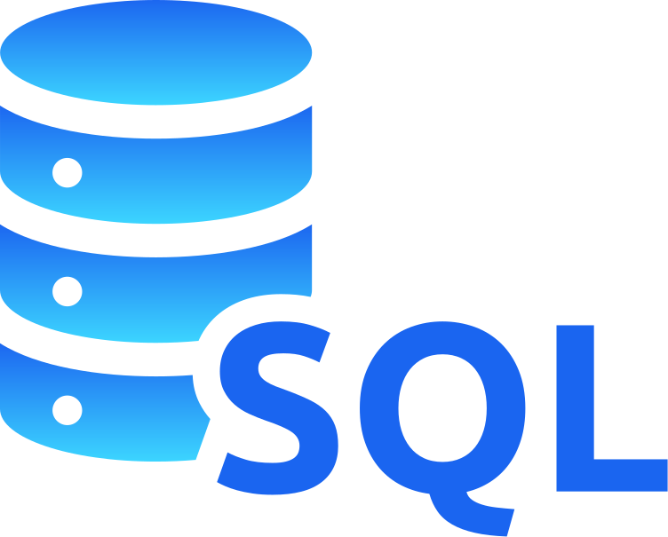


From raw SQL to table and plot
Explore your data with direct SQL
View tabular results
Visualize
information

Slide 4





Plug into the tools you already use
15 mins
to start analytics with your BI tools
No midware required!
Seamlessly connect to any
SQL-compatible BI tool.
IoT Query integrates natively
so you can start analyzing from
the day one.

Slide 5

Build smarter, not harder
70%
savings
IoT Query delivers analytics-ready data instantly, cutting data engineering overhead.
for data preparation costs
Ready-to-query data from day one
  No ingestion scripts
  No ETL jobs
  No maintenance costs

Slide 6
Eliminate API bottlenecks
x5
Say goodbye to rate limits, throttling, and delays.
With direct SQL access, queries return data retrieval, enabling
real-time insights instead of nightly batch updates.
to retrieve data within SQL
faster

Slide 7
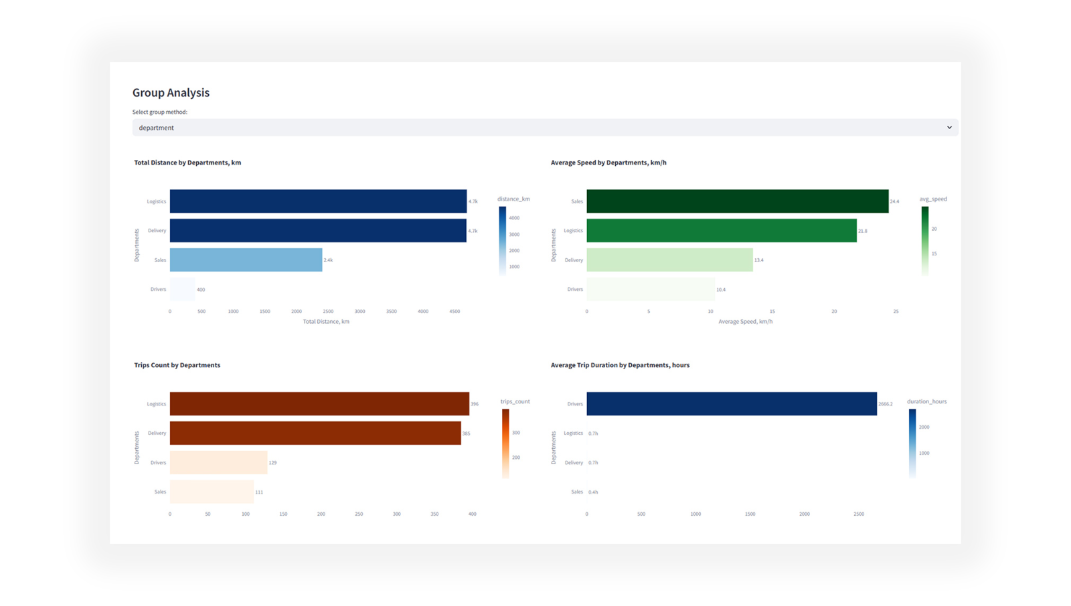
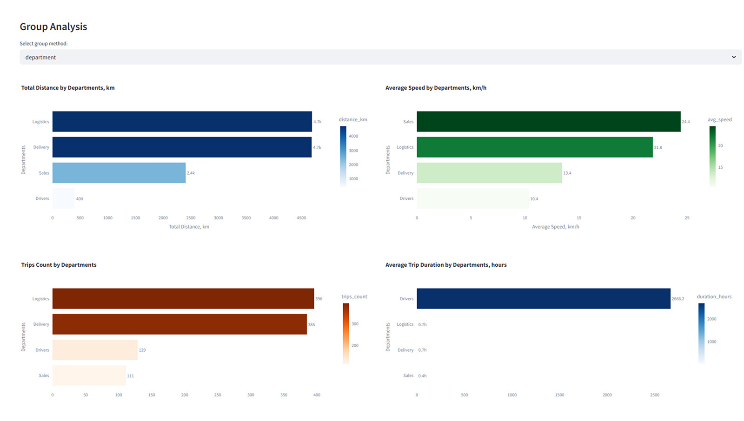
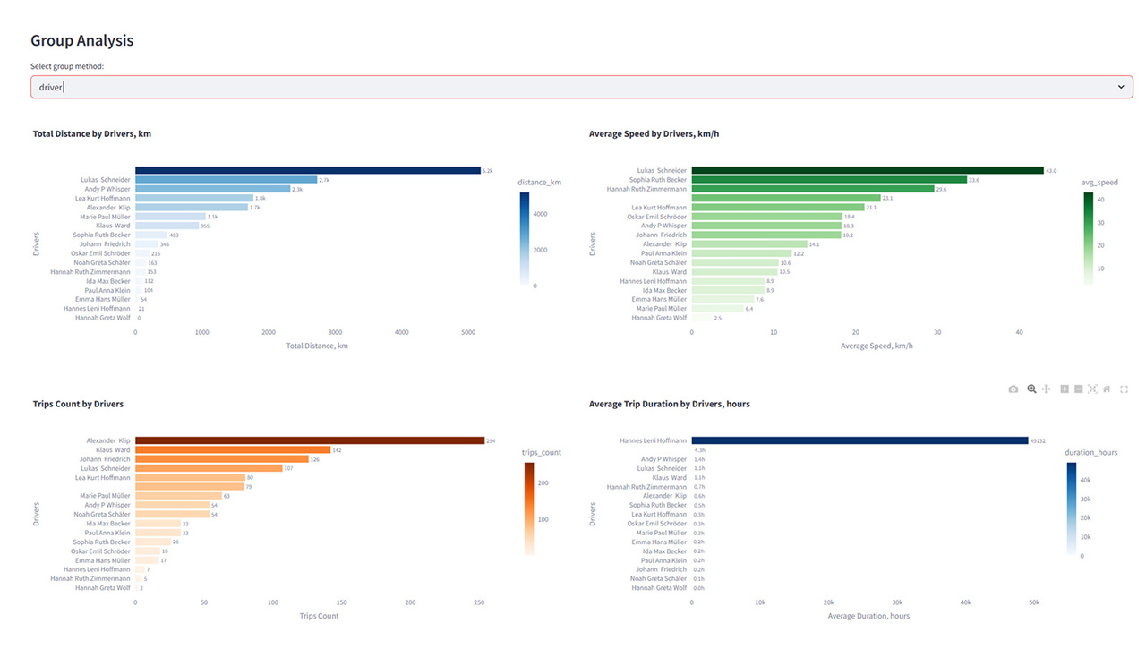

Embed and extend
30% more
Enable your users to explore data interactively while your engineers stay focused on application development.
engagement with customers
Embed dashboards and analytics directly into your product or internal portals.

Slide 8
What you can gain
with IoT Query
FULL CUSTOMIZATION
CONSOLIDATION
INTEGRATIONS
FULL ACCESS

Slide 9






Why IoT Query matters
for enterprise fleets?
Complete data access
Work with your telematics, business and meta datasets
Longitudinal storage
Access historical data for analysis and model training
Near real-time streaming
Monitor actual data for immediate insights
Client isolation
Access your own secured data environment
Structured data model
Leverage a well-organized multi-layer architecture
Cross-entities joins
Combine telematics and business data for holistic analytics

Slide 10
Choose the plan that fits your stage
Shared / Freemium
For evaluation and prototypes
  Historical data: up to 7 days
  SQL queries: fair‑use limits
(reduced concurrency & result size)
  Storage model: shared
  Streaming: not included (periodic refresh)
  Integrations: just manual SQL queries
  Support: community/email
Enterprise / Premium
For production workloads
  Historical data: 1+ month included
(extended retention available)
  SQL queries: high concurrency, large result sets
  Storage model: private storage (single‑tenant)
  Streaming: near real‑time ingestion included
  Integrations: BI/ML stack; export to CRM/ERP
  Support: SLA support
  Professional services: on demand

Slide 11
Iotquery@navixy.com
navixy.com

