Slide 1





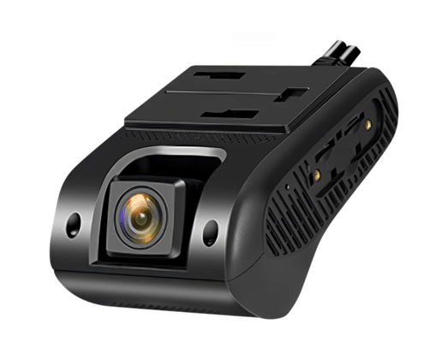
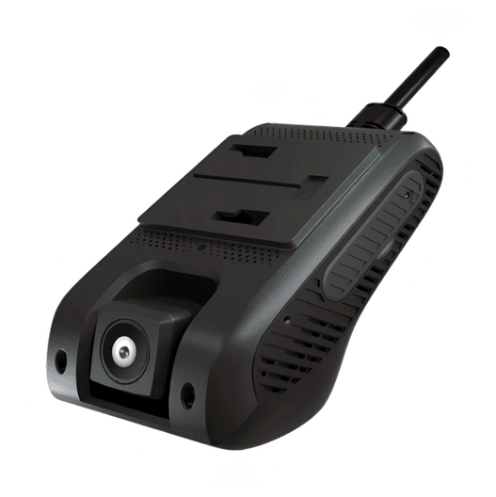



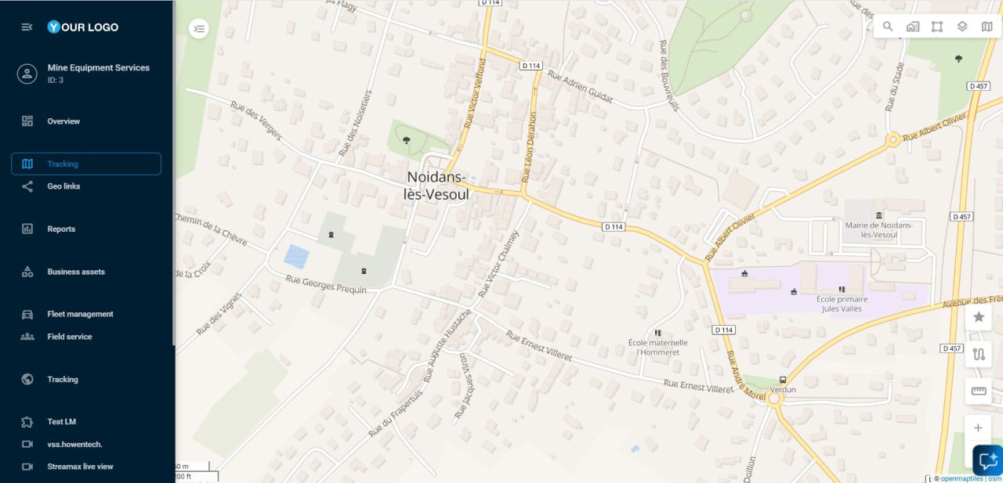
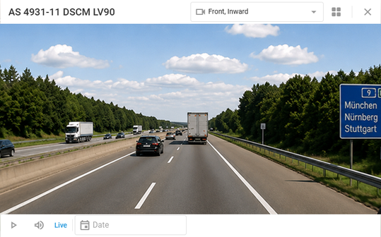

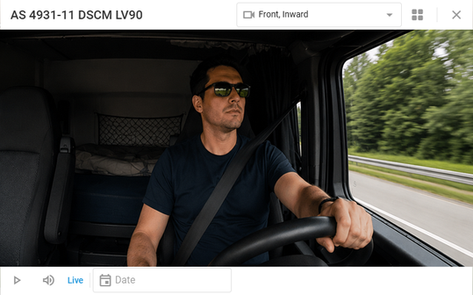
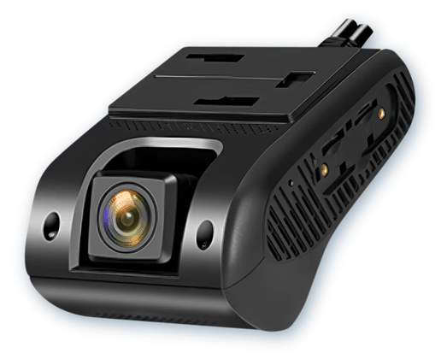
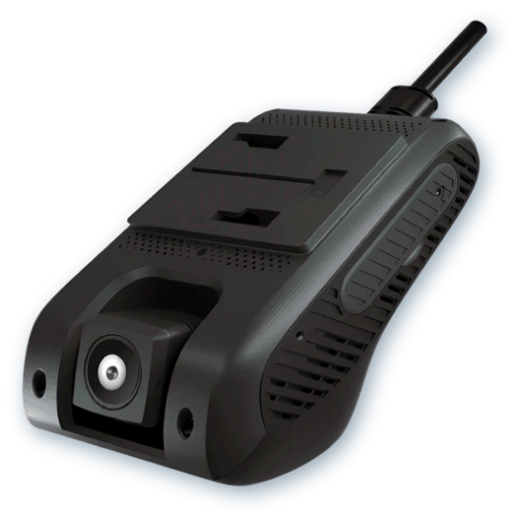
Jimi
JC261/JC400
Expand your fleet management offering
with AI-powered video telematics
Grow your business with an easy-to-sell video telematics solution.
Help customers improve fleet safety
and gain complete trip visibility with live video, recorded footage, and AI-powered driver safety events in Navixy.
Jimi
JC261P/JC400P
Everything your customers need for smarter
fleet operations
Live streaming
Video playback
Video events
Monitor road and cabin cameras in real time without leaving Navixy. Give fleet managers instant visibility into what's happening on the road.
Replay recorded footage alongside route history and vehicle location to quickly understand what happened before, during, and after an incident.
Review ADAS, DMS, car crash, SOS, and harsh driving events with automatically attached video evidence, making incident investigations and driver coaching more effective.
Choose the right dashcam for every monitoring need
Jimi JC261 | Jimi JC400
Jimi JC261P | Jimi JC400P
Road-facing dashcam with support
for an optional external camera, giving fleets the flexibility to expand coverage where needed.
Road-facing and cabin cameras integrated into a single device
for comprehensive driver and vehicle monitoring.
Ideal when
You need flexible camera placement or additional viewing angles.
Ideal when
You need built-in driver and road monitoring with minimal installation.
All four devices support automatic SMS activation in Navixy and use standard SIM and SD cards for onboard storage, making deployment quick and straightforward.

Slide 2

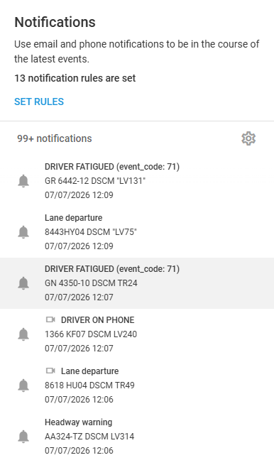
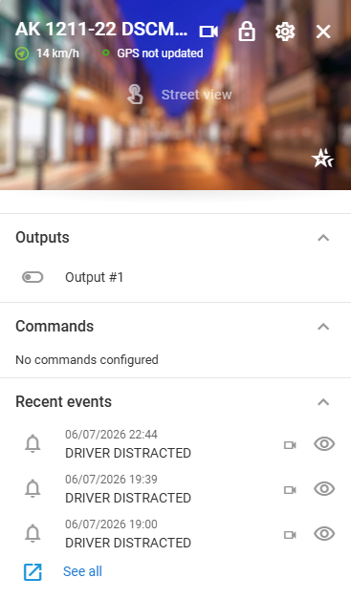





Supported ADAS/DMS events
Every event below is detected on-device and matched to a Navixy alert rule, with an attached video clip available in event history.
Event
JC261
JC261P
Category
SOS alarm
Safety
Car crash event
Safety
Harsh acceleration / braking / turning
Driving behavior
Speeding (device-detected)
Driving behavior
Fatigue driving
DMS
Yawning
DMS
Eyes closed
DMS
Distracted / head lowt
DMS
Smoking
DMS
Phone calling
DMS
No face detected
DMS
Front car collision warning
ADAS
Vehicle too close warning
ADAS
Lane deviation warning
ADAS
Why choose Navixy video telematics
Automate responses
One platform, less overhead
Offer video telematics as a premium add-on alongside GPS tracking
Deliver GPS tracking, live video, playback, and driver safety events through a single platform
Actionable safety insights
Reliable video delivery
Help customers coach drivers, investigate incidents, and support insurance claims with synchronized video evidence
The .ts video format helps preserve recorded footage even when uploads are interrupted
Fast deployment
Automatic SMS activation streamlines device provisioning and speeds up rollout
Ready to add video telematics to your offering?
Talk to your Navixy partner manager to get it enabled on your account

