Slide 1


Telematics
and asset management

Slide 2



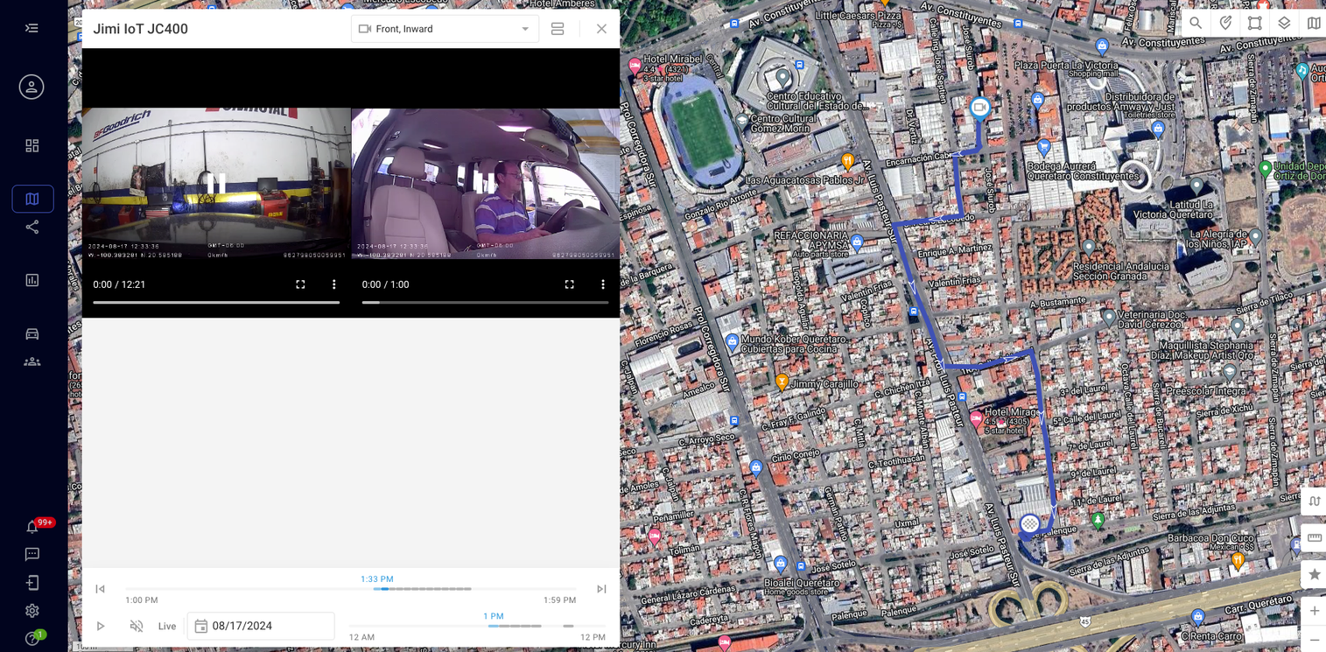



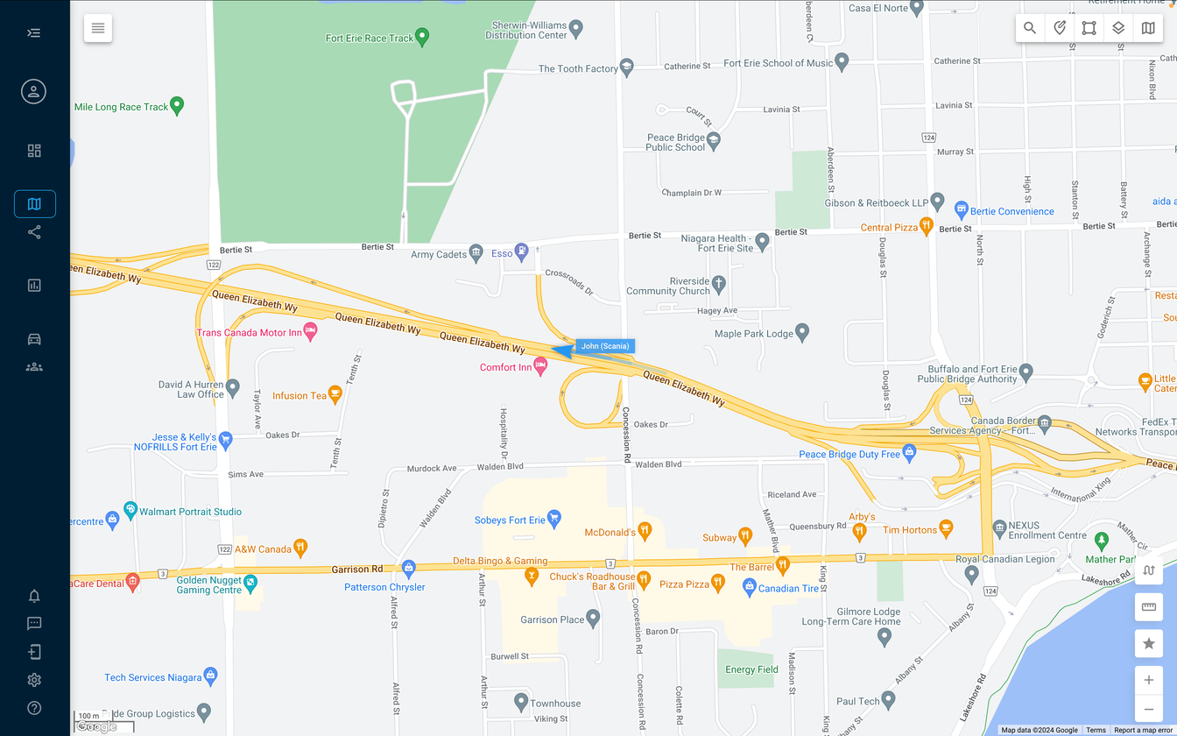
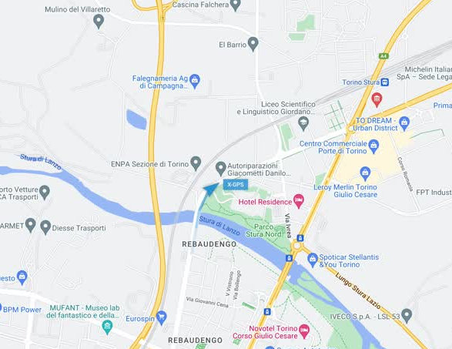

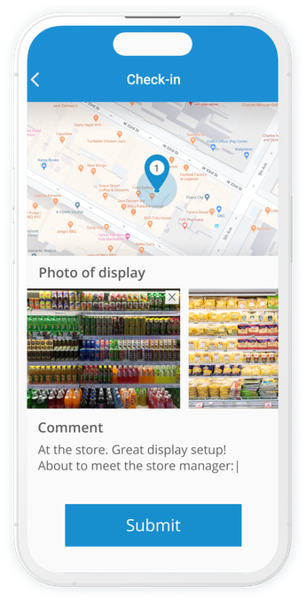
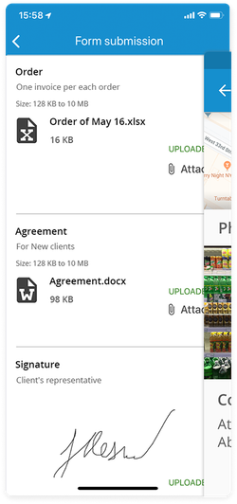
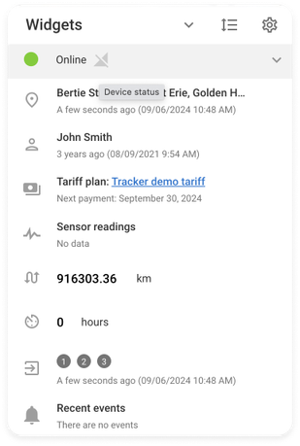

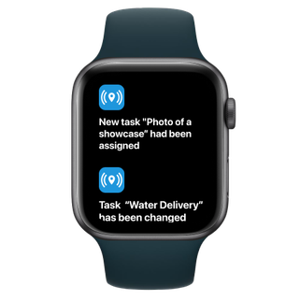


All-in-one GPS Fleet
& Asset tracking platform
Fleet Management
Asset Monitoring
Field Service
Video Telematics

Slide 3

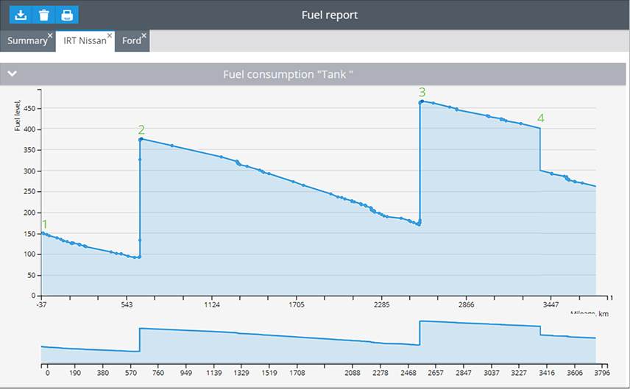

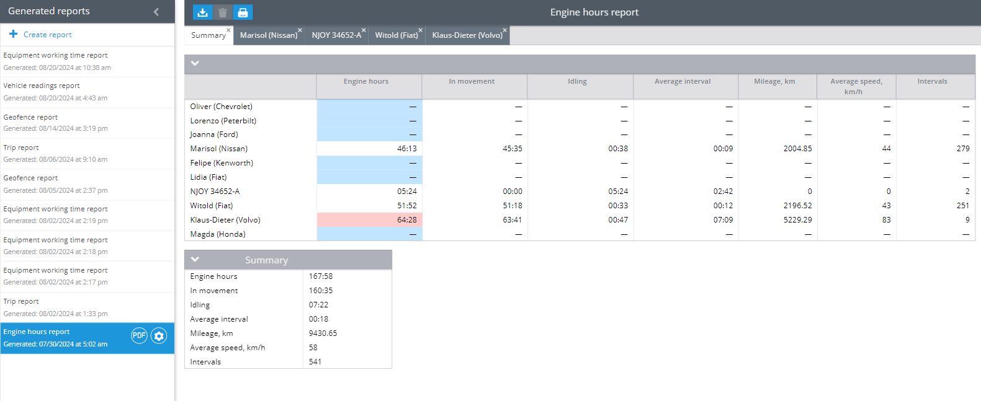
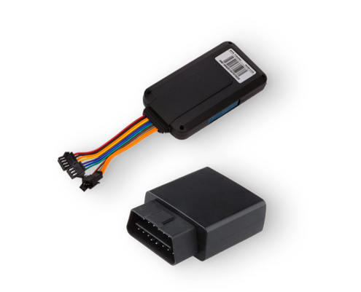
Features
Fleet management
GPS and telemetry
Road safety
Driver management
Temperature monitoring
Fuel monitoring
Remote device management

Slide 4
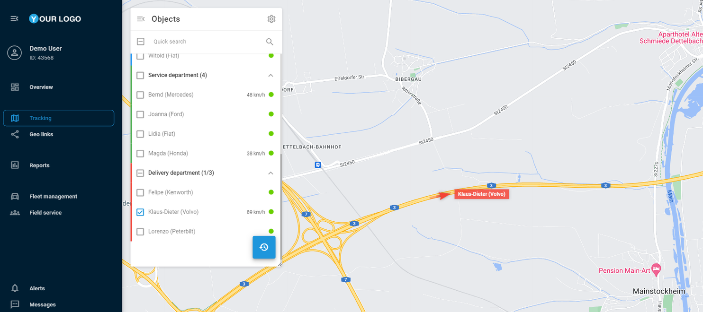
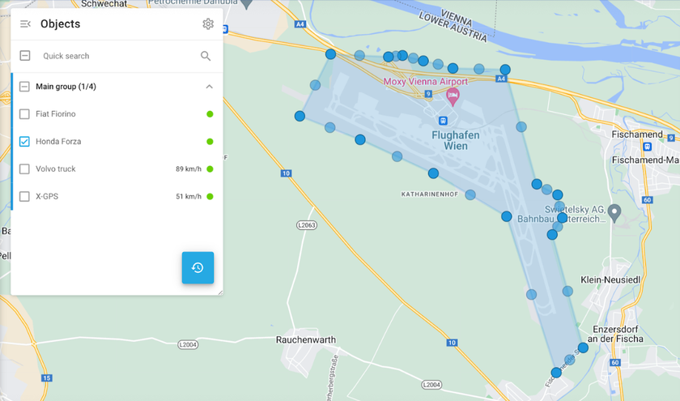
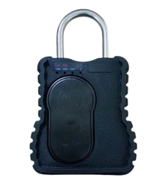
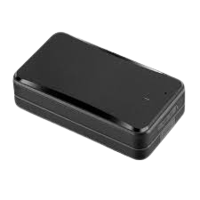
Features
Asset monitoring
GPS and advanced telemetry
Remote device management
Geofencing and POI
Sustainable power source
Condition change alerts
Temperature monitoring

Slide 5
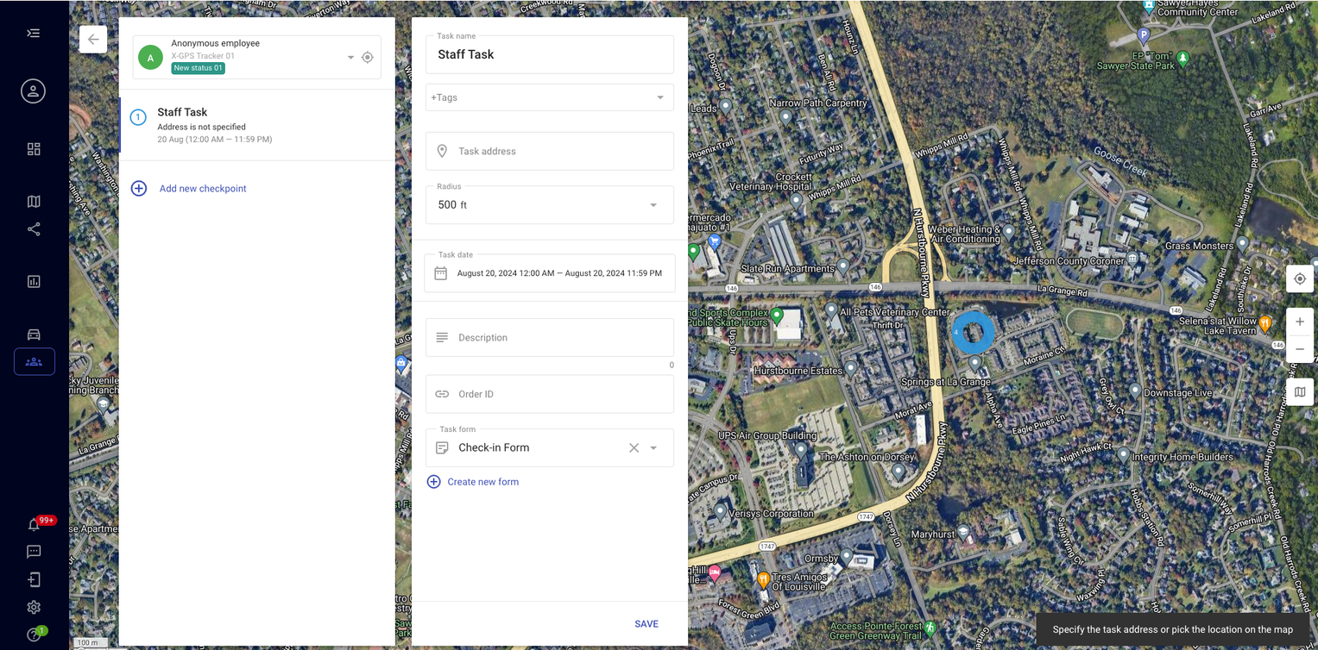
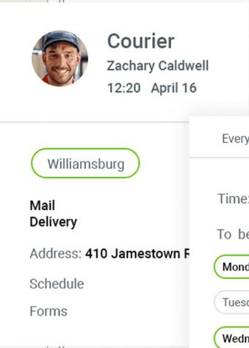
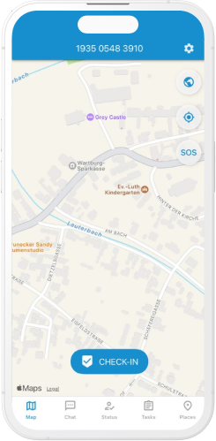
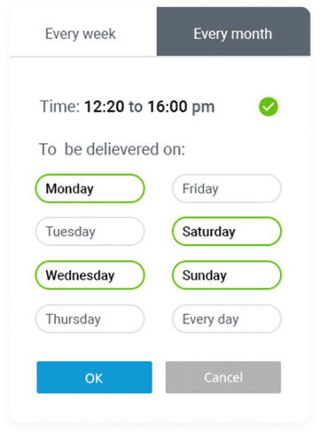
Features
Field service
Job dispatching
Custom digital forms
Route optimization
Proof of delivery (POD)
Places management

Slide 6

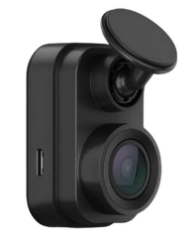
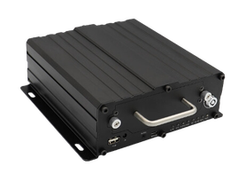
Features
Video telematics
Video evidence
Accident monitoring
Driver coaching
DMS and ADSA
Multi-channel MDVR

Slide 7

















Objects
Max out the performance of:
Fleets
Mobile workforce
Heavy machinery
Buses / passenger vehicles
Cargo
Cold chain
Personal vehicles
Stationary objects

Slide 8


Industries
Experience from a bunch of industries
‘We've simplified complex operations, ensuring that users from any industry can access GPS and asset tracking with just a few clicks.’
Den Demianikov
VP of Product Management at Navixy

Slide 9

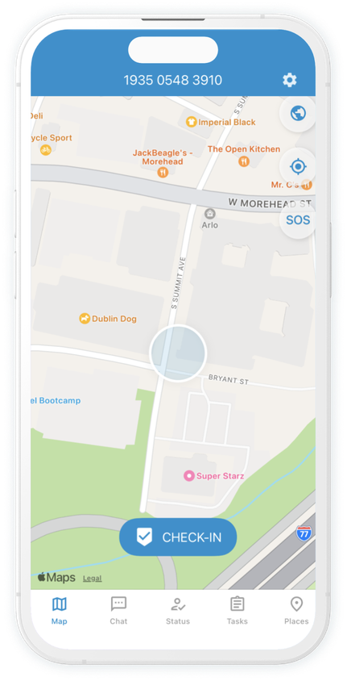
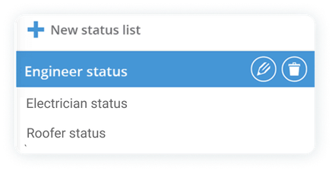
Industries
Experience from a bunch of industries
Transportation and logistics
Retail and distribution
Leasing and rental
Mining industry
Construction
Agriculture
Healthcare and pharma
Insurance
Public transportation
Utilities and services

Slide 10

Connecting people, vehicles
and assets
navixy.com

Slide 11




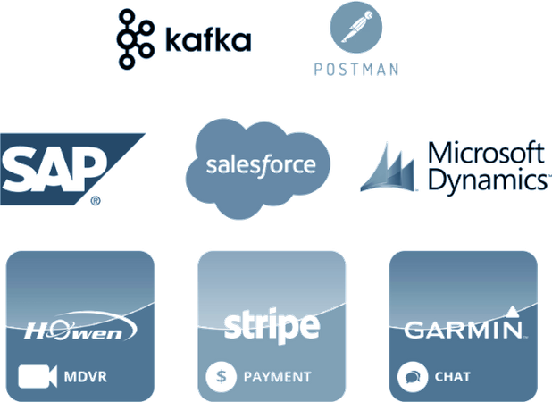
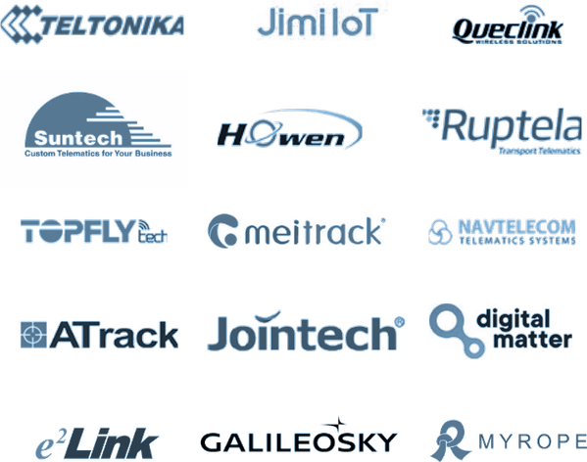
Growth
Solving the problem and securing growth
Advanced solutions
Marketplace, API/ SDK
Community
Features and cases
Flexibility and adaptiveness
Manufacturers & providers

Slide 12


Clients
We and our partners understand the challenges businesses face, with over 10,000
successful projects completed for clients from different industries worldwide.

Slide 13
Thank you for your attention!

