Slide 1


Technology to power up your telematics solutions

Slide 2

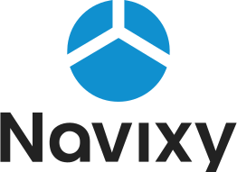


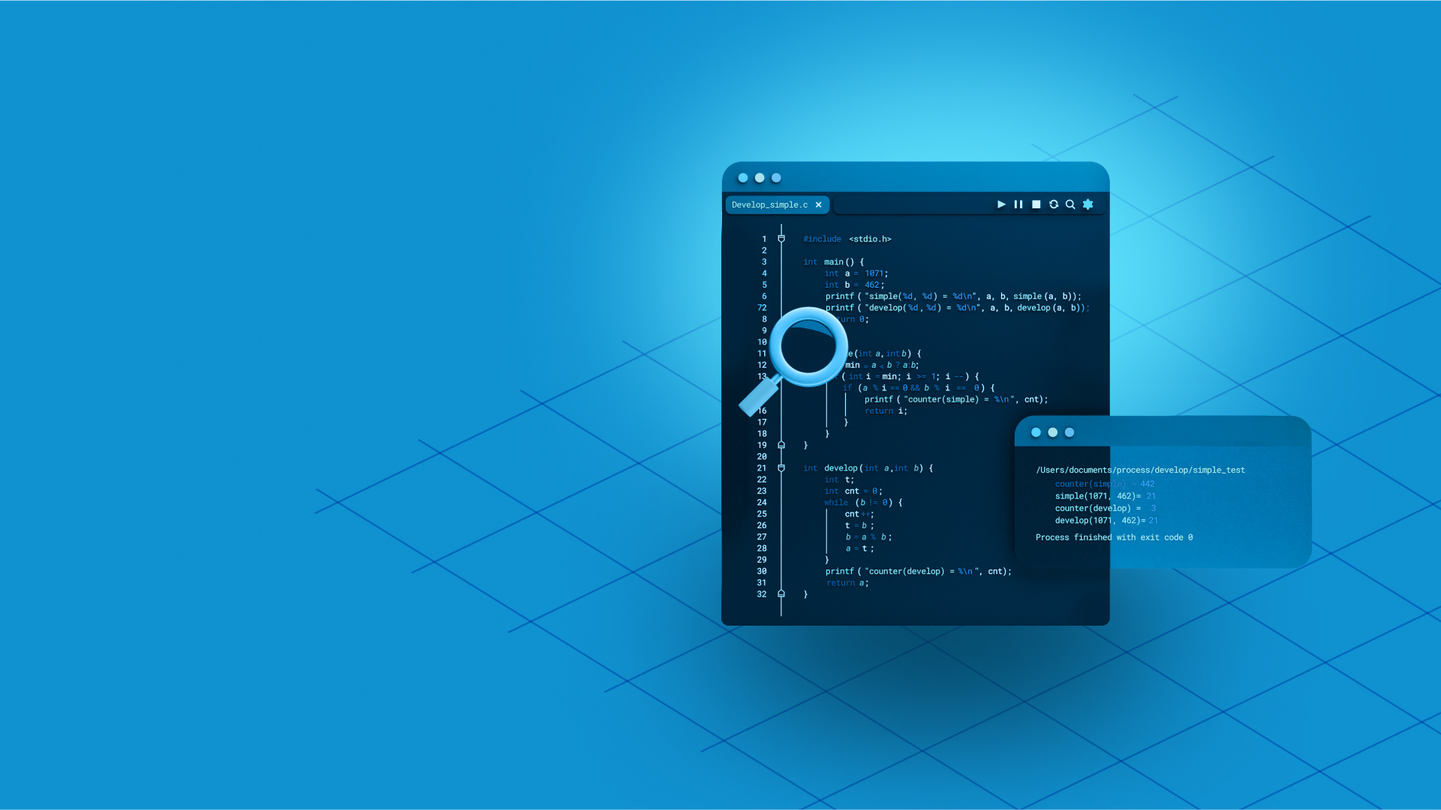

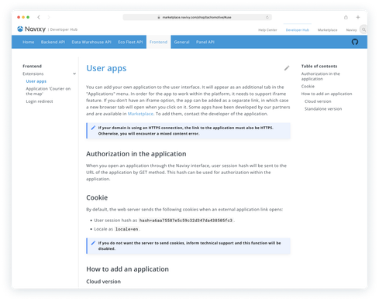
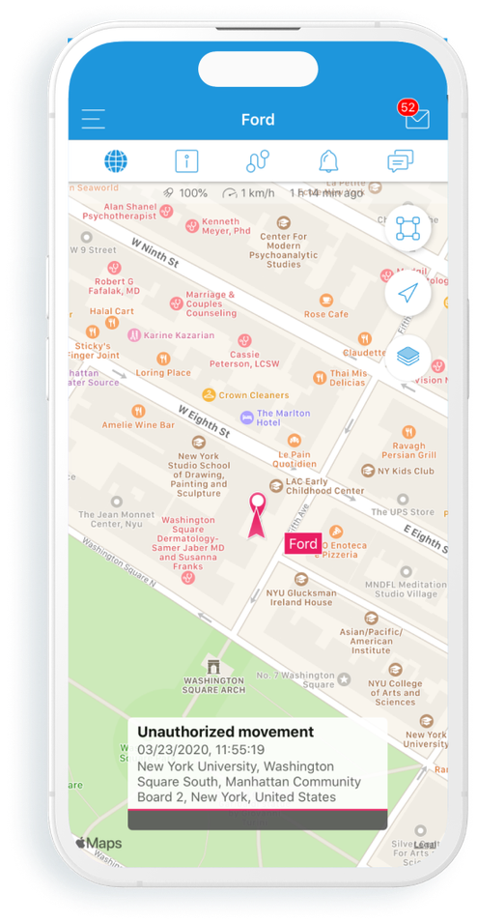
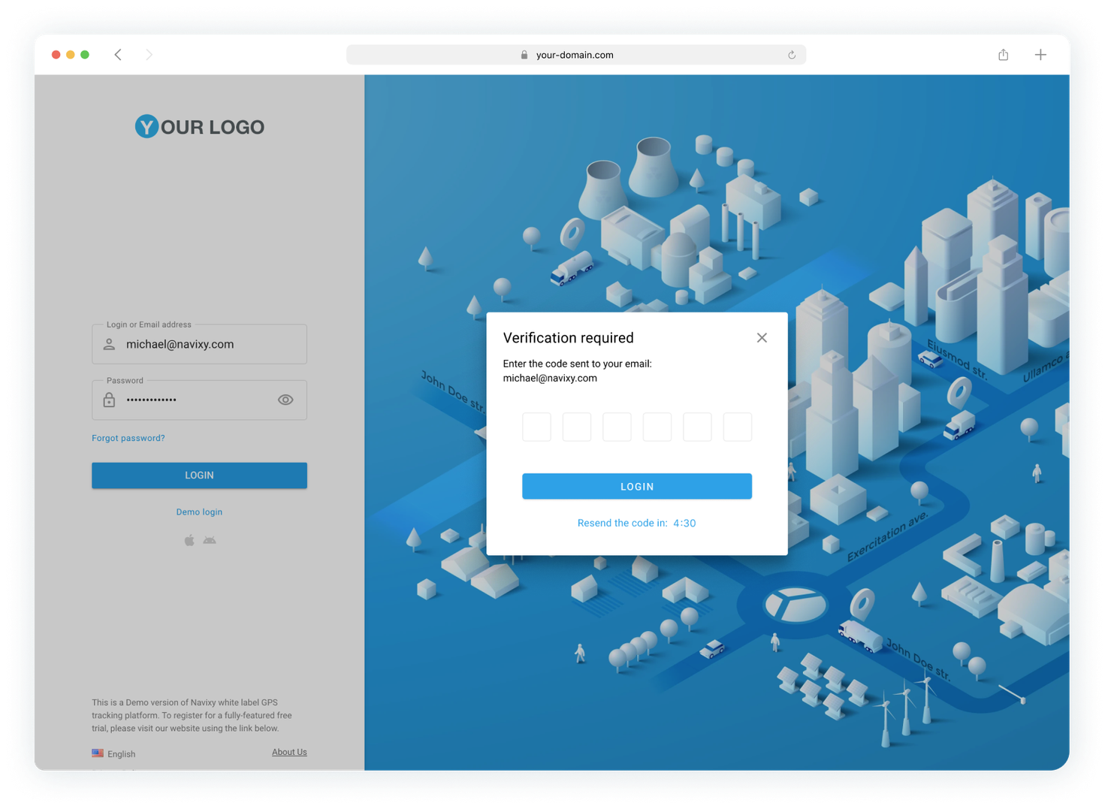


User-centered Mobile Resource Management platform
MRM stands for Mobile Resource Management. You are free to create solutions effective for fleet management, field service, and GPS asset tracking – all at once. Discover how Navixy transforms your data to opportunities to drive the business forward.
Data collection
Data processing and monitoring
Data integration
App integration and development
Easy to collect, manage, monitor and troubleshoot the data remotely in real time.
Make telematics data work for you the best way. Easily access and transfer raw data, IoT Logic solution - a traffic manager for data.
Efficiently work with telematics data across various platforms with Navixy's robust tools.
Tailor Navixy to your specific needs and extend it's capabilities or embed telematics functionality into your apps.
go to page
03
go to page
09
go to page
15
go to page
19
Be sure with a proactive, robust approach to information security, meeting the strict standards.
24
Security
go to page

Slide 3
Data collection
Easily collect telematics data across multiple devices. Manage, monitor and troubleshoot the data remotely in real time, ensuring uninterrupted flow and maximum efficiency.
Device agnosticism
Connectivity
Remote device management

Slide 4
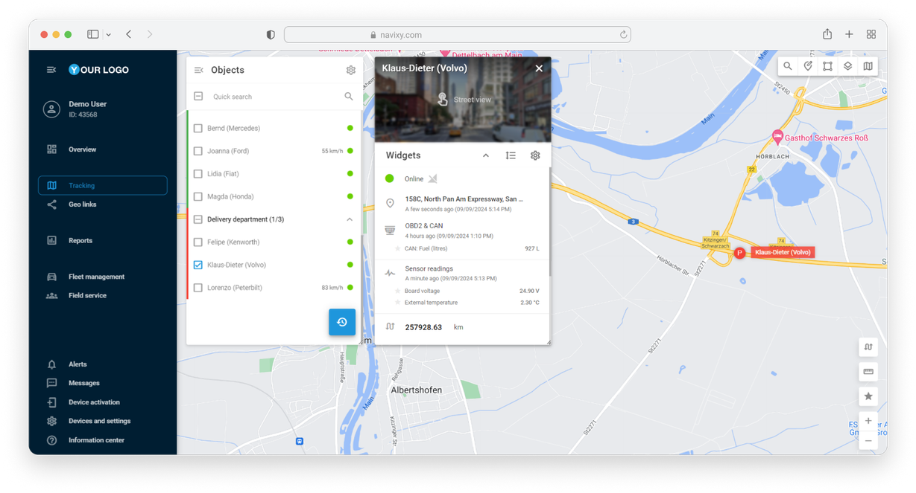

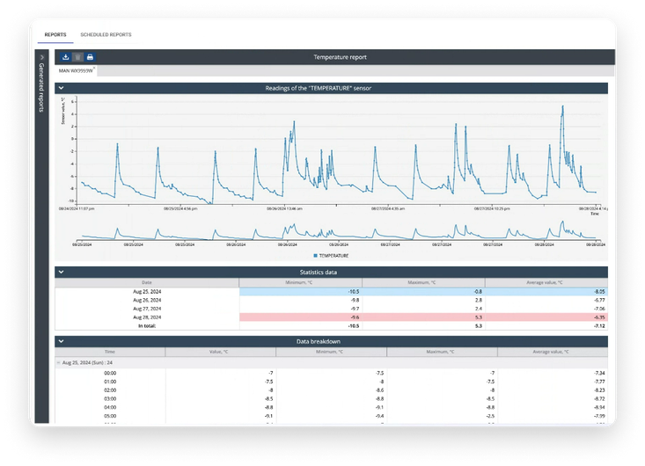
Data collection
GPS trackers
Device agnosticism
1600+
Get data from multiple devices in one place. Monitor assets, vehicles, and environmental conditions efficiently, adapting to your operational needs.
devices supported
Video devices
Dash cams
MDVR
Telemetry sensors
Built-in sensors
External sensors

Slide 5


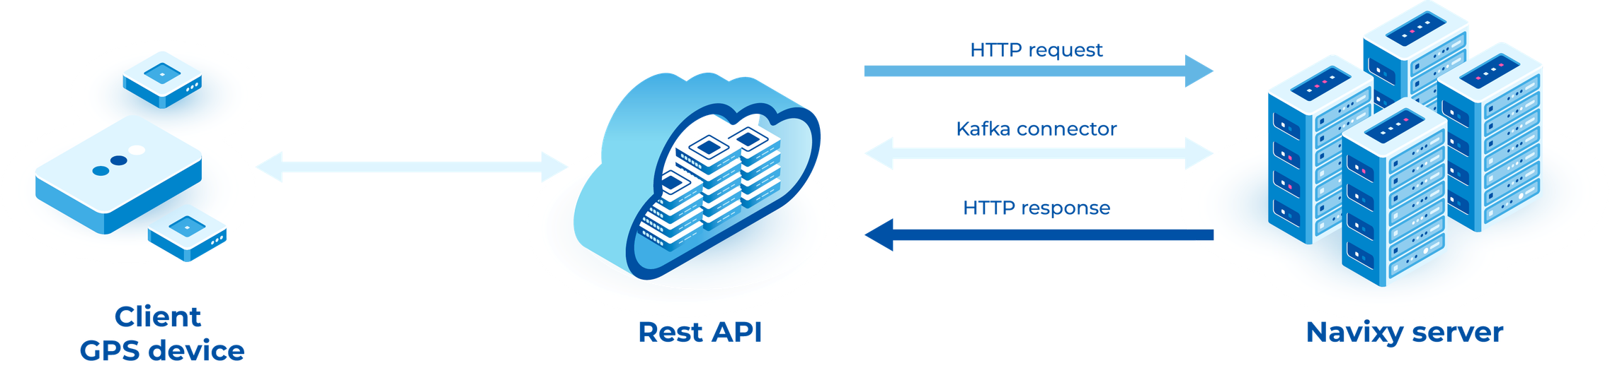
Data collection
Comprehensive connectivity
Maintain real-time control and responsiveness, even in challenging locations, boosting operational efficiency and reducing downtime. Whether devices send data directly to Navixy or your server first, Navixy can retrieve the information in multiple ways, ensuring a consistent data stream.
Cellular networks
Kafka connector
TCP/UDP
Satellites
HTTP
LPWAN
MQTT

Slide 6
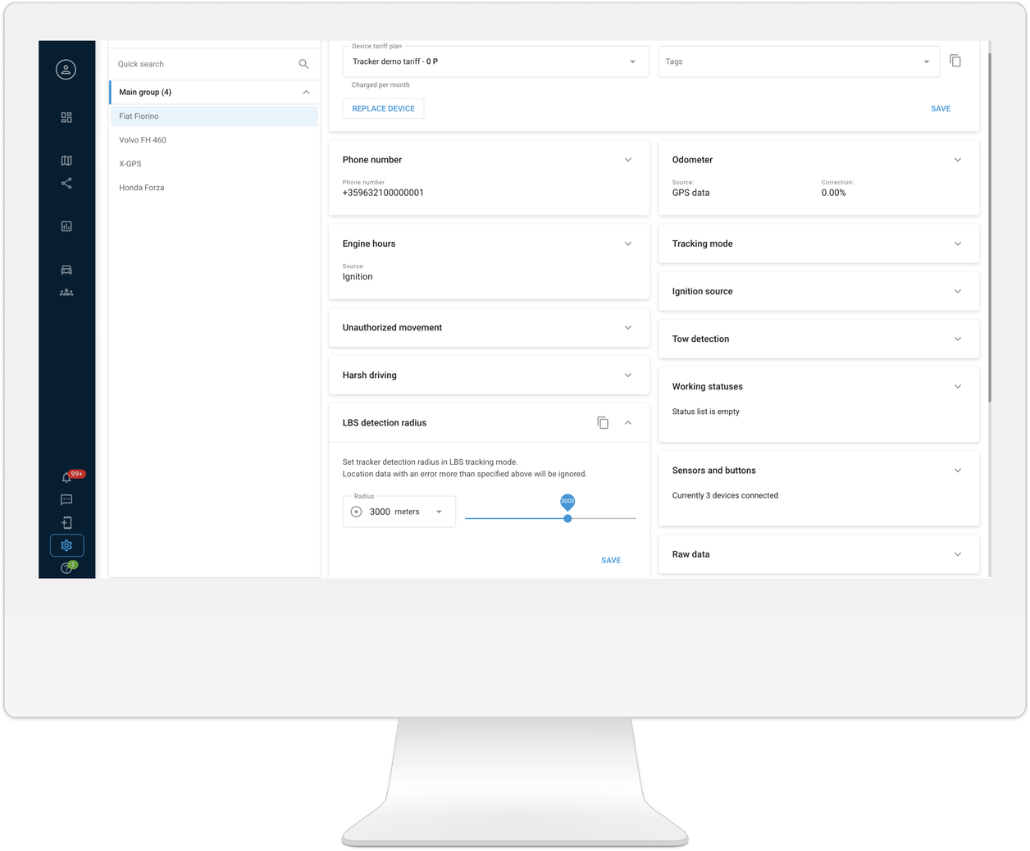



Data collection
Remote IoT device management
Guaranty reliable, real-time data collection by monitoring and adjusting devices from anywhere on the go. Reduce downtime, cut maintenance costs, and keep operations running.
Minimize response times and downtime, managing devices remotely from any location.
Adjust tracking modes, alert settings, and other parameters
to optimize device performance and address specific operational needs.
Centralize device management and data monitoring from a single platform.
Device settings
Air Console

Slide 7
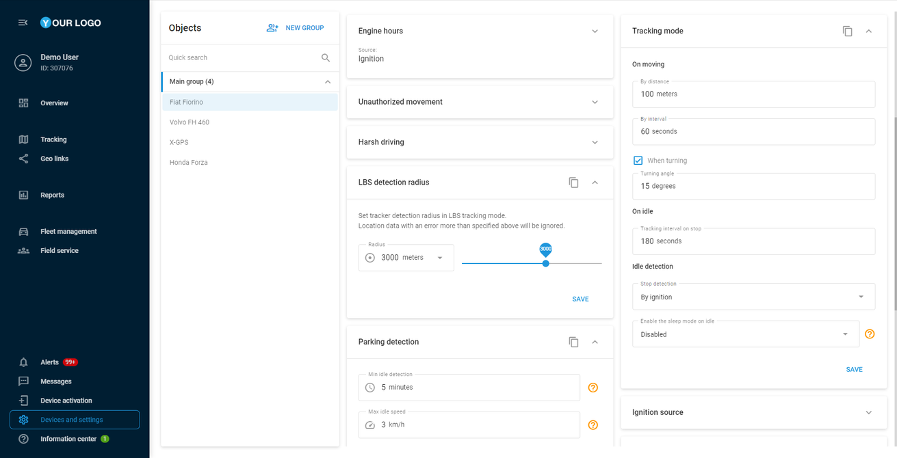
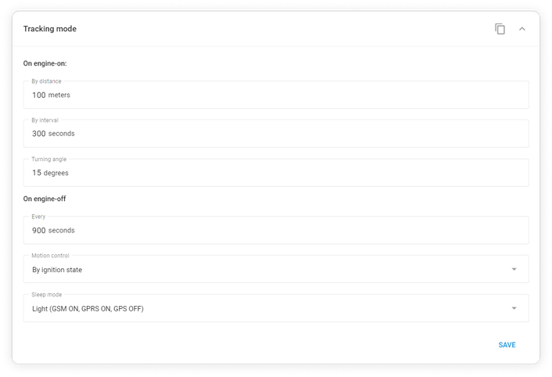
Data collection
Remote IoT device management
Device settings
Configure devices remotely, setup device sensors, and apply other settings related to particular devices (assets).
Set how often the device collects
and sends GPS data.
Manage ignition-related functions like vehicle start/stop detection.
Enable alerts like tow detection or harsh driving.
Set up sensors and parameters like CAN BUS, fuel, temperature, etc.

Slide 8
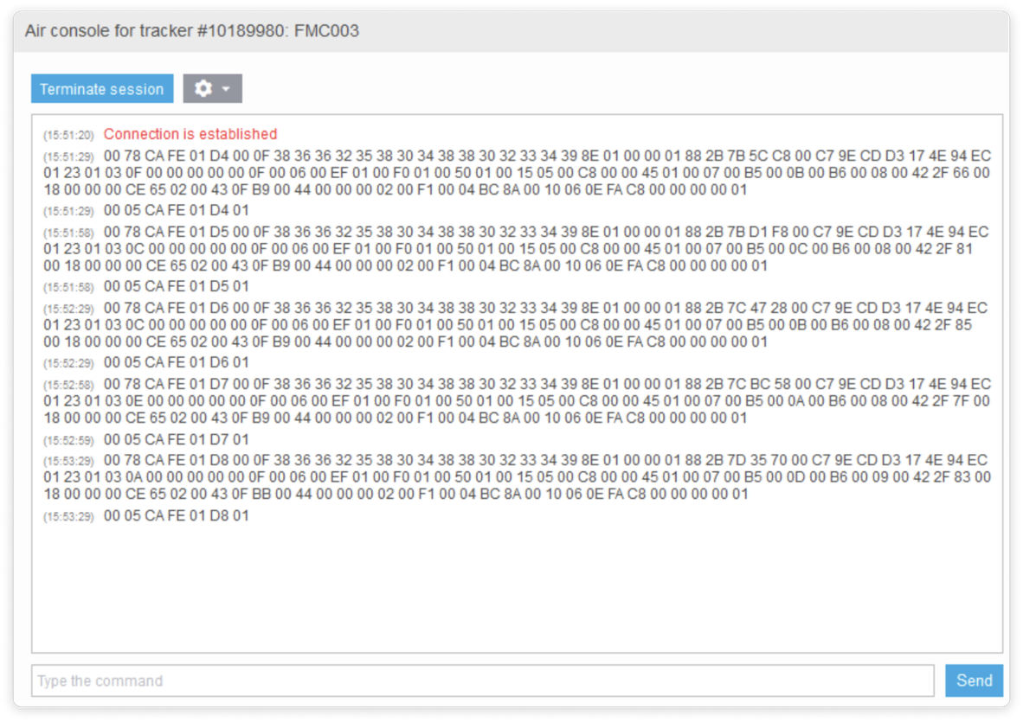
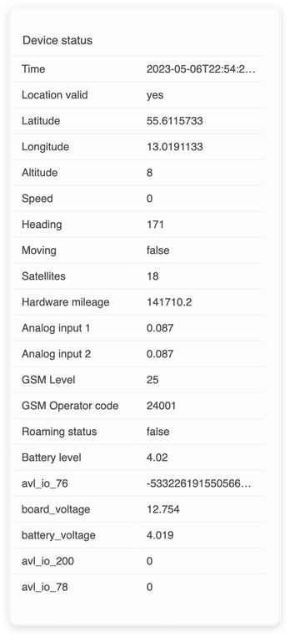
Data collection
Remote IoT device management
Air Console
Monitor raw device data in real time, send remote commands, and troubleshoot issues efficiently. Ensure accurate data conversion, device communication and control.
01
Instantly view raw data from the devices.
02
Troubleshoot incoming device parameters and messages.
03
Manually send commands to any device, using GPRS.

Slide 9

Data processing
and monitoring
Make telematics data work for you the best way. Easily access and transfer raw data, monitor and manage real-time and historical data flow, and troubleshoot on the go.
Raw data
Navixy IoT Logic
Data forwarding

Slide 10
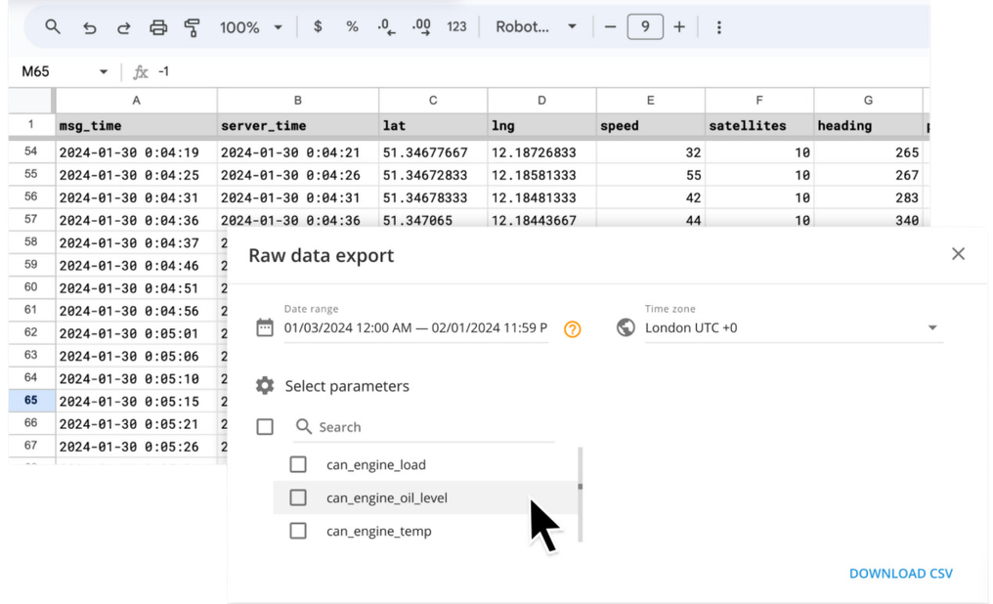


Data processing and monitoring
Raw data export
Facilitate detailed analysis (ex. evaluating sensor performance) supporting various telematics applications.
Select up to 1000 specific parameters for export, including CAN bus data and sensor values for tailored data management.
Quickly choose devices, date ranges, and parameters.
Export up to 6 months’ worth of data in the Parquet format.

Slide 11
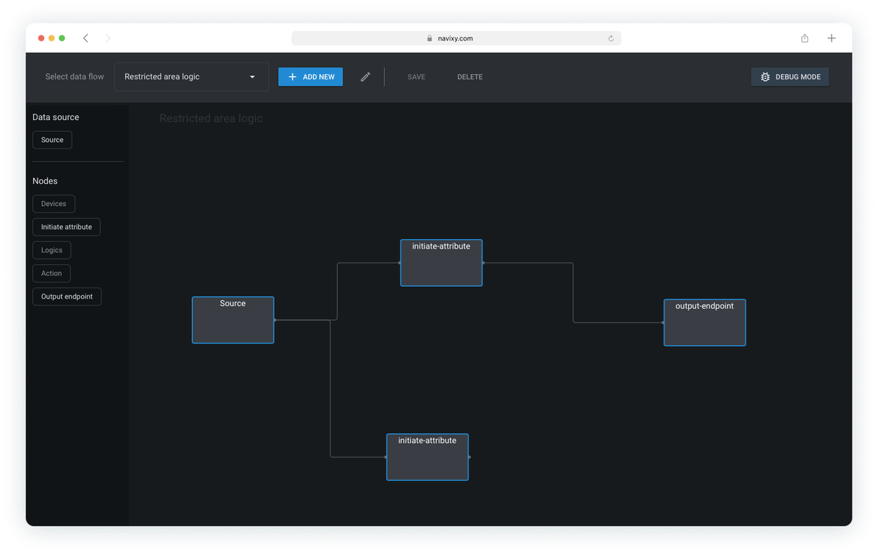
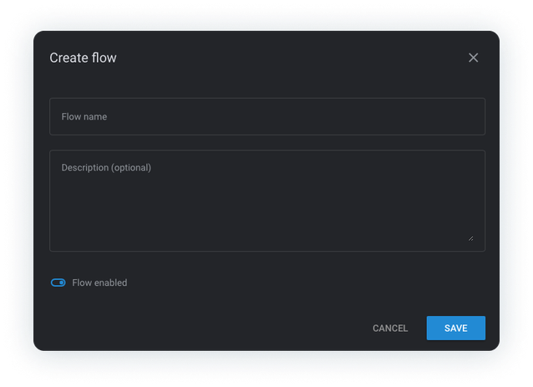




Data processing and monitoring
Navixy IoT Logic
Process, decode, and route data in real time. Navixy’s IoT Logic enables telematics service providers, system integrators, and developers
to integrate diverse data sources hands down.
Track and manage large-scale data streams.
Set how often the device collects and sends GPS data.
Send enriched data to multiple recipients and manage various parameters for different sources.
IoT Logic Expression Language
Data Stream Analyzer

Slide 12
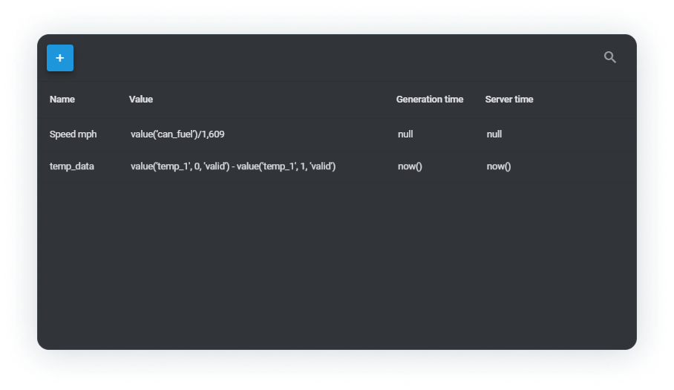
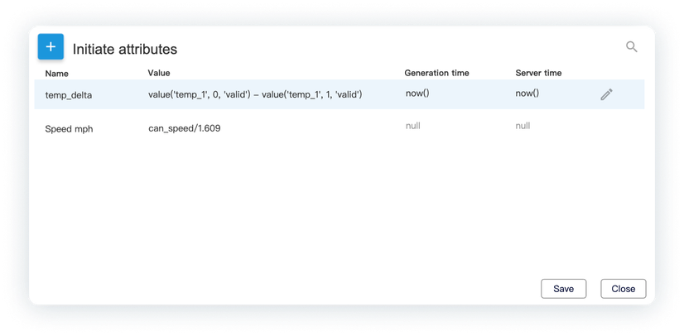
Data processing and monitoring
Navixy IoT Logic
IoT Logic Expression Language
A Java-based tool for real-time manipulation and enrichment of raw device data. It facilitates custom functions creation and seamless integration with other platforms.
IoT Logic Expression Language
Utilize a low-code JEXL-based language for real time and historical data manipulation, enabling tailored calculations and automated processes.
temp_delta
Transform raw data into actionable insights with custom logic, enhancing data utility beyond straightforward tracker outputs.

Slide 13
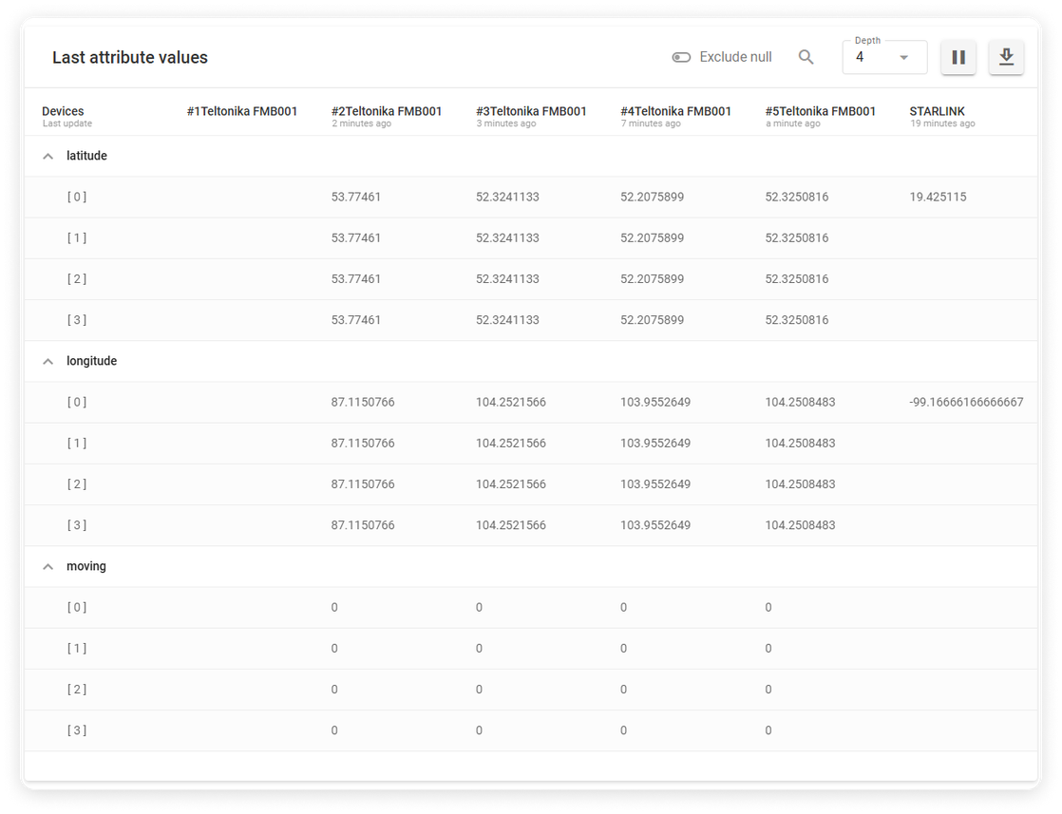
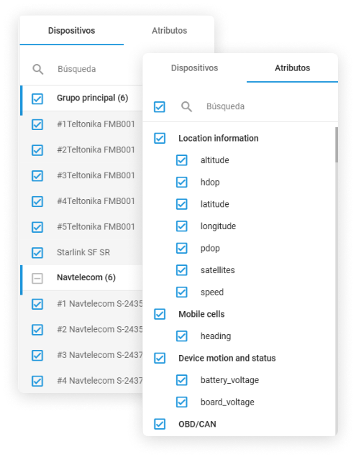
Data processing and monitoring
Navixy IoT Logic
Data Stream Analyzer
Data Stream Analyzer lets you analyze and track device data in real time, focusing on specific parameters and trackers. View enriched data, compare sources, and examine logs for troubleshooting and analysis.
Data Stream Analyzer
Tracks and analyzes data flows, storing the last
12 parameter values for current and past data.
Utilizes distributed caching for rapid access and processing, facilitating effective debugging and trend detection.

Slide 14
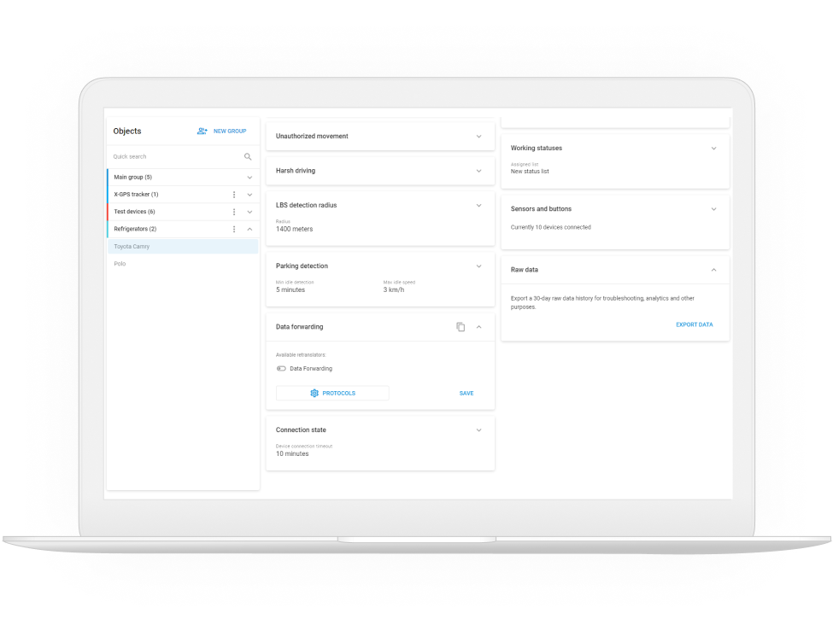
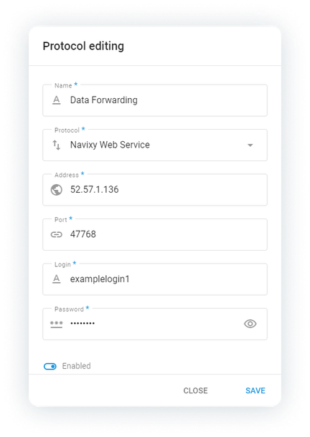
Data processing and monitoring
Data forwarding
Forward GPS tracker data from Navixy to external servers, supporting integration with various software and IT systems.
Real-time data transfer to multiple servers
Support for various data protocols and custom server configurations
Configurable via the web interface or API

Slide 15
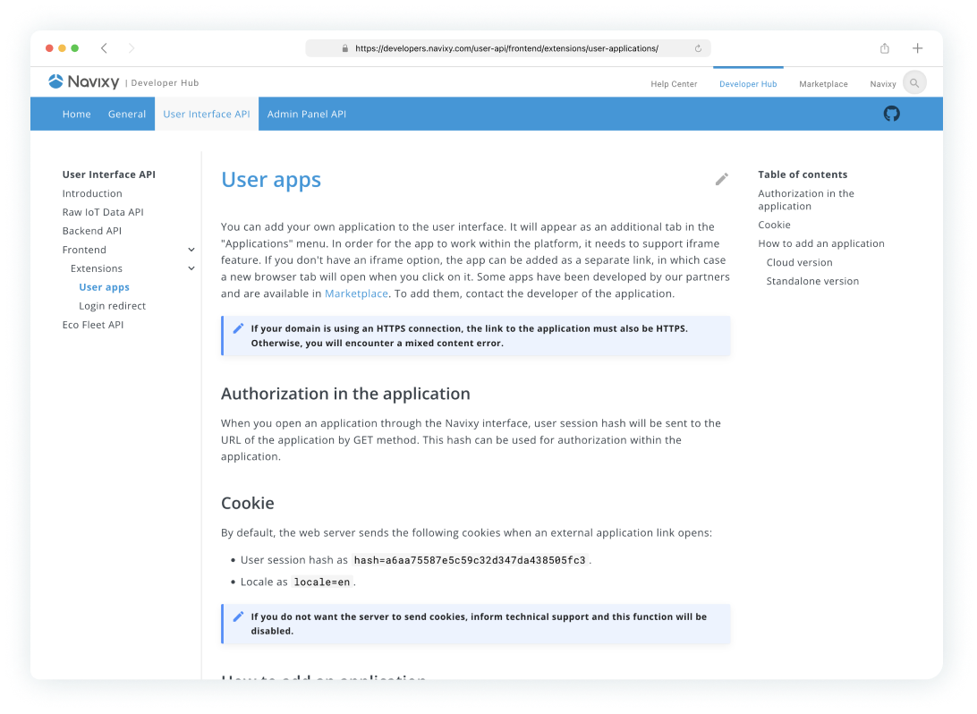

Data integration
Efficiently work with telematics data across various platforms with Navixy's robust tools for seamless data integration.
IoT Query
Navixy APIs
Navixy API Sandbox in Postman
Navixy SDK

Slide 16


Data integration
Navixy Repository
Navixy Repository is a high-performance, PostgreSQL-based system designed for unified modeling of business data.
With a RESTful API, technical teams can define custom entities such as trucks, geofences, departments, groups, and associate them with sensor inputs, spatial boundaries, and inter-entity relationships.
Navixy Repository enables organizations to create a digital twin of their operations through a structured and scalable data model. Real-world entities such as vehicles, geofences, technicians, or containers are represented not as static labels but as dynamic, richly described objects linked directly to live telematics data.

Slide 17
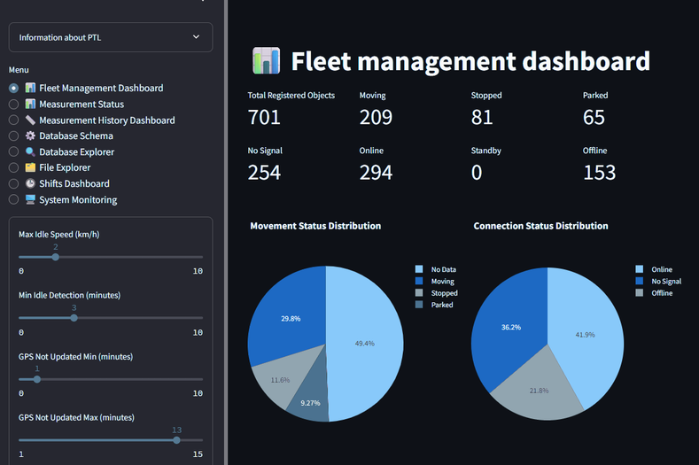
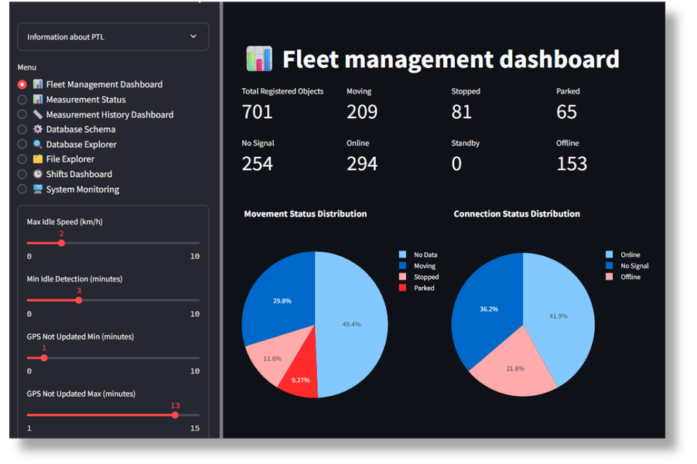

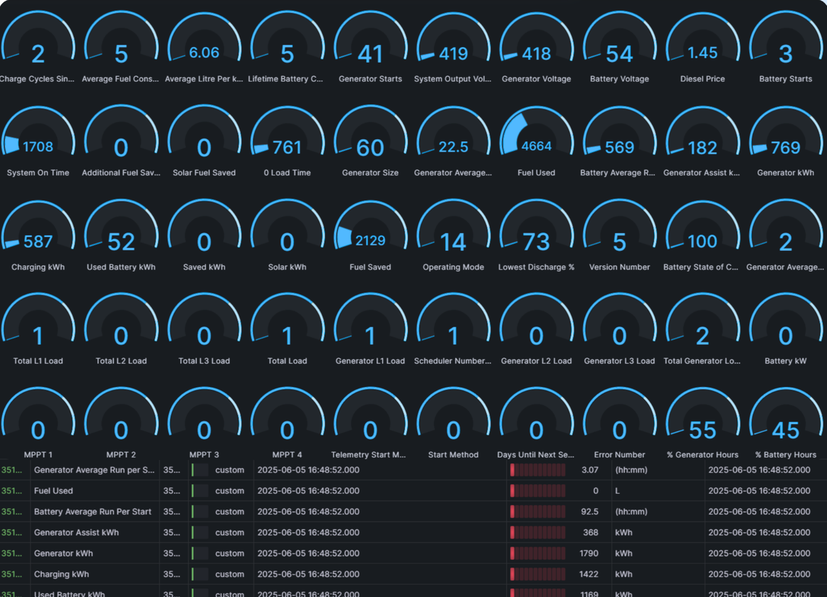
Data integration
IoT Query
IoT Query delivers direct, fast, and secure access to telematics
and business data — purpose-built for enterprise fleets 500+ assets.
Direct SQL access. Query telematics and business data directly using standard SQL—no API limits, no static reports, no delays.
Zero infrastructure overhead. Navixy’s managed Private Telematics Lakehouse architecture removes infrastructure costs and technical complexity, reducing total cost of ownership (TCO).
BI and ML seamless integration. Connect instantly with BI, analytics, and ML tools. Applicable for data modeling, forecasting, and real-time insights with plug-and-play connectivity.

Slide 18
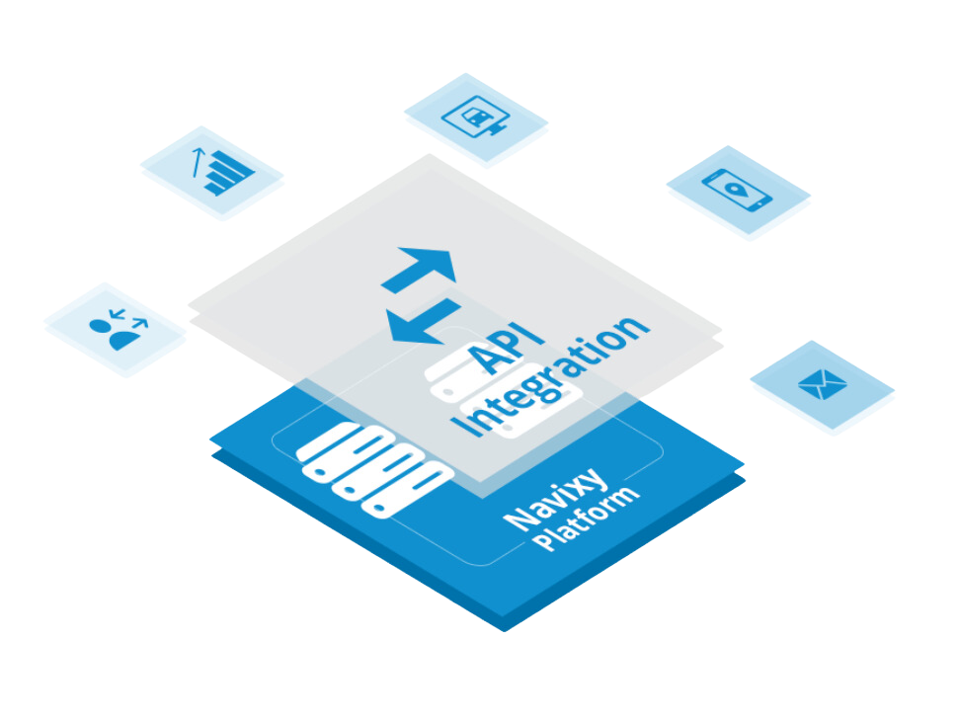
Data integration
Navixy APIs
Integrate telematics with CRMs, ERPs or any other 3rd party tools. Get access to all the data to integrate or create your own applications for customers with the powerful Navixy API.
Backend API – user interface functionalities like tracking, reports, and tasks.
Admin Panel API – admin panel functionalities such as platform config and user management.
Raw IoT Data API – obtaining raw IoT data received from devices.

Slide 19
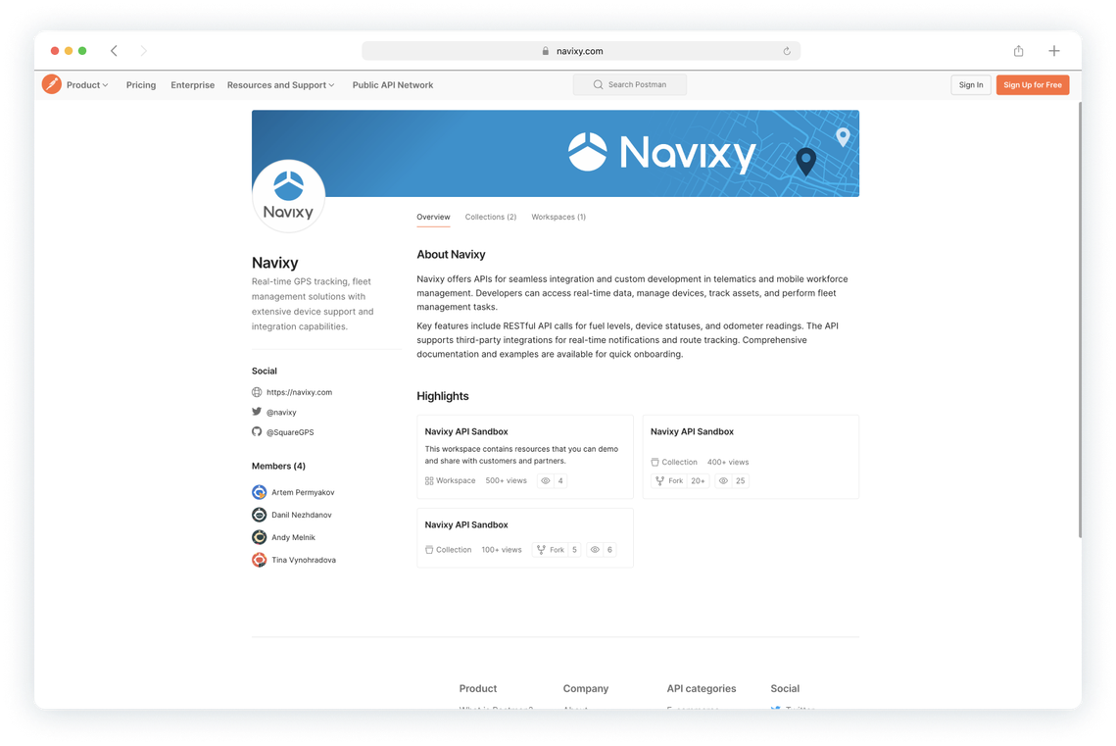
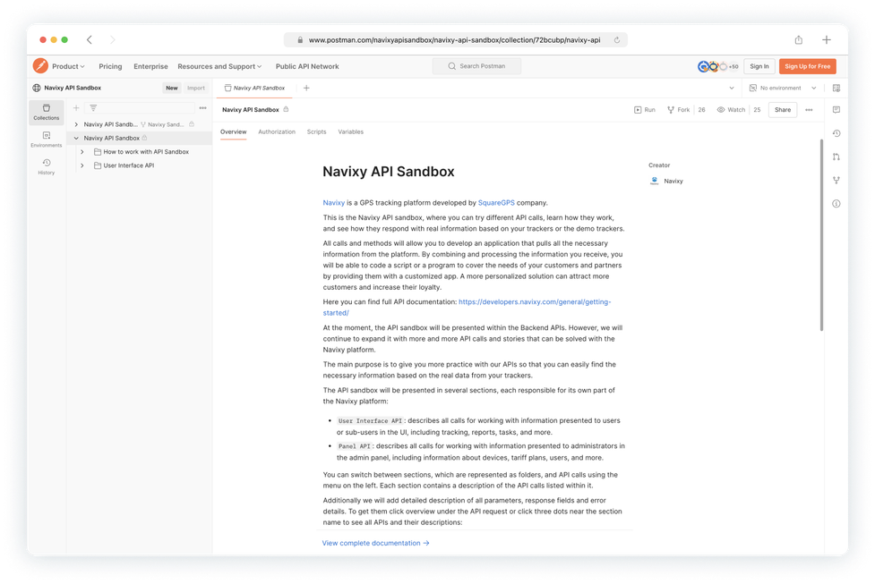
Data integration
Navixy API Sandbox
in Postman
Navixy's API Sandbox allows developers to easily explore and test Navixy's telematics APIs within Postman, providing a seamless environment for quick integration and experimentation without needing a live account.
Test API endpoints without affecting live data or production environments.
Easily access pre-set collections and environments for rapid testing.
Quickly identify issues and validate API responses.
Reduce time spent on setup, enabling faster prototyping and implementation.

Slide 20
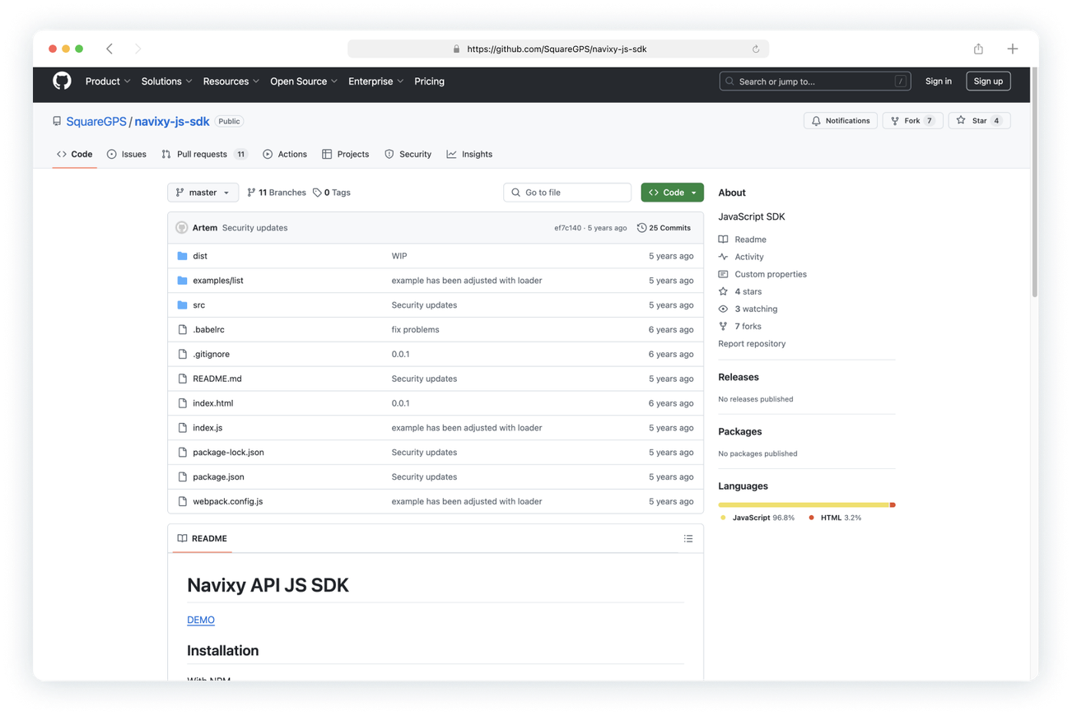
Data integration
Navixy SDK
Accelerate integration with Navixy SDK, a set of tools, libraries, and documentation for developers, and create custom applications using Navixy's telematics and GPS tracking platform.
Facilitate the integration of Navixy’s telematics and GPS tracking capabilities into custom applications.
Utilize detailed documentation for developers
to understand and create unique solution.
Build solutions for different operating systems and environments.

Slide 21
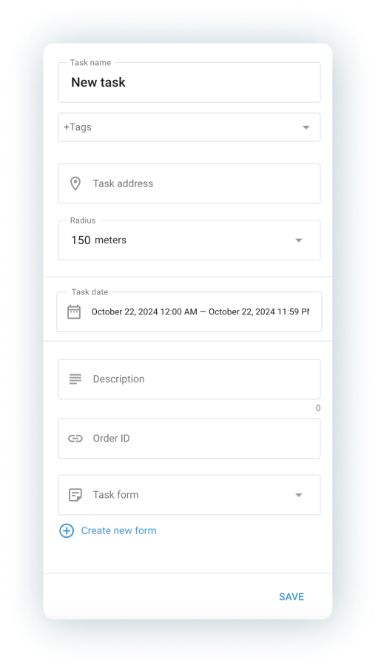
App integration
and development
Tailor Navixy to your specific needs and extend its capabilities or embed telematics functionality into your apps using Navixy's app integration and development features.
Customizable menu
Integrated UX
Geo links

Slide 22
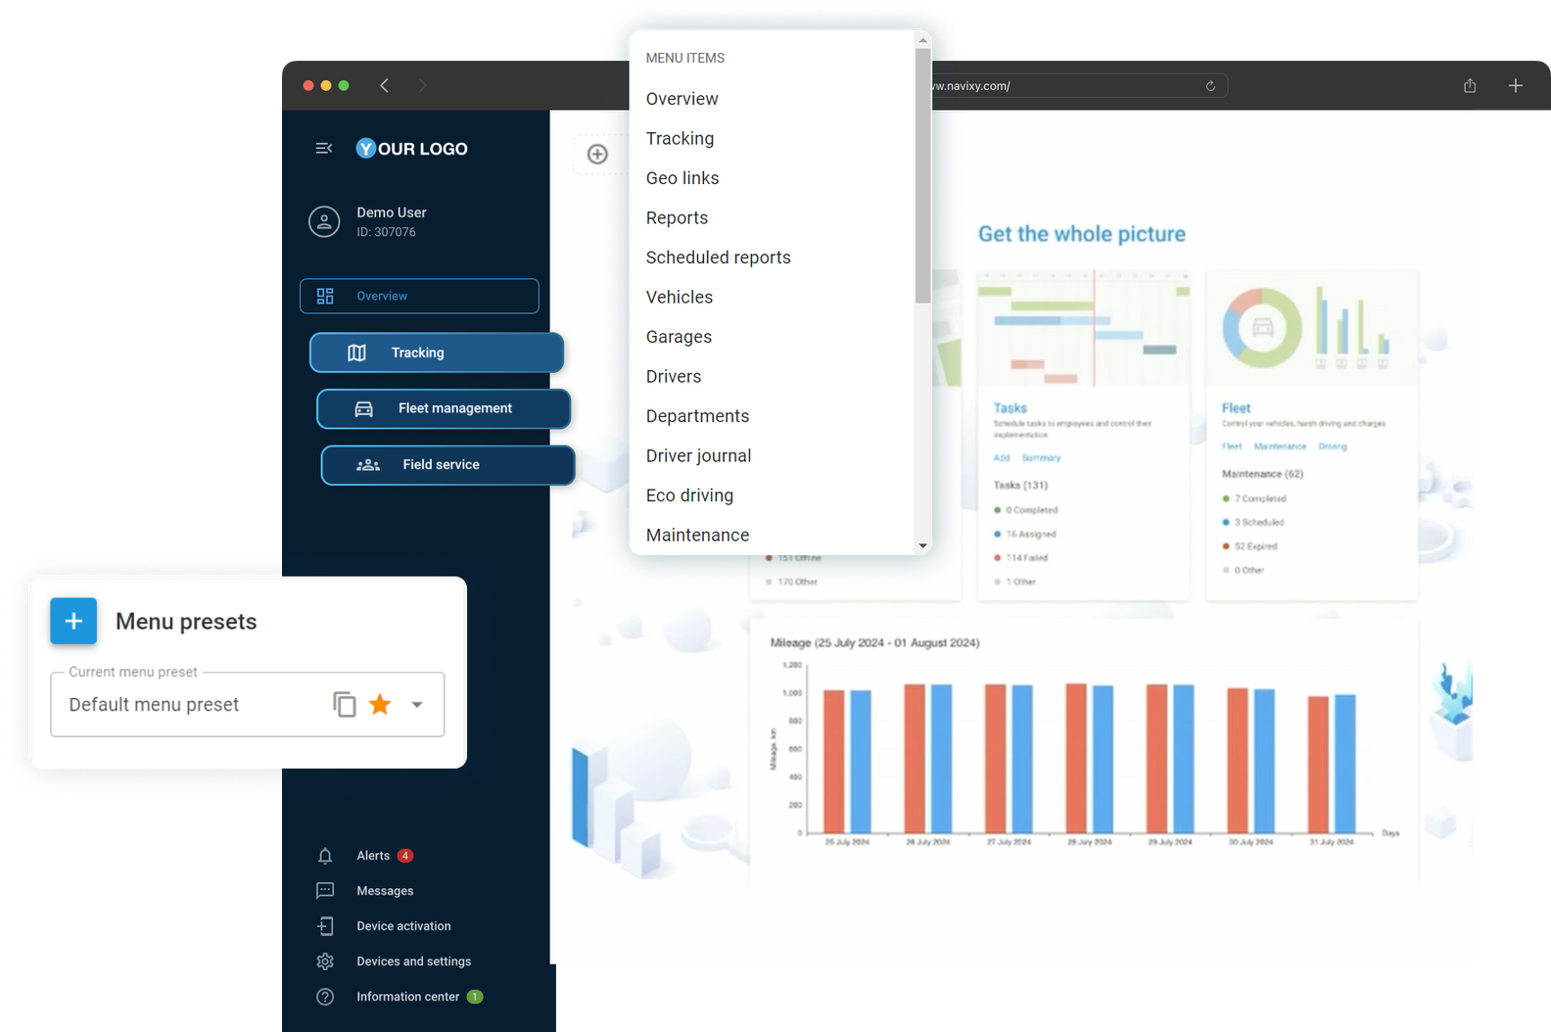
App integration and development
A no-code customizable menu
Easily customise the platform’s interface with Menu Editor to improve navigation and user experience. Simplify deployment, accelerate transitions from other platforms, and align the system with specific business needs.
Effortless menu customisation: reorder, rename,
and group items.
Improved navigation for faster access to critical functions.
Personalised interface without coding or technical support.

Slide 23
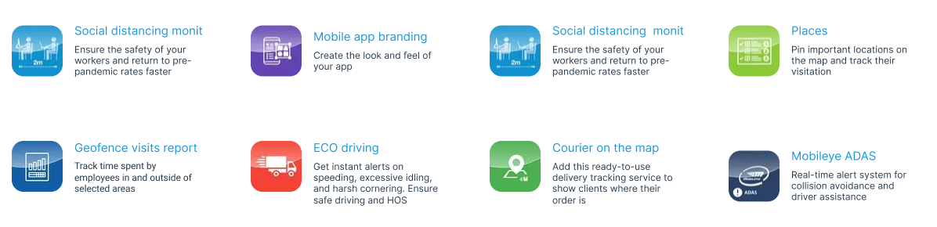


App integration and development
Integrated UX
Expand Navixy's functionality with apps and plugins – access native and third-party apps within the same UI for a seamless user experience. Easily integrate custom applications to address your particular needs. Choose the one from the Marketplace or create your own.
App embedding via i-frame
Adding custom apps via API

Slide 24
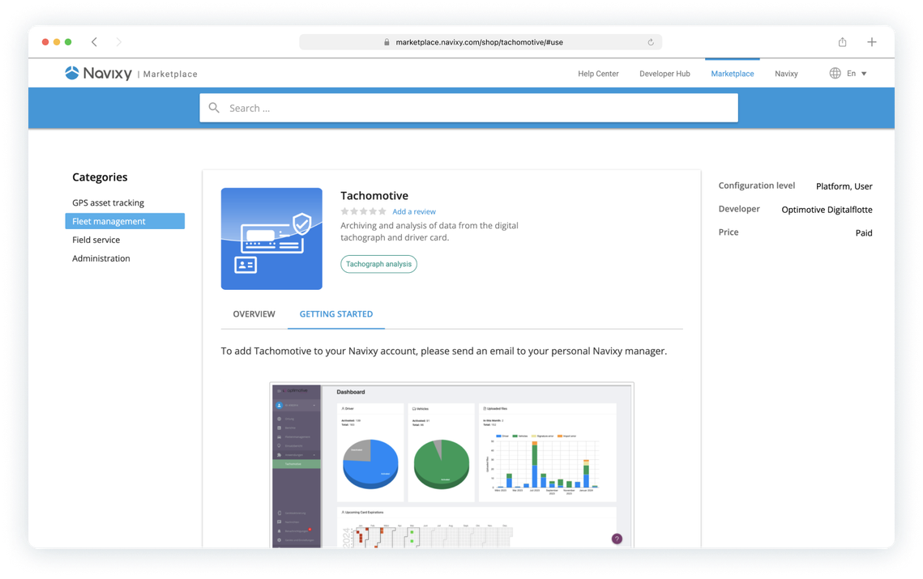
App integration and development
Adding custom apps via API
01
Write your custom web application using any programming language
02
Integrate the application with Navixy system data through API calls.
03
Submit the app name and URL to Navixy.
04
Use SQL queries to enable the app in the Navixy database for specific users or the entire service account.

Slide 25
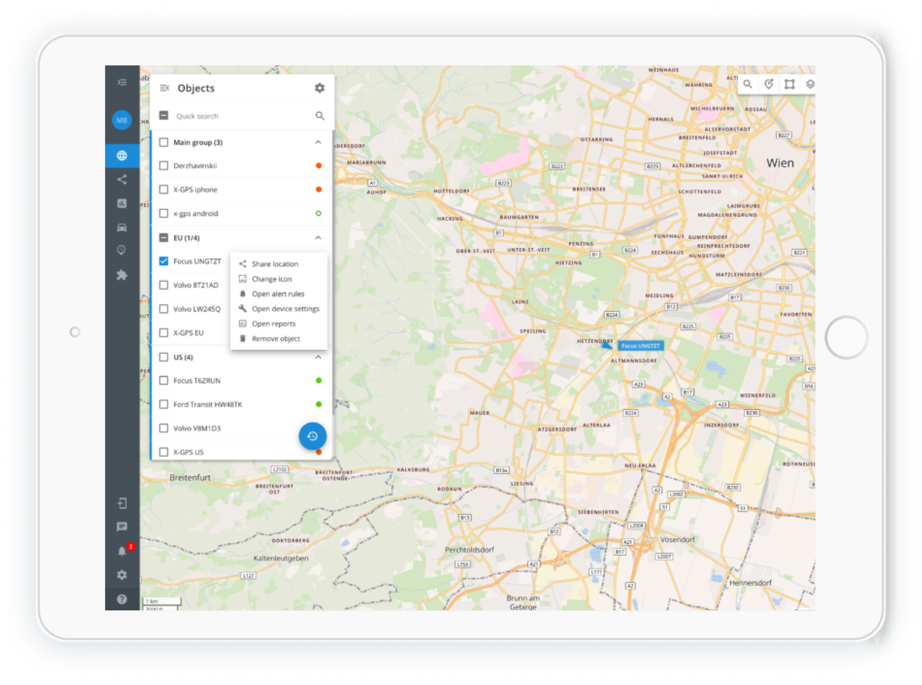
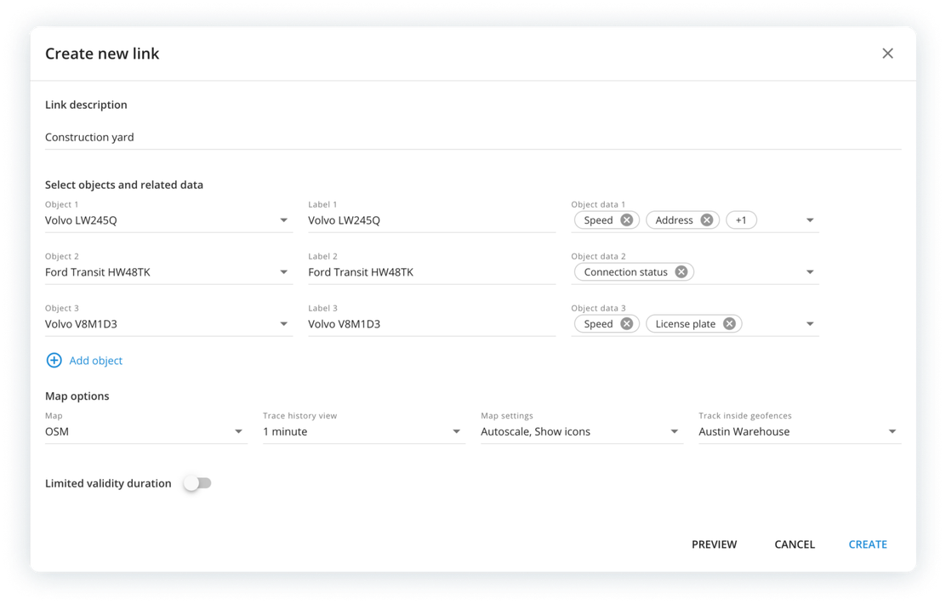

App integration and development
Geo links
Share real-time location data of vehicles, cargo, and assets with customers or team members through simple, customizable links. Enhance operational efficiency, transparency, and customer satisfaction across industries.
Instantly share asset locations via a simple link.
Adjust assets, attributes and link duration.
Supports Email, Whatsapp, Viber and Telegram
Easily add live location sharing to your website or apps.

Slide 26
Security
Ensure your data is secure with Navixy. We take a proactive, robust approach to information security, meeting the strict standards of enterprises, telematics service providers, and government organizations.
Data protection & encryption
Access control & authentication
Security monitoring & auditing

Slide 27


Security
Security
Data protection
& encryption
Navixy employs industry-leading encryption standards to safeguard data at all stages. We leverage region-specific encryption keys, ensuring that data complies with local regulations.
Industry-leading encryption standards (AES-256, TLS)
Data protection at all stages: in transit & at rest
Region-specific encryption keys for local compliance
Continuous monitoring & updates to security protocols

Slide 28
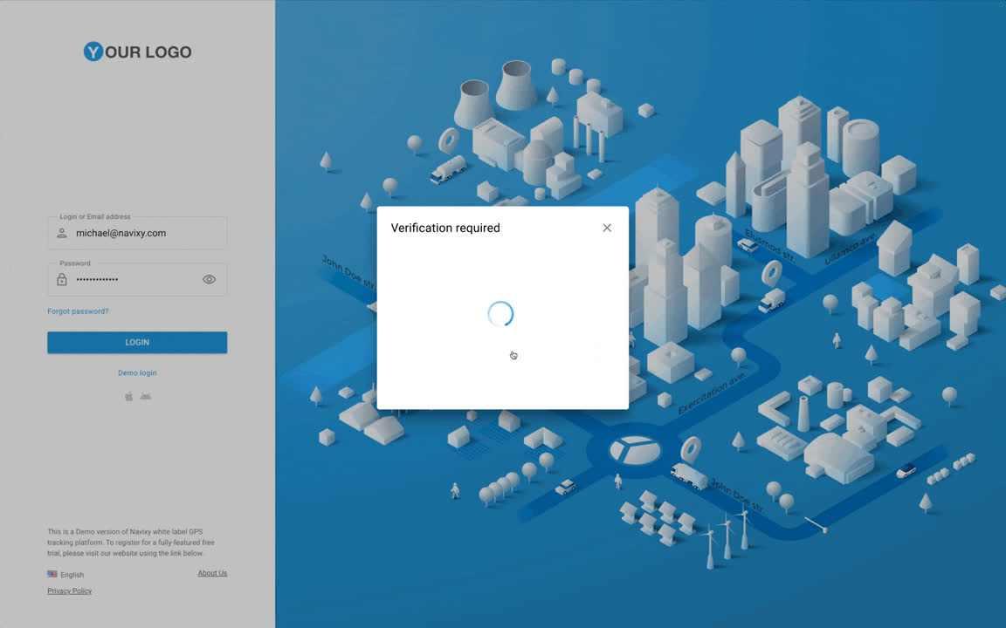
Security
Security
Access control
& authentication
Navixy implements a multi-layered approach to access control, designed to minimize the risk of unauthorized access to sensitive systems and data:
Role-based access control (RBAC) to limit user
permissions
Multi-layered authentication with Two-Factor Authentication (2FA)

Slide 29

Security
Security monitoring
& auditing
Navixy ensures continuous monitoring of system performance and potential security risks. Our security auditing process includes both internal and third-party assessments, providing a comprehensive review of our infrastructure
Continuous security event logging and monitoring
Regular internal and third-party security audits
Compliance with global data protection regulations (GDPR, CCPA)
Region-specific data storage and high availability

Slide 30



Learn more about Navixy
Opportunities for your business
Technical side of our platform
Get quick answers 24/7
Explore blog
Learn more
Use Navixy AI Assistant
Thanks for your attention!

