Slide 1

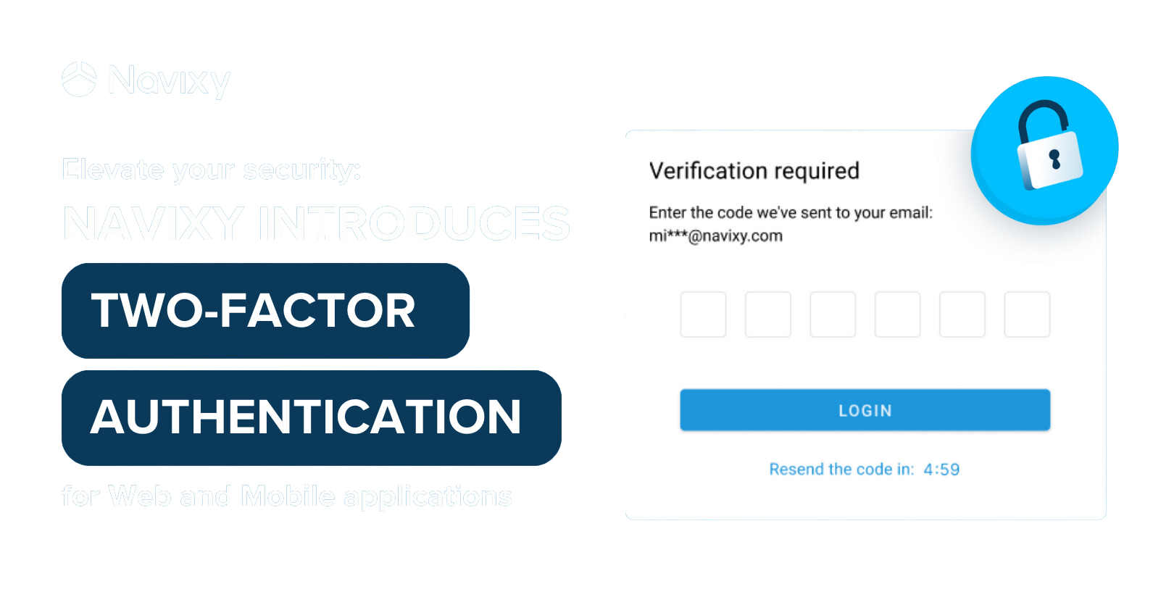
Security
Two-factor authentication (2FA) for users
Navixy implements two-factor authentication (2FA) for enhanced security across web and mobile applications.
End users verify their identity with a one-time passcode delivered via email, providing an additional security layer beyond password protection.
Administrators can enforce 2FA across all user accounts or selectively enable it based on client-specific security policies, aligning with best practices for access control and data protection.
Notes:
At Navixy, security is our top priority. That’s why we’ve implemented two-factor authentication (2FA) across our web and mobile applications.
With 2FA, end users verify their identity using a one-time passcode sent via email, adding an extra layer of protection beyond just passwords. Administrators can enforce 2FA for all users or customize it based on specific client security policies, ensuring best practices for access control and data protection.

Slide 2



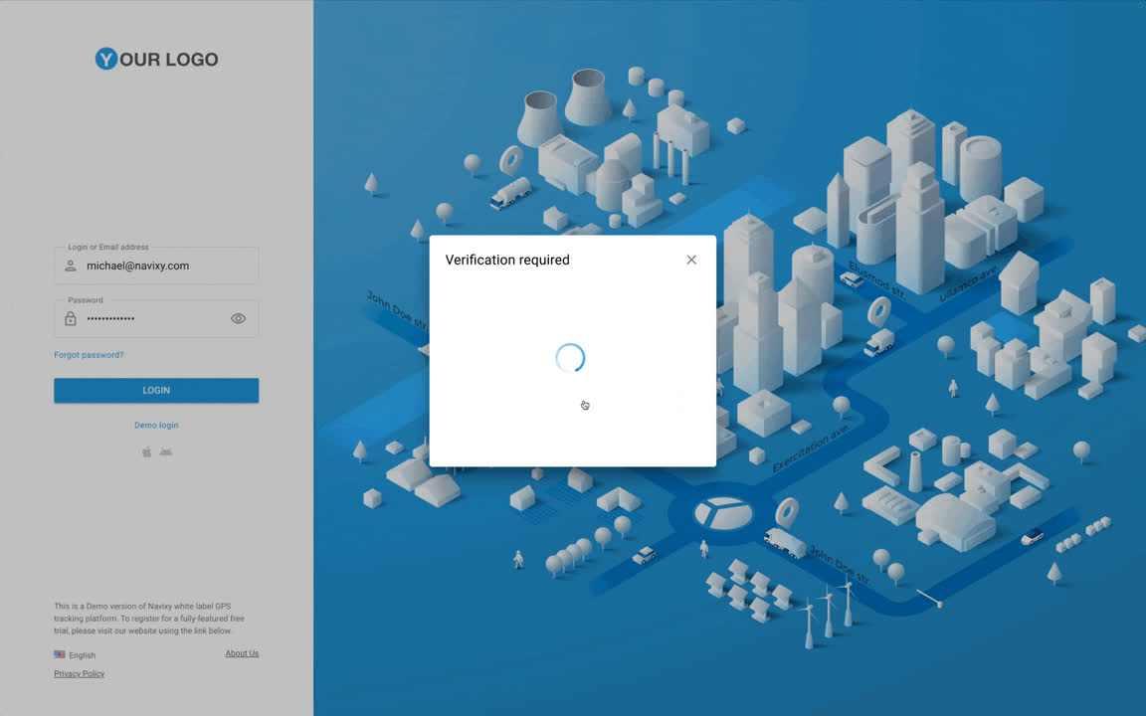

Security
Two-factor authentication (2FA) for users
To enhance data security across web and mobile apps, Navixy provides 2FA. This extra step ensures that even if your password is compromised, unauthorized users cannot access your account without access to their email.
Login with your password: enter your username and password to start the login process.
Receive a one-time code: it will be sent to your registered email.
Enter the code: Input the OTP from the email to complete your login.
Access your account: if the OTP is correct, access is granted; otherwise, login is denied.
Notes:
Benefits for Navixy platform users
I’d like to talk about a feature that significantly enhances the security of your data on the Navixy platform – Two-Factor Authentication, or 2FA.
What is 2FA?
Two-Factor Authentication, or 2FA, adds an extra layer of protection for your account. In addition to your regular password, it requires a second step: a one-time passcode, or OTP, that’s sent to your registered email. This makes it much harder for unauthorized users to access your account, even if they somehow get hold of your password.
Why is 2FA important?
With increasing cyber threats, relying on just a password for account security can be risky. 2FA protects you by ensuring that even if your password is compromised, an unauthorized person won’t be able to access your account without having access to your email.
How does 2FA work at Navixy?
Here’s how it works when logging in to the Navixy platform:
- Enter your password – Just like you normally do.
- Receive a passcode – A one-time passcode (OTP) will be sent to your registered email.
- Enter the code – You’ll need to input the OTP in order to complete the login process.
- Access granted – If the OTP is correct, you’ll be logged in. If not, access is denied.
This system ensures that your account is protected not only by a password but also by an additional verification method.
Additional security features:
The OTP is valid for only 5 minutes, and you can request it just once per minute. This ensures that no one can misuse the passcode, further boosting your account security.
Conclusion:
So, enabling 2FA on your Navixy account is a simple yet effective way to secure your GPS and telematics data. Your provider will set up the option for you, ensuring that your account remains safe and secure.

Slide 3
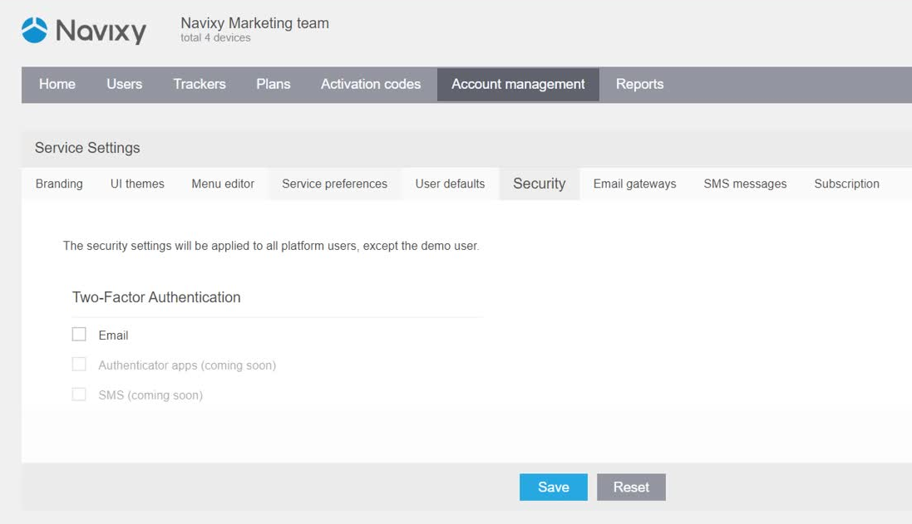
Security
Two-factor authentication (2FA) for admins
Admins can enable 2FA for all user accounts or customize it for specific accounts.
Enabling 2FA for all user accounts
Go to Admin Panel → Account Management → Security.
This applies 2FA to all current and new users, including sub-users and imported accounts. (Note: 2FA does not apply to demo accounts.)
Enabling 2FA for specific user accounts
Use the Admin Panel or Panel API to configure 2FA settings, read/update settings for specific users, or set defaults for new accounts. Learn more in the Developer Hub.
Notes:
I’d like to talk about a feature that significantly enhances the security of your clients’ data on the Navixy platform – Two-Factor Authentication, or 2FA.
As a reseller or integrator, securing both your account and your clients' is critical, and 2FA offers an effective, simple solution.
Strengthening security with 2FA
In today's world, passwords alone aren’t enough. 2FA adds an extra layer of protection by requiring a second verification step, such as a code from an SMS or an app. Even if someone gains access to a password, 2FA ensures they won’t get into the account.
This reduces the risk of unauthorized access and strengthens overall platform security.
Flexibility for different security needs
Navixy allows you to enable 2FA for all users or specific accounts, giving you the flexibility to meet your clients’ individual security needs – especially those with stricter policies, like government or finance clients.
You can customize 2FA for different users, ensuring it matches each client's security expectations.
Easy setup for administrators
Enabling 2FA is simple. In the Admin Panel, go to ‘Account Management’ → ‘Security’ to apply 2FA across all users, including sub-users and new accounts, with just a few clicks.
Advanced configuration via API
For more granular control, Navixy offers API integration to configure 2FA settings for specific users or set defaults for new accounts. You can find more details in the Developer Hub for advanced configuration needs.
Conclusion
2FA not only enhances security but also helps you meet your clients' security requirements easily. As a reseller or integrator, it’s a simple way to provide added protection and build trust with your clients.

